Slide 1
Costa Rica Caribbean Side
by Jesse Braswell

Slide 2
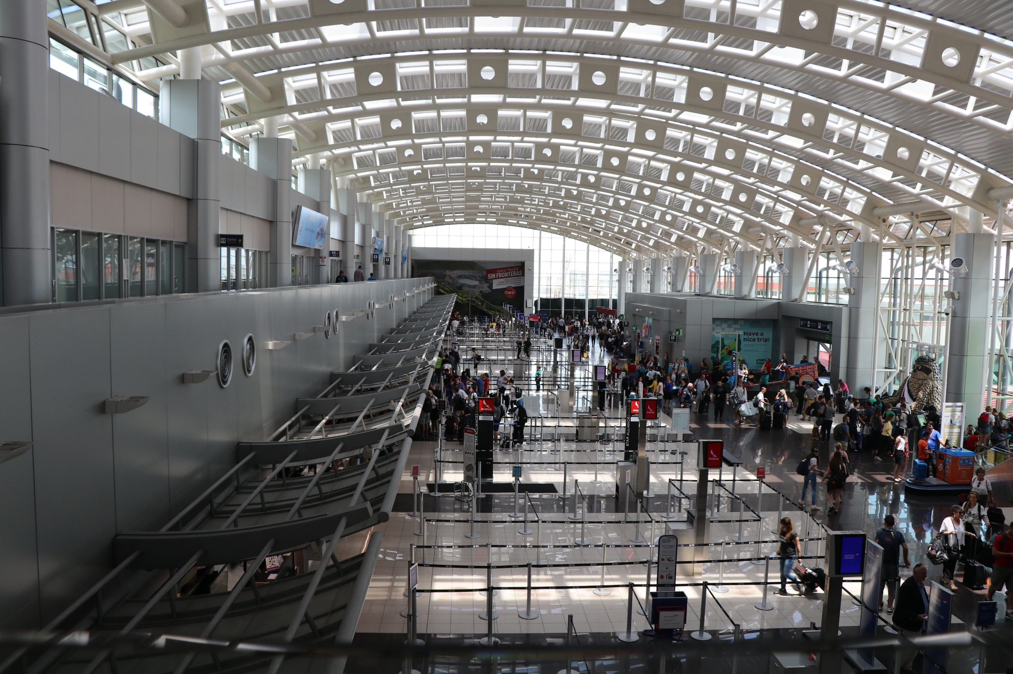
San Jose International airport.

Slide 3
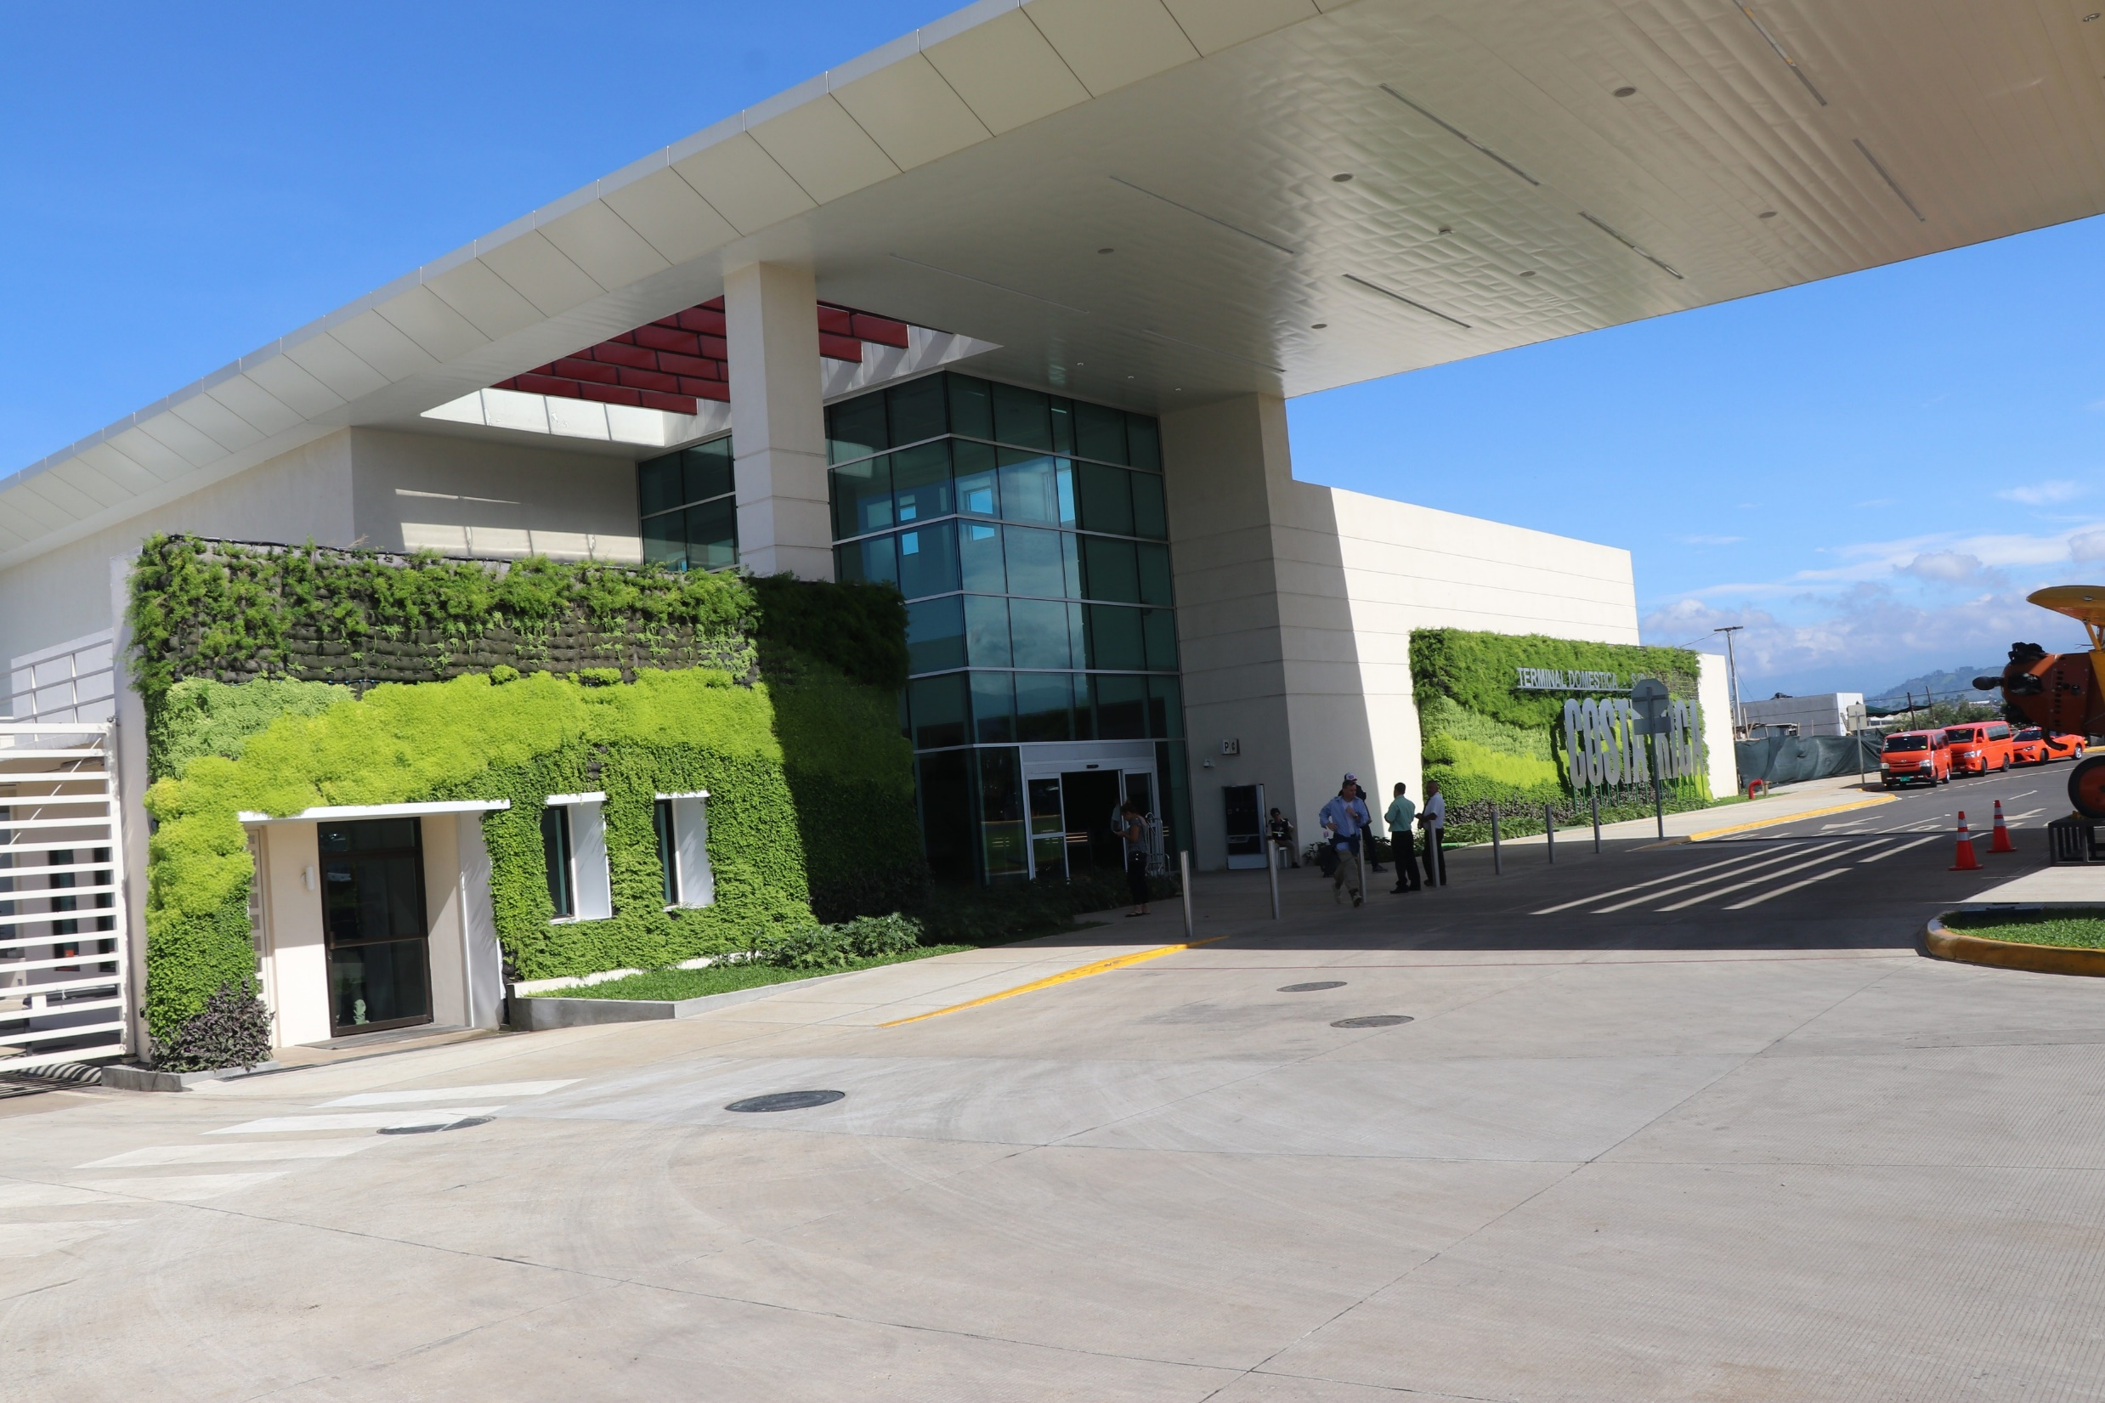
San Jose Domestic airport terminal.

Slide 4
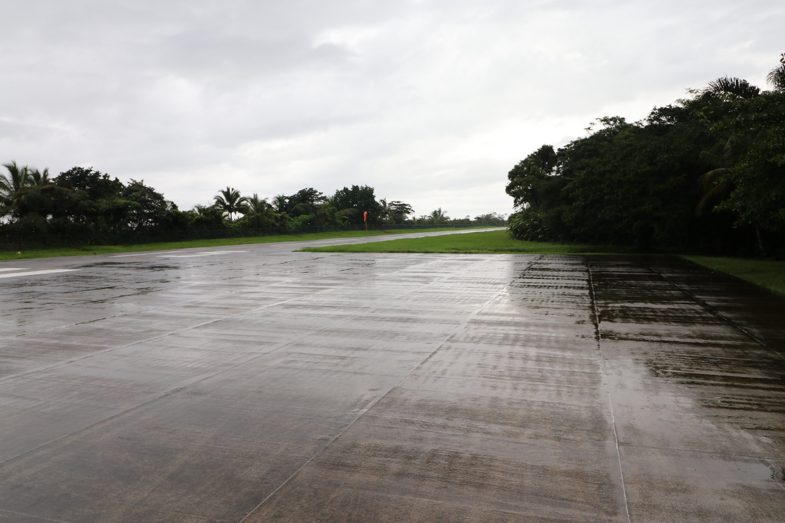
Airfield next to the beach a stop we made right before landing in Limon. I believe this is Tortuguero which is famous for Turtles.

Slide 5
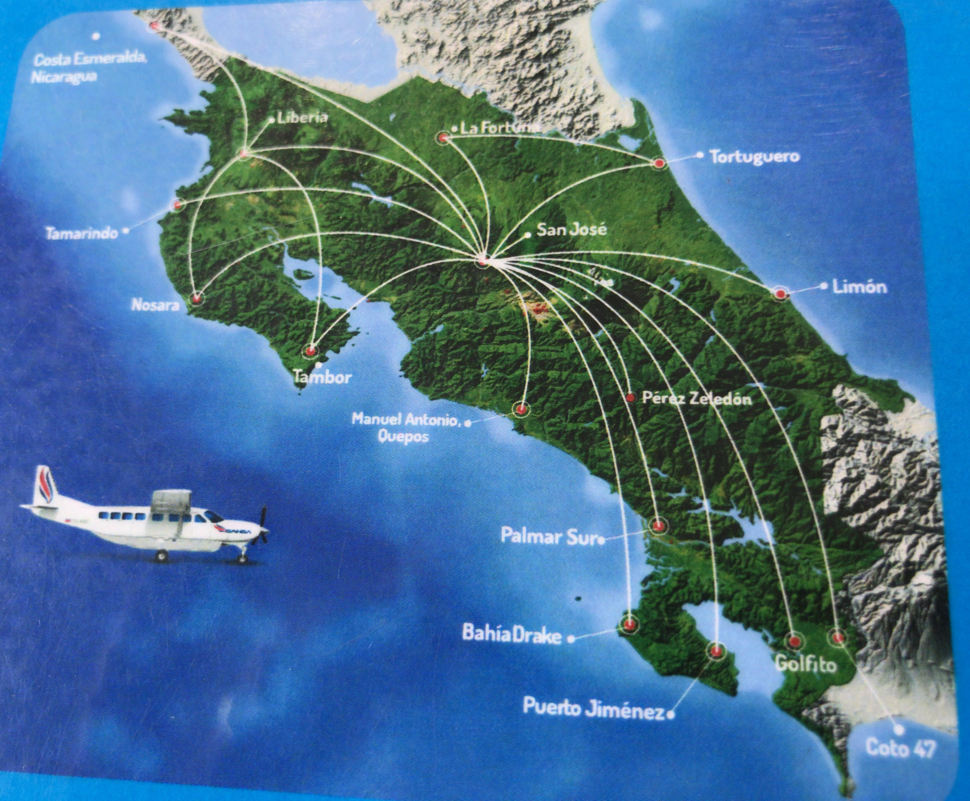
Yes, the second arrow down is where I will be living.

Slide 6
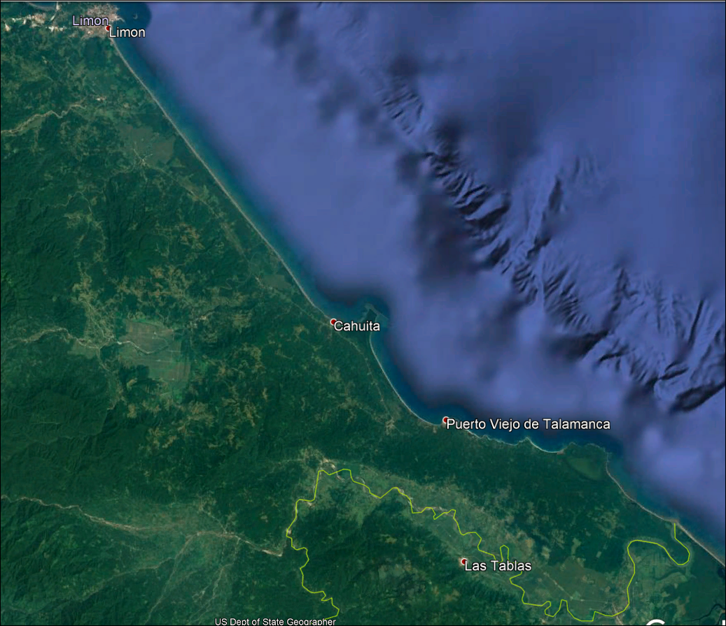
Just south of Cocles is the Panama border.
I will be living in a community called Cocles.

Slide 7
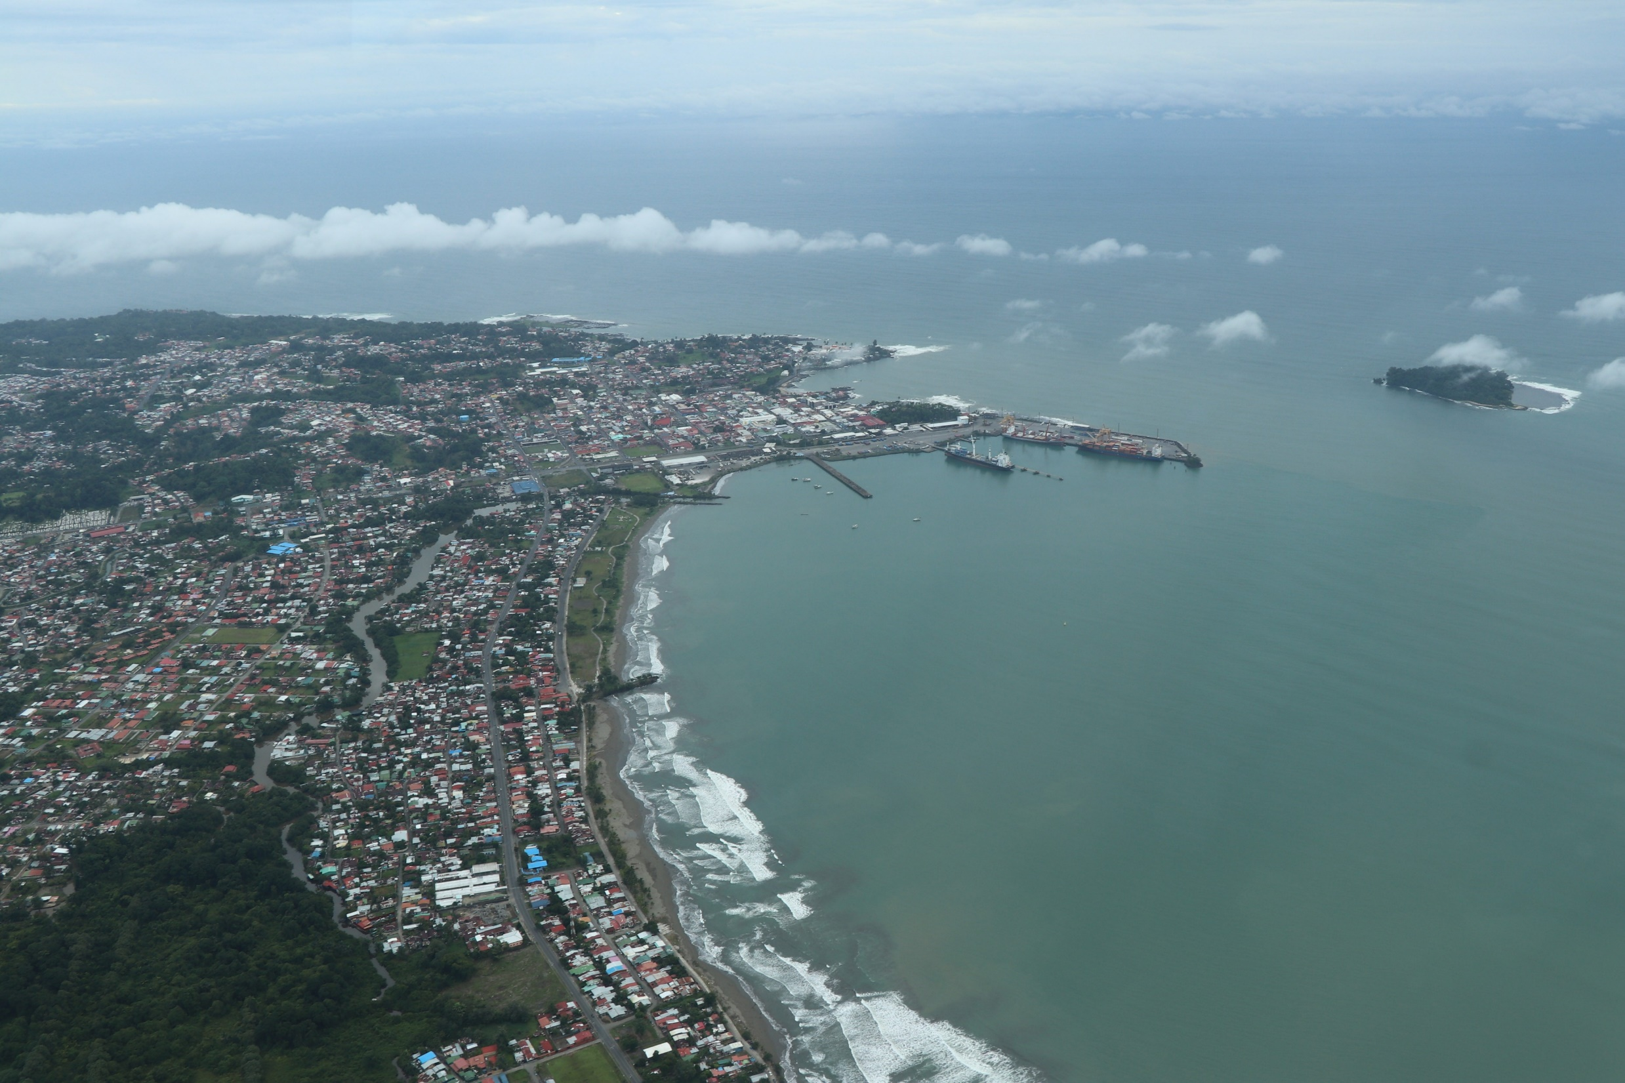
This is an over head shot of Limon. Population is about 60 thousand.

Slide 8
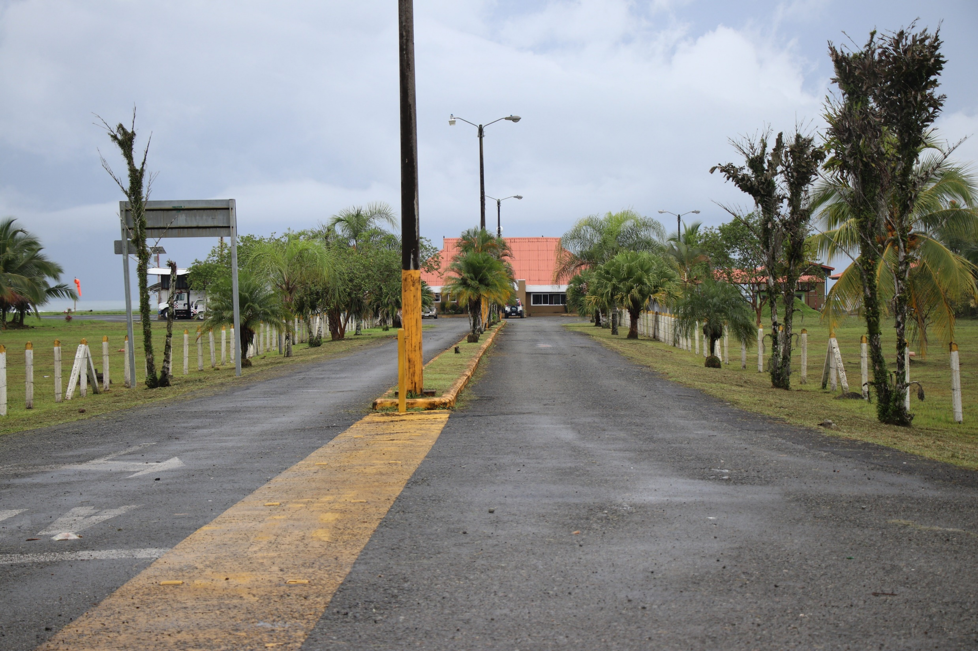
Limon International airport.

Slide 9
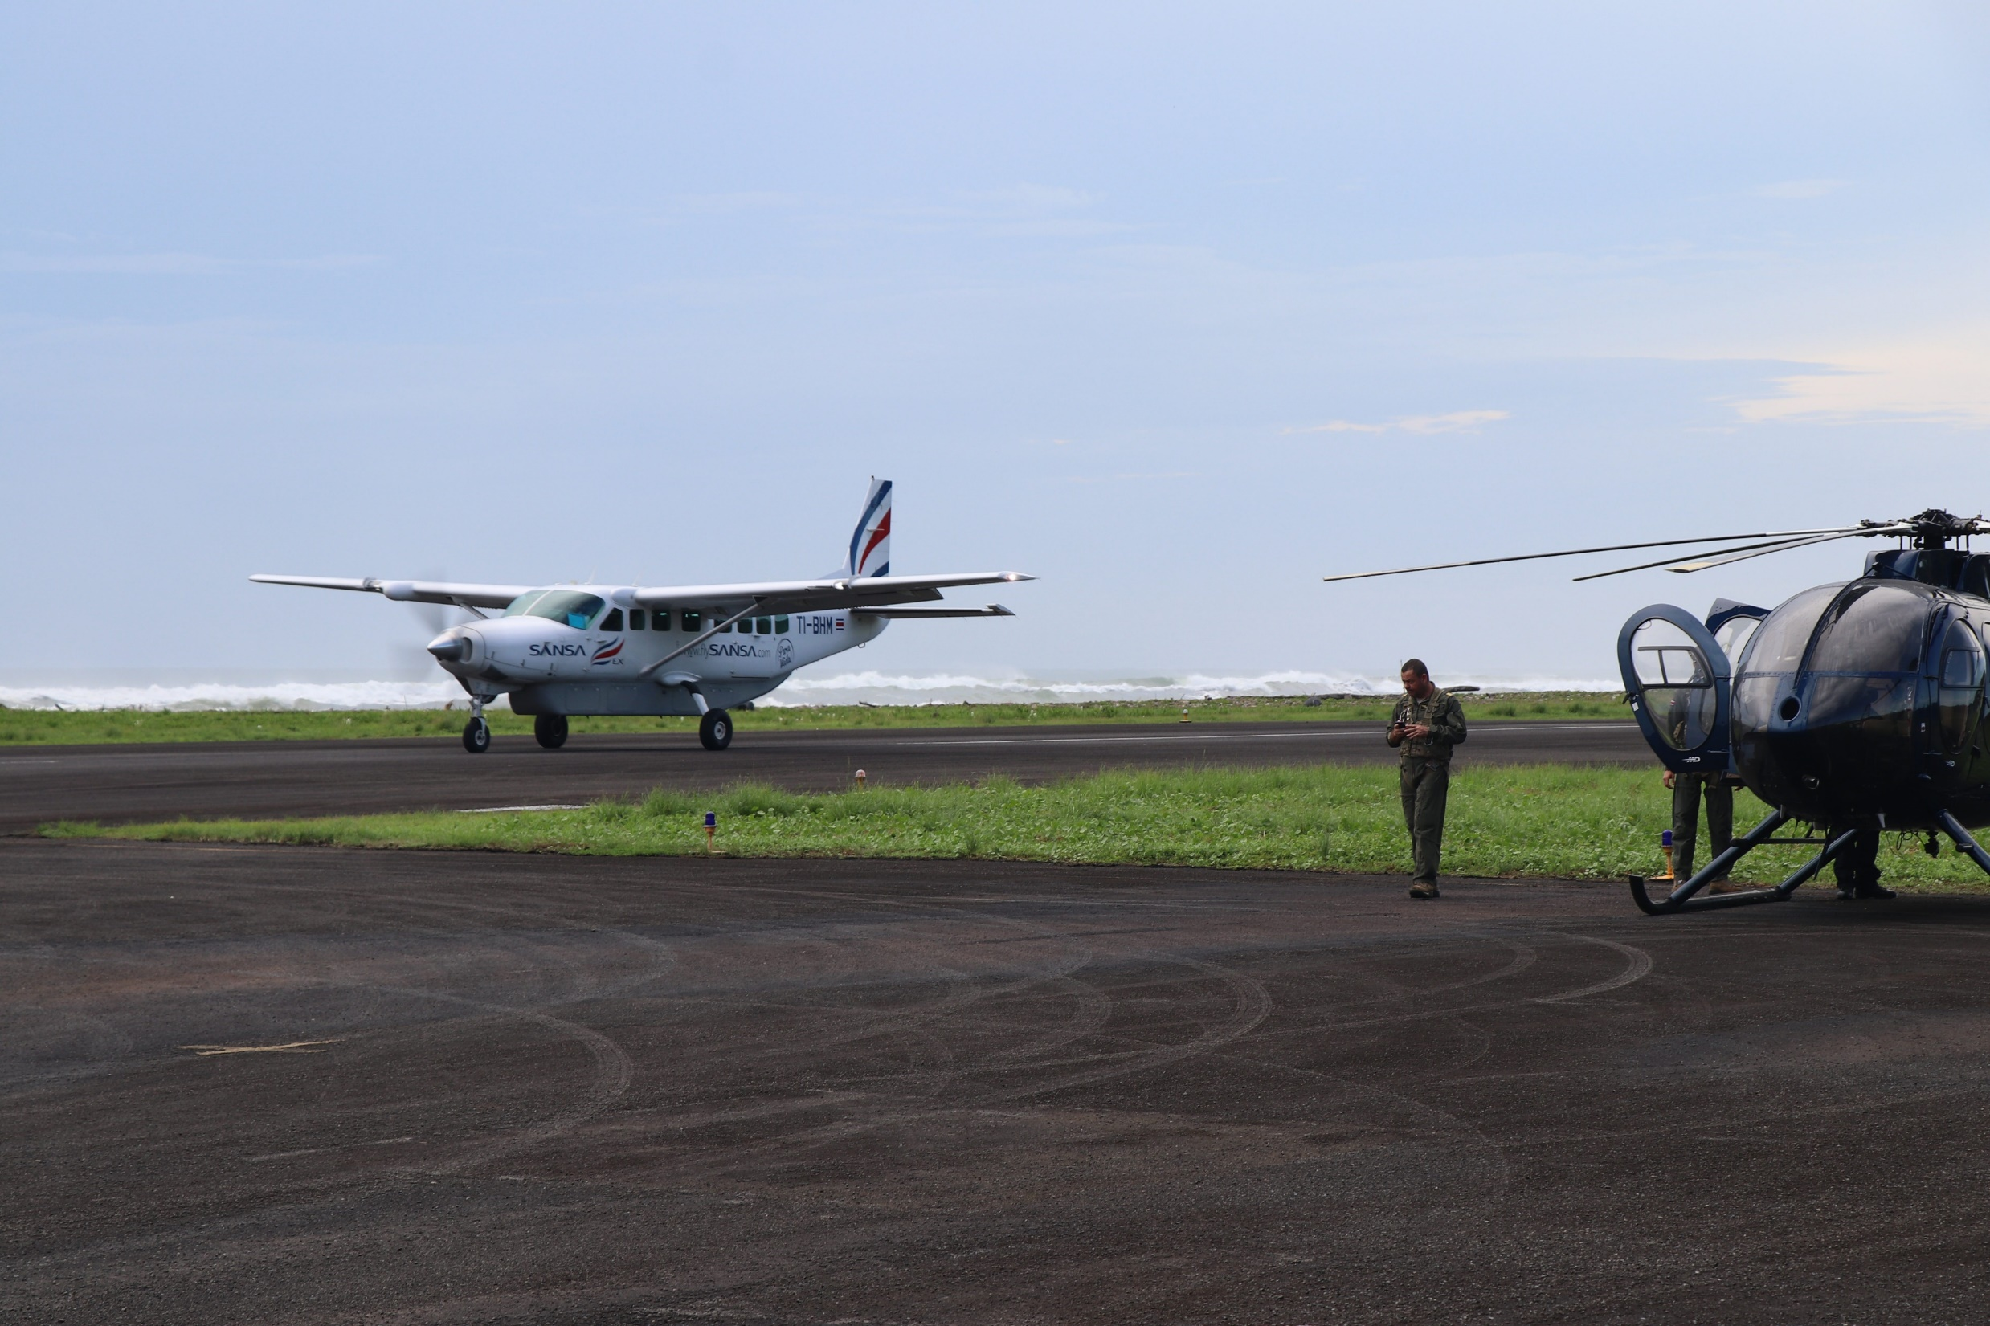
Limon International airport is right on the beach.

Slide 10
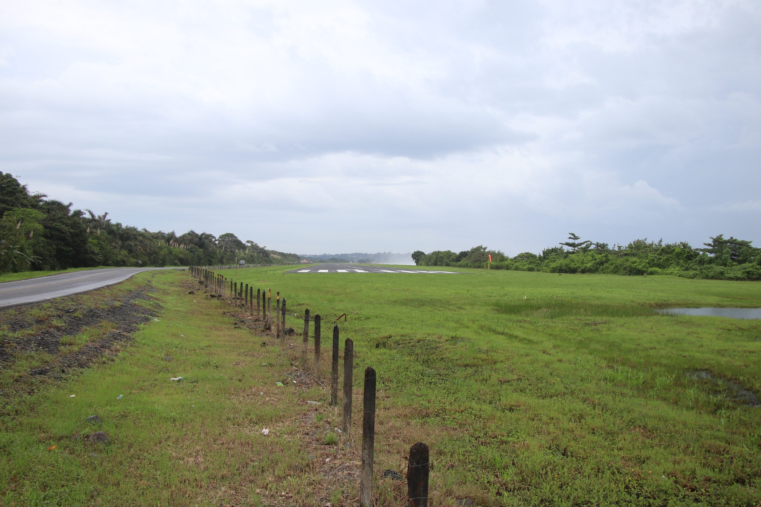
Limon International airport south end of runway.

Slide 11
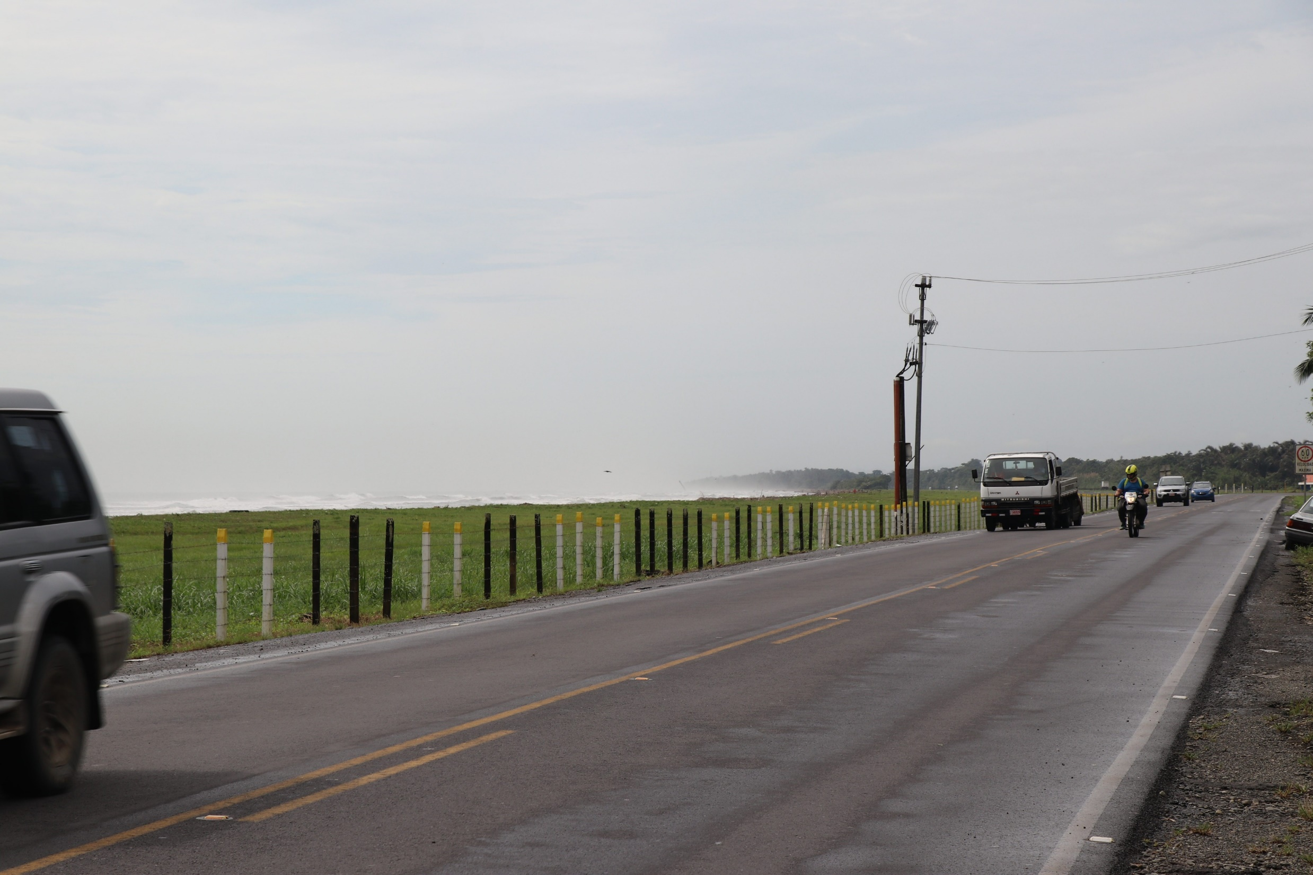
Main highway going south from Limon airport.

Slide 12
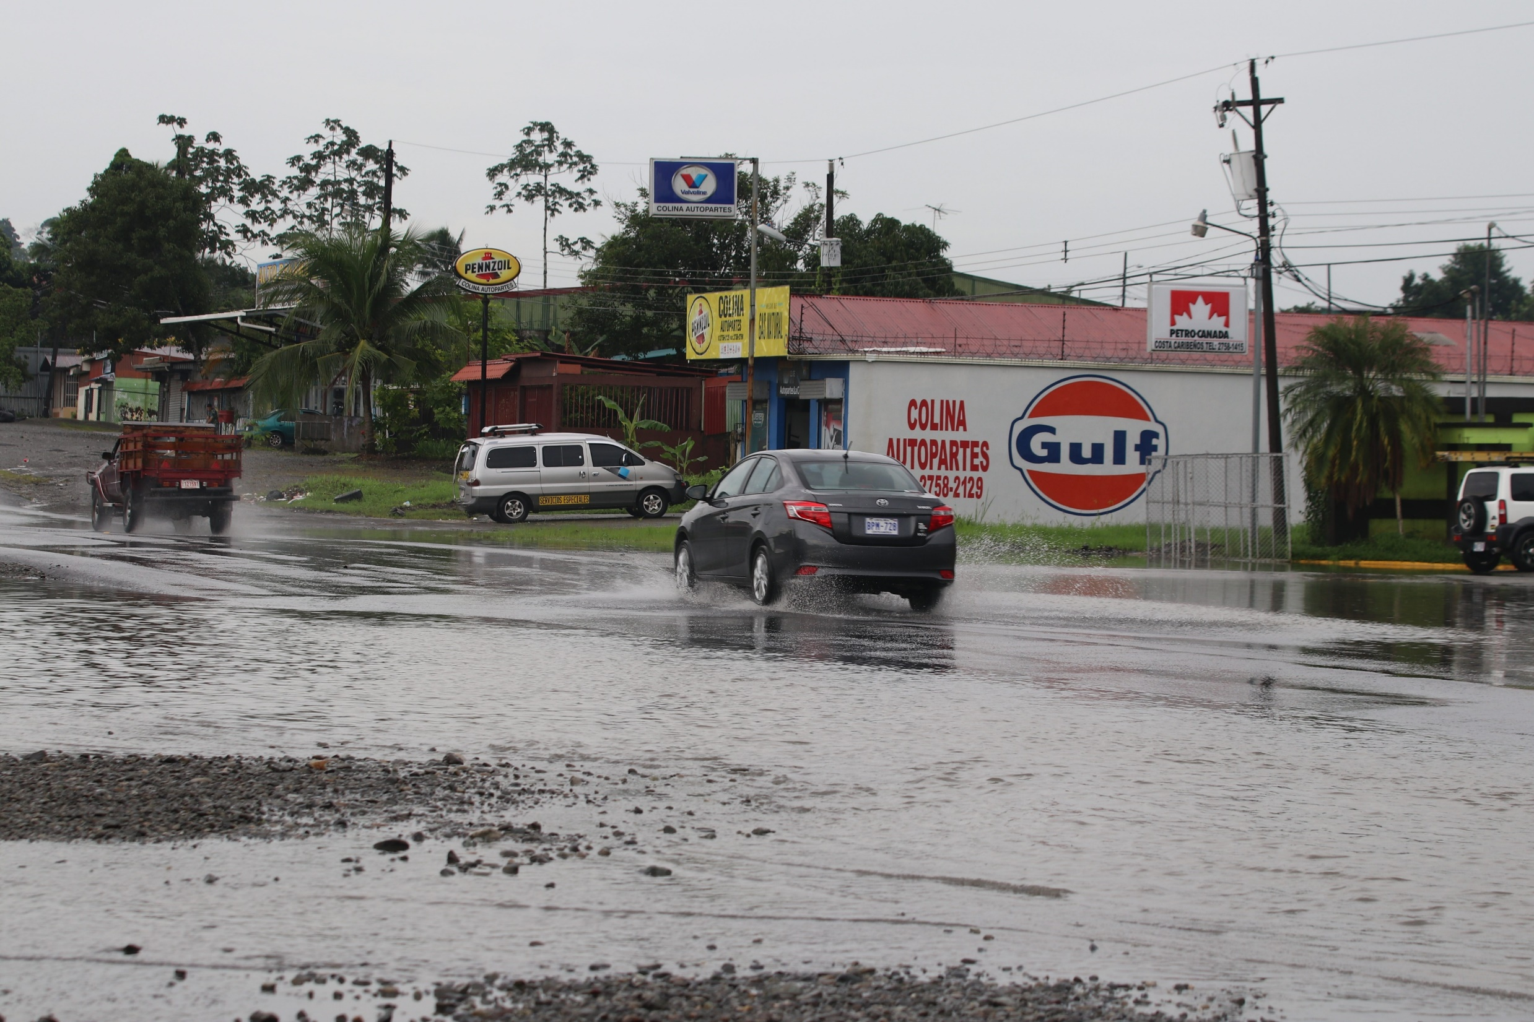
Last time I was there it was the rainy season.

Slide 13
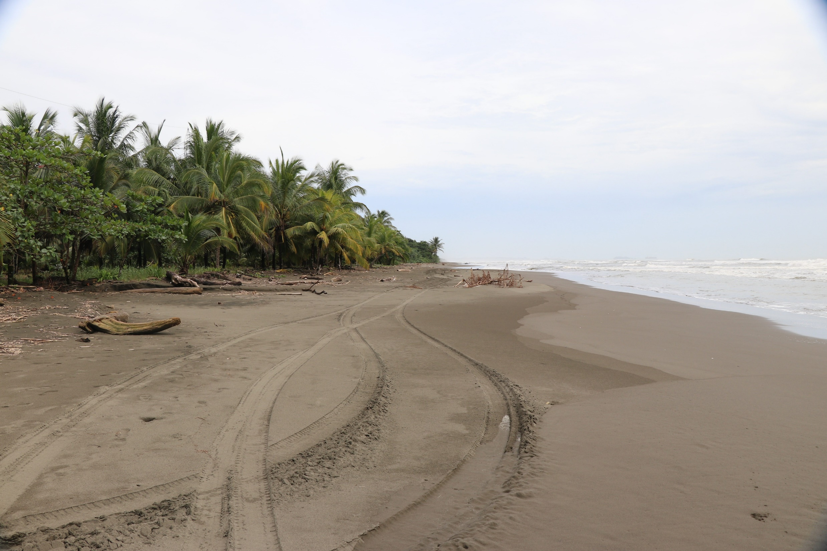
Yes, anyone can drive right on the beach if you like.

Slide 14
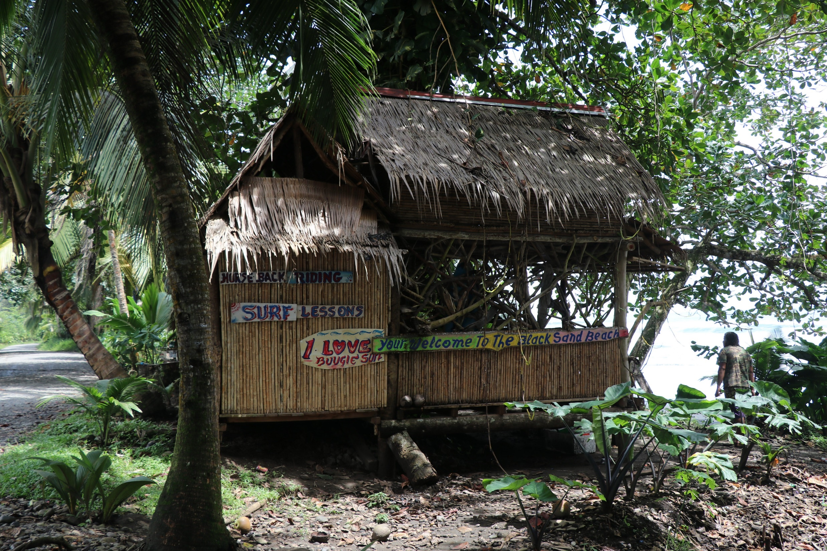
Want to learn how to surf?

Slide 15
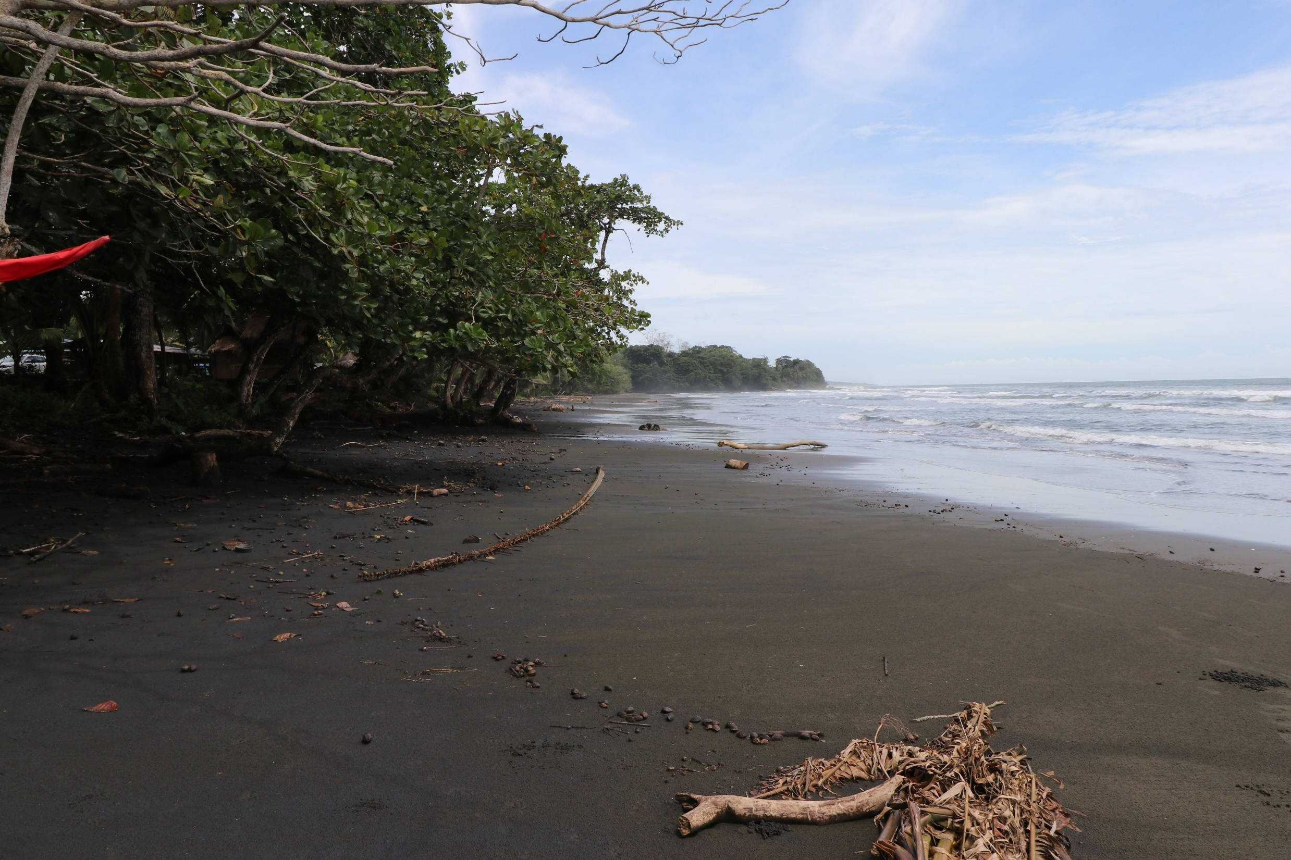
Yes some of the beaches have black sand.

Slide 16
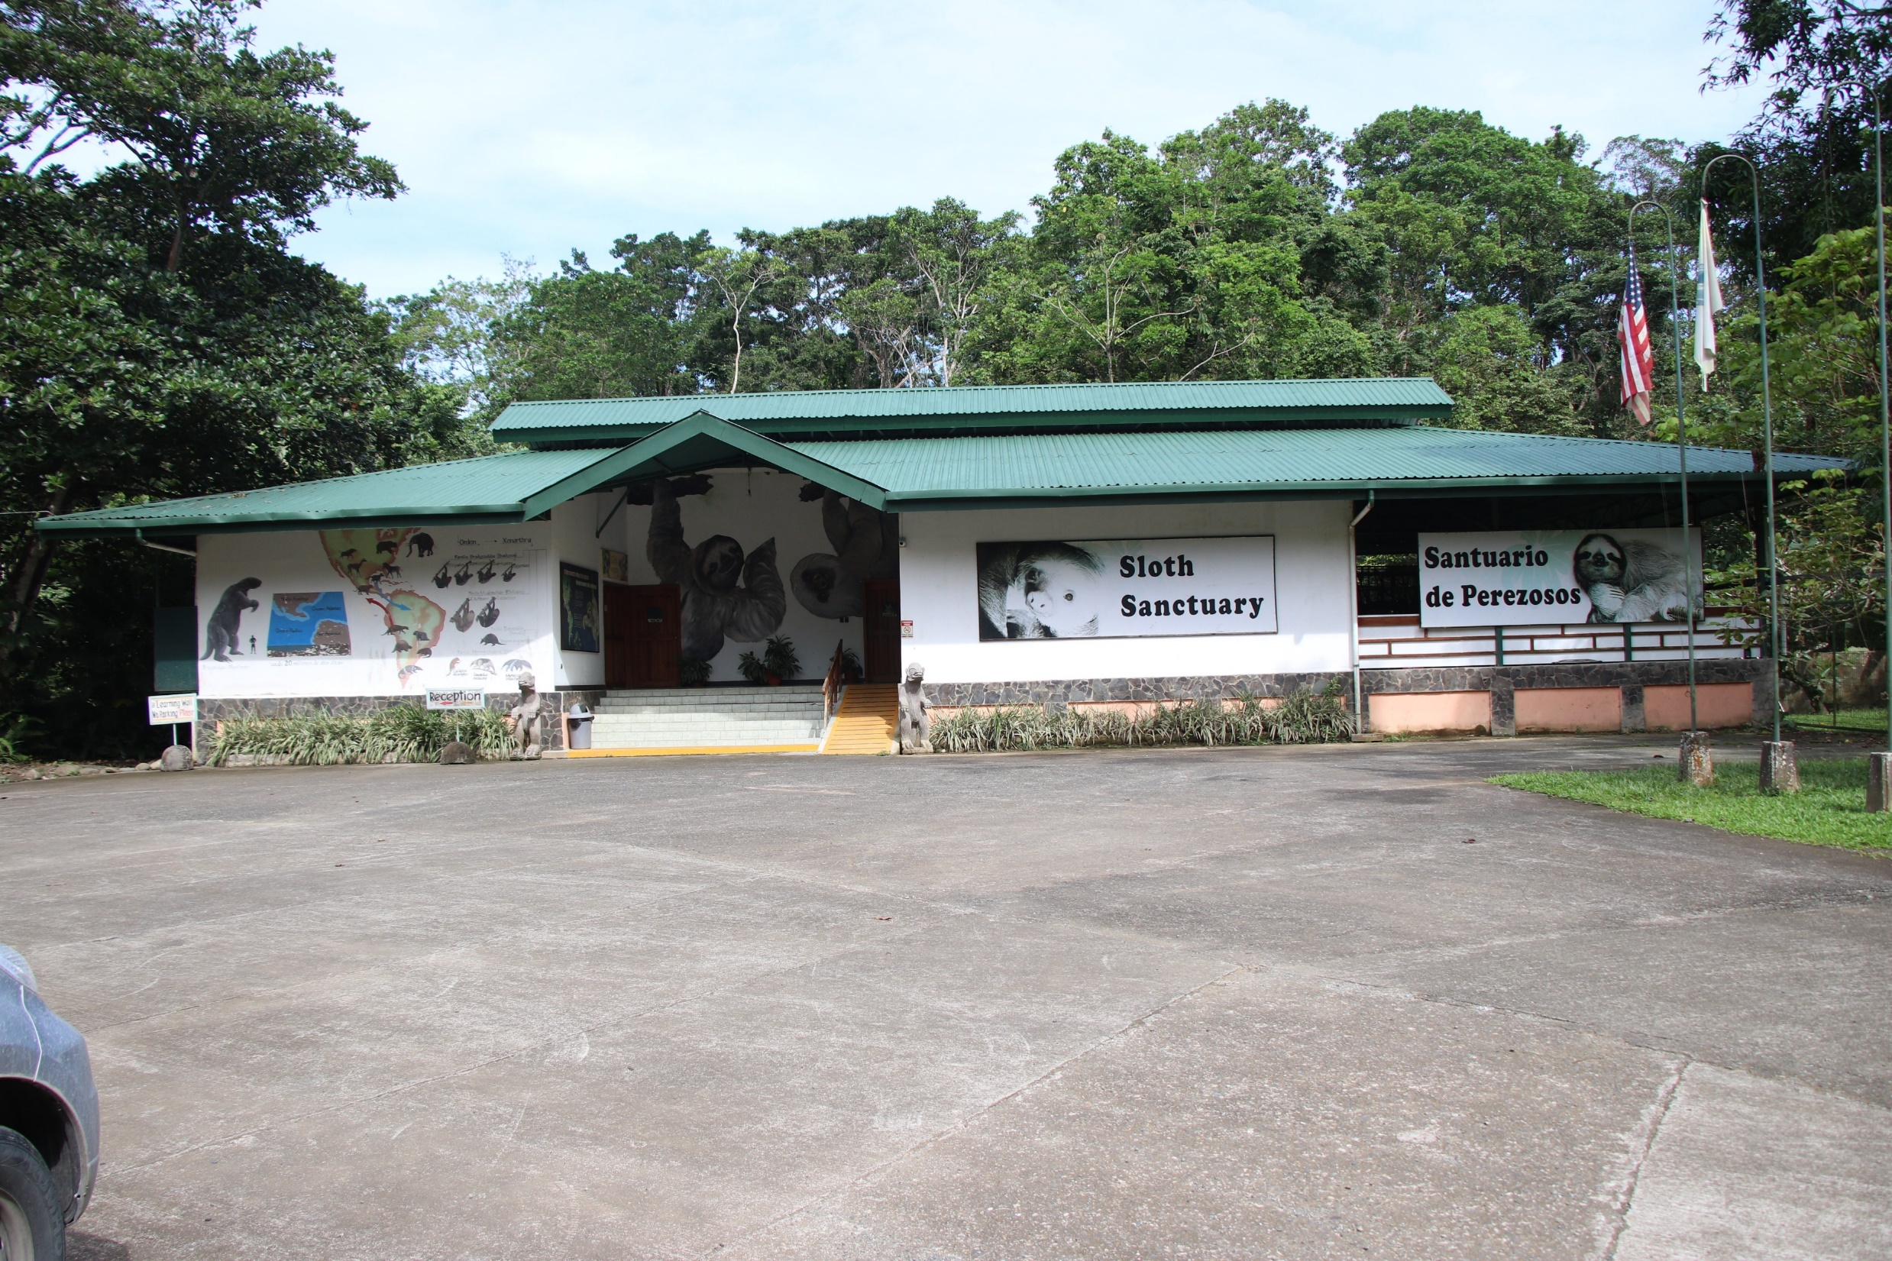
The picture says it all.

Slide 17
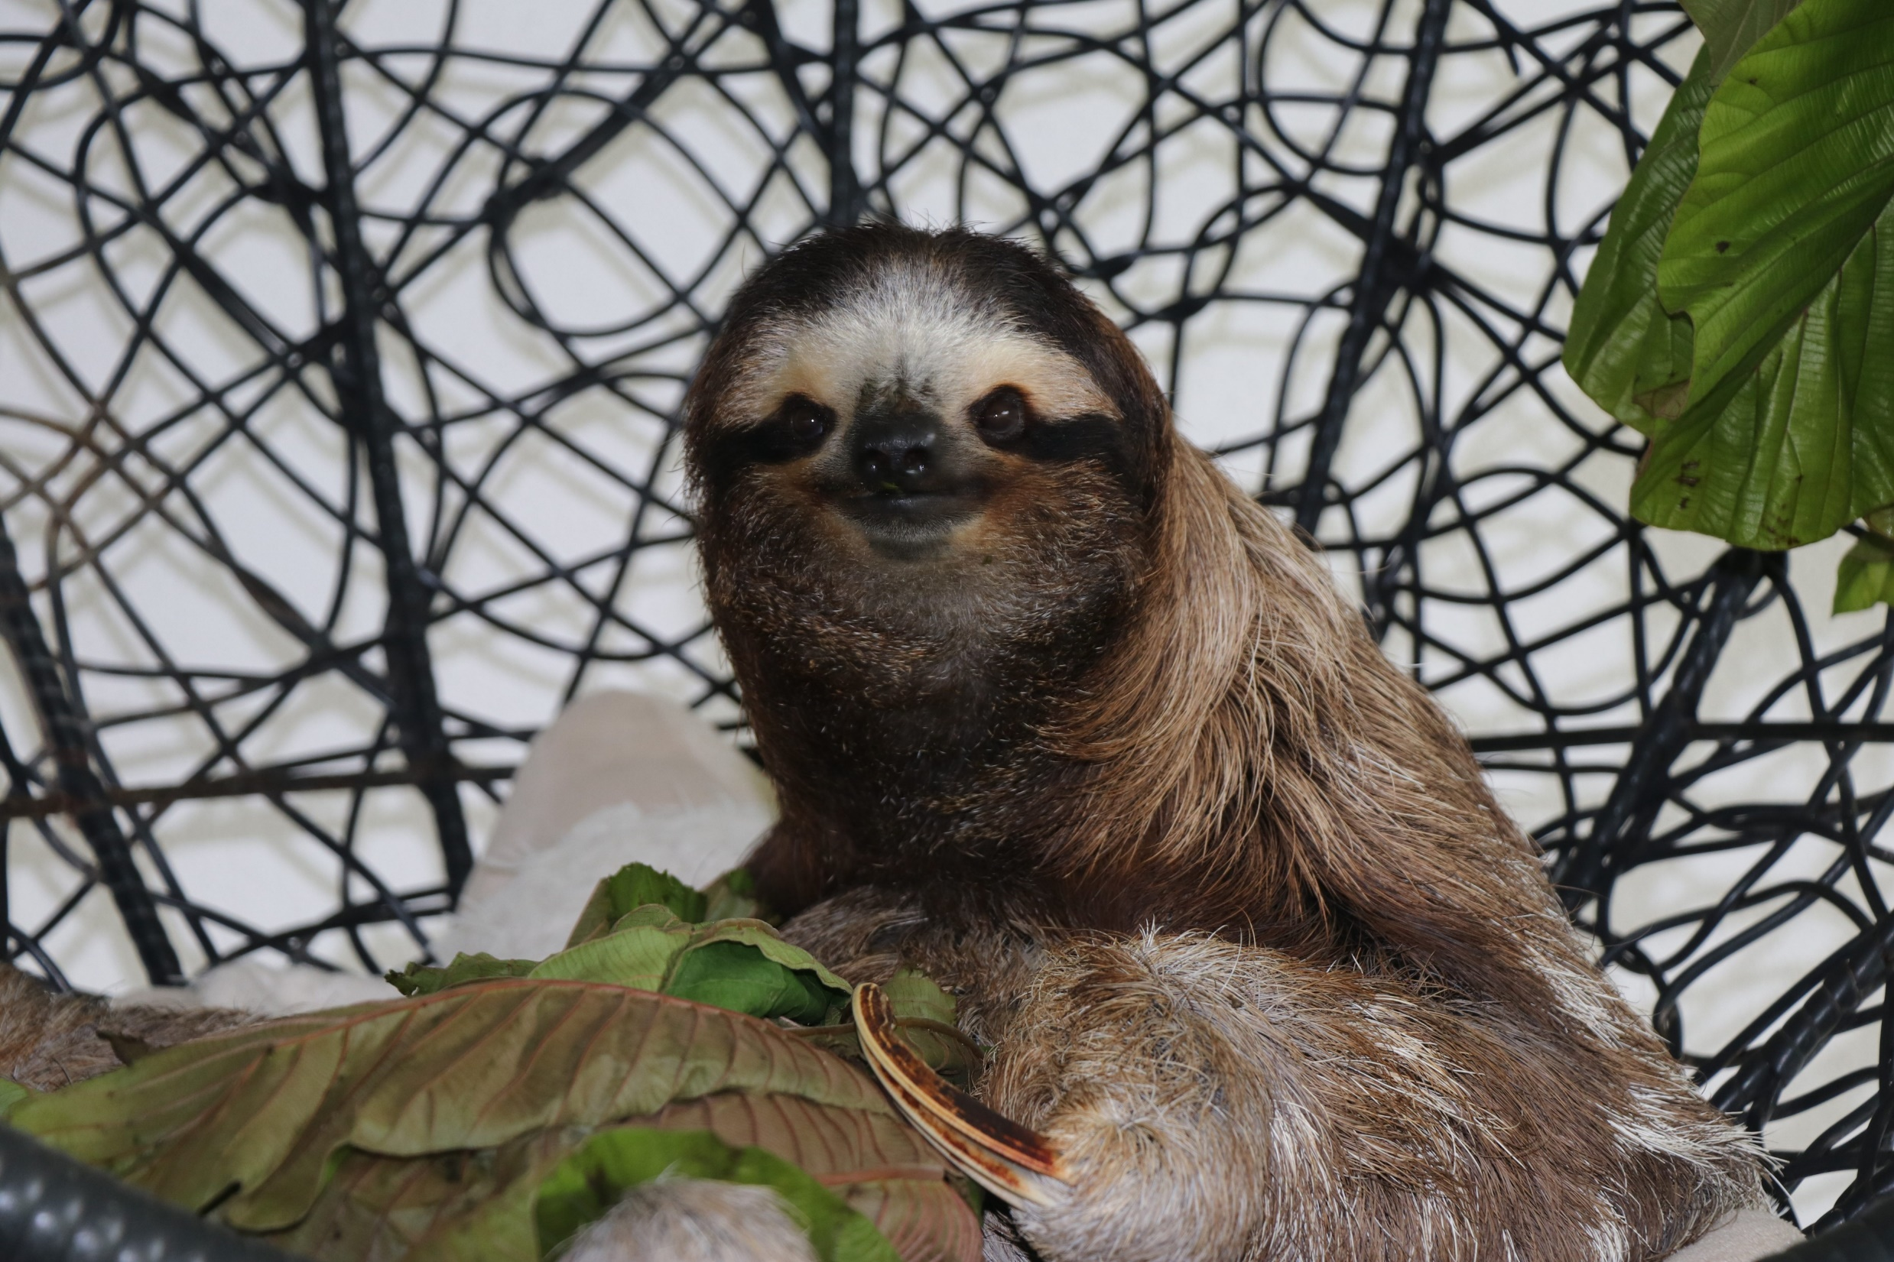
This is Buttercup, she will greet you when you visit.

Slide 18
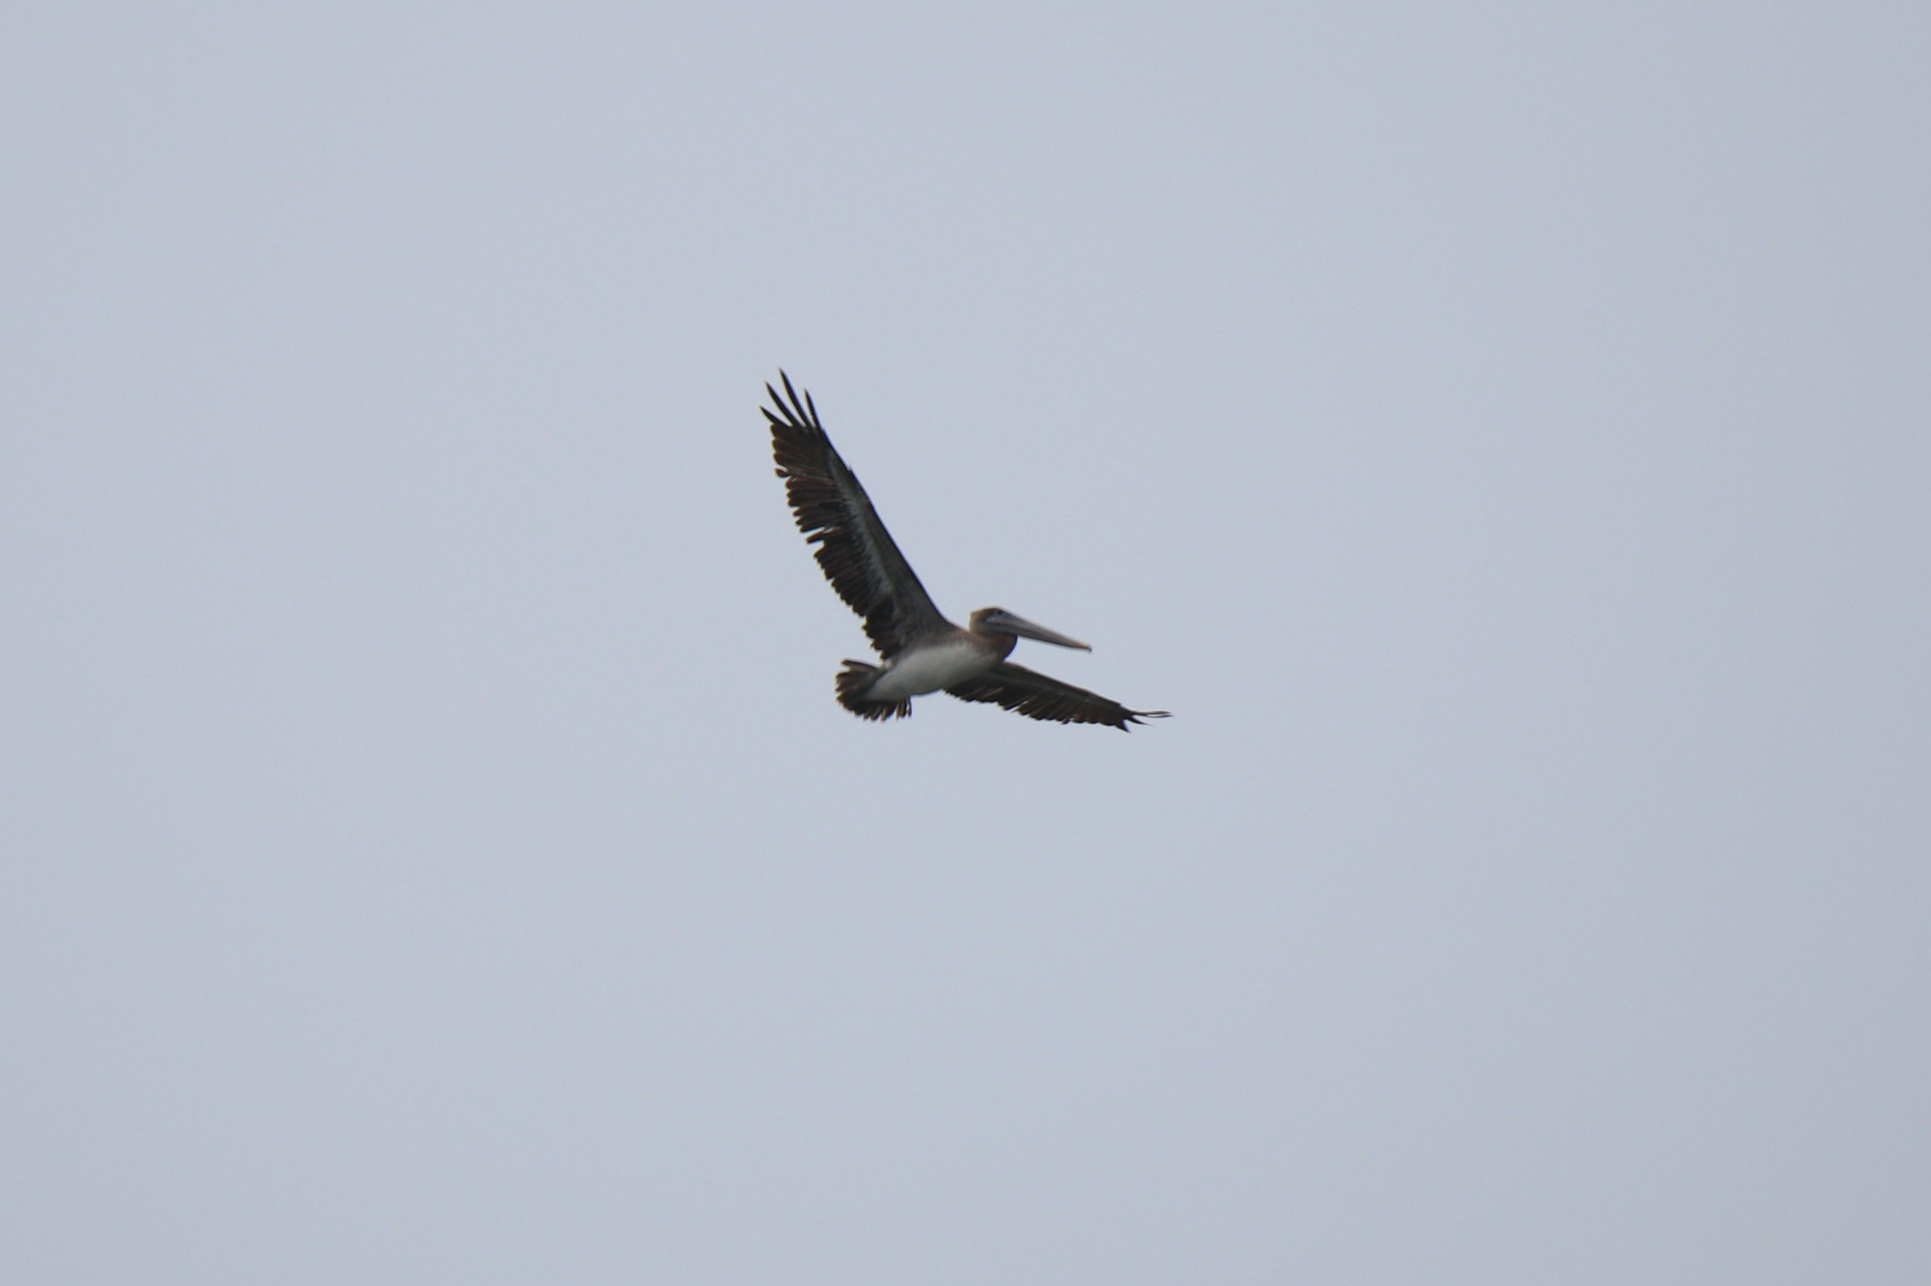
There are quite a few pelicans in Costa Rica.

Slide 19
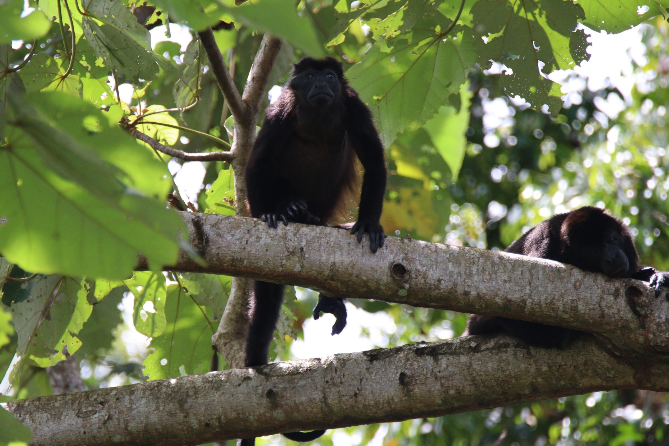
Also howler monkeys can be heard if not seen in Costa Rica.

Slide 20
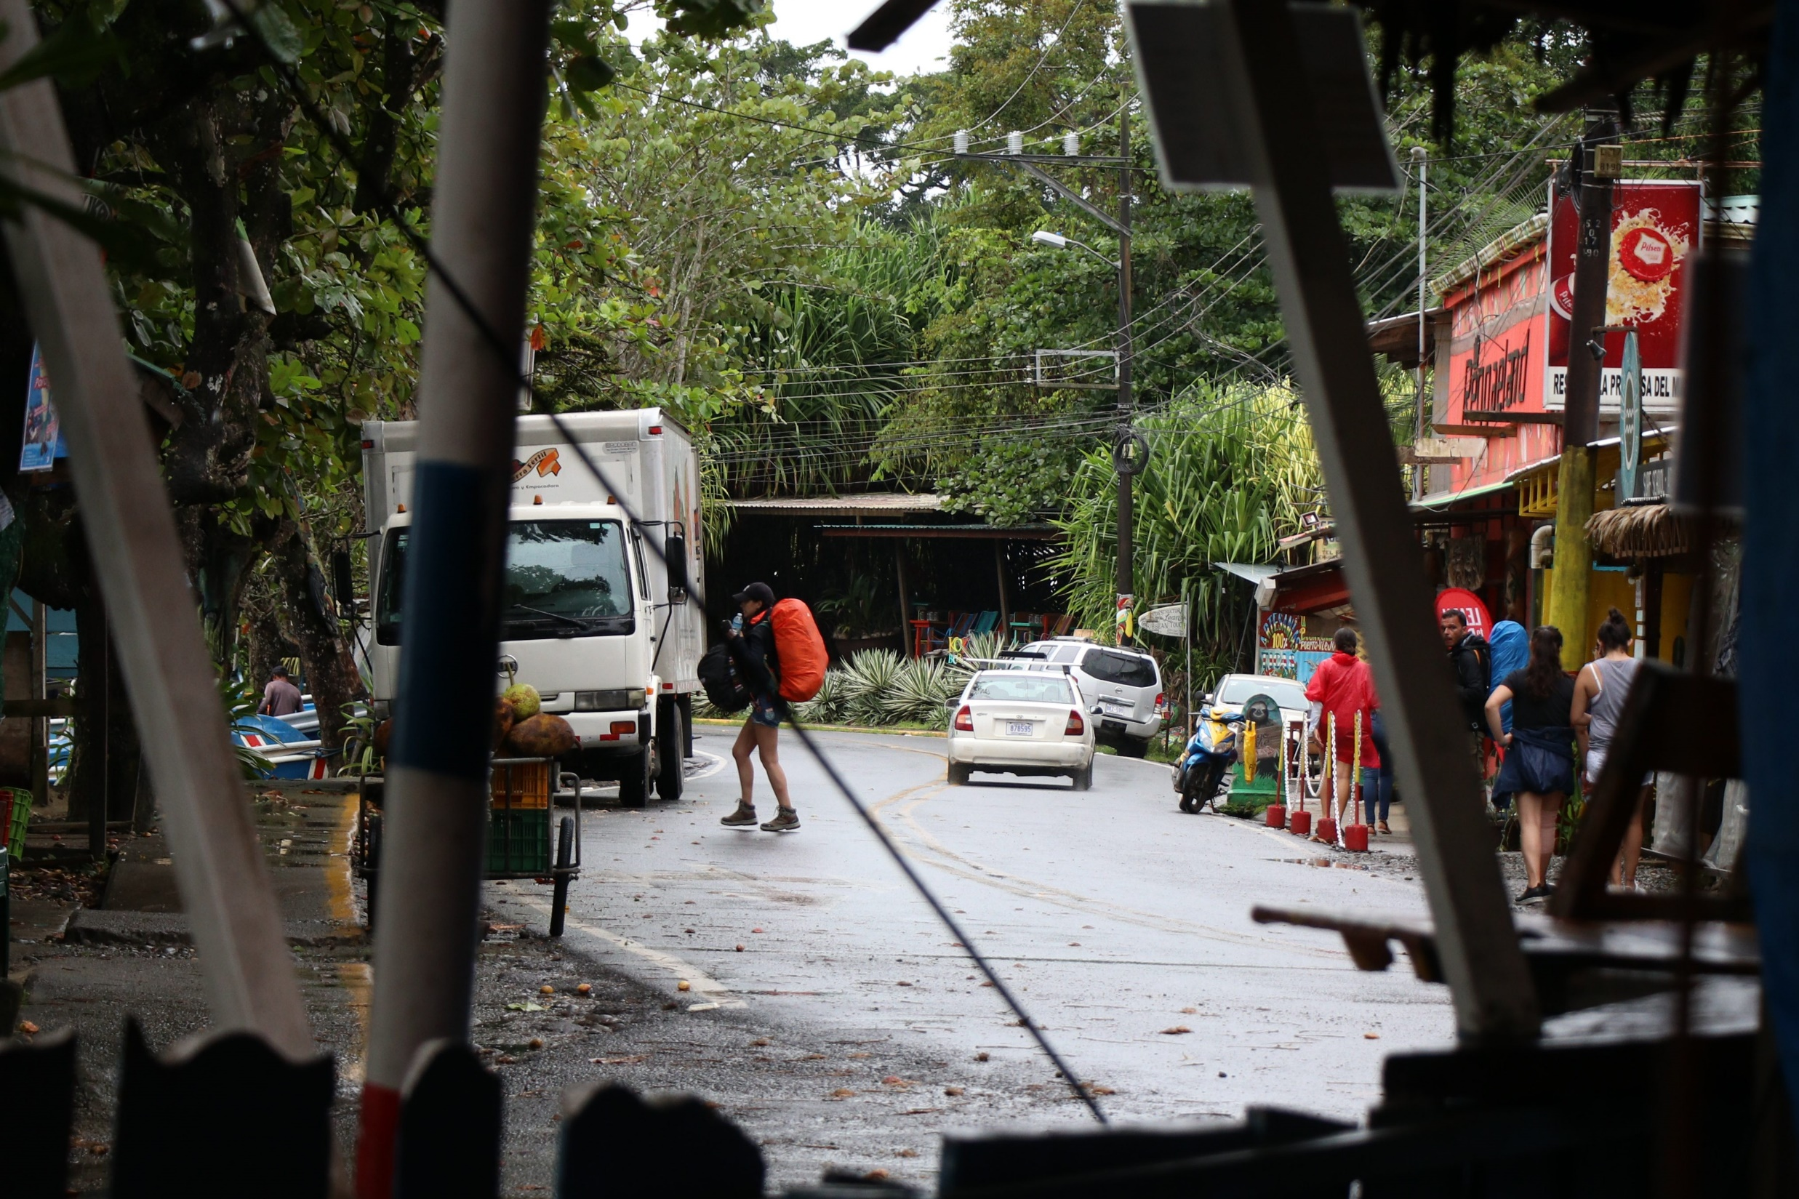
Busy downtown Puerto Viejo in the middle of winter.

Slide 21
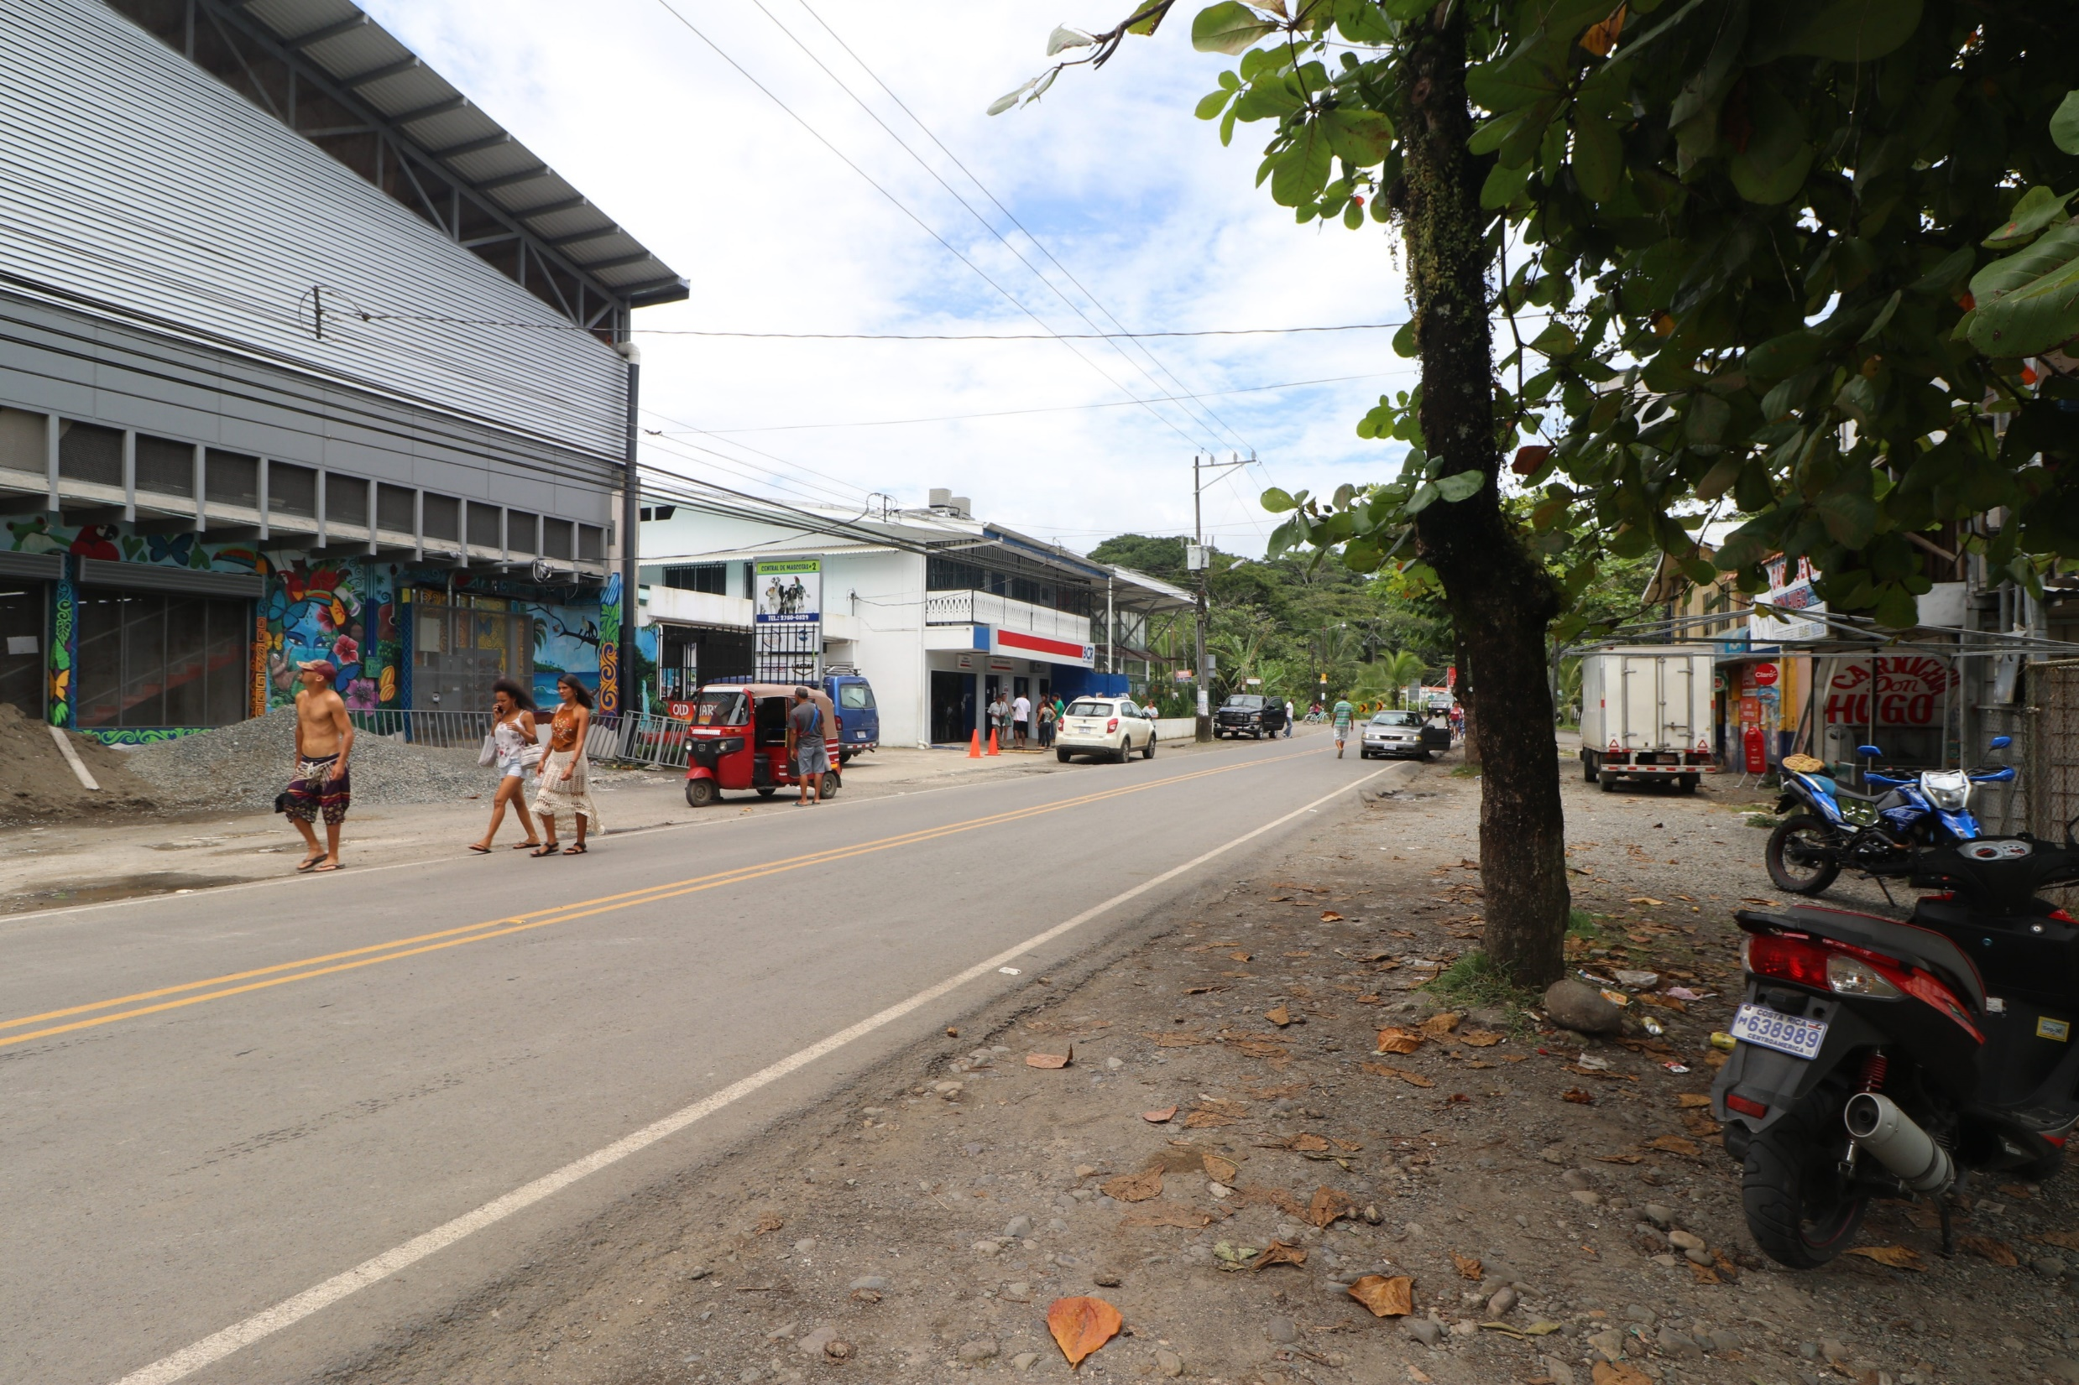

Slide 22
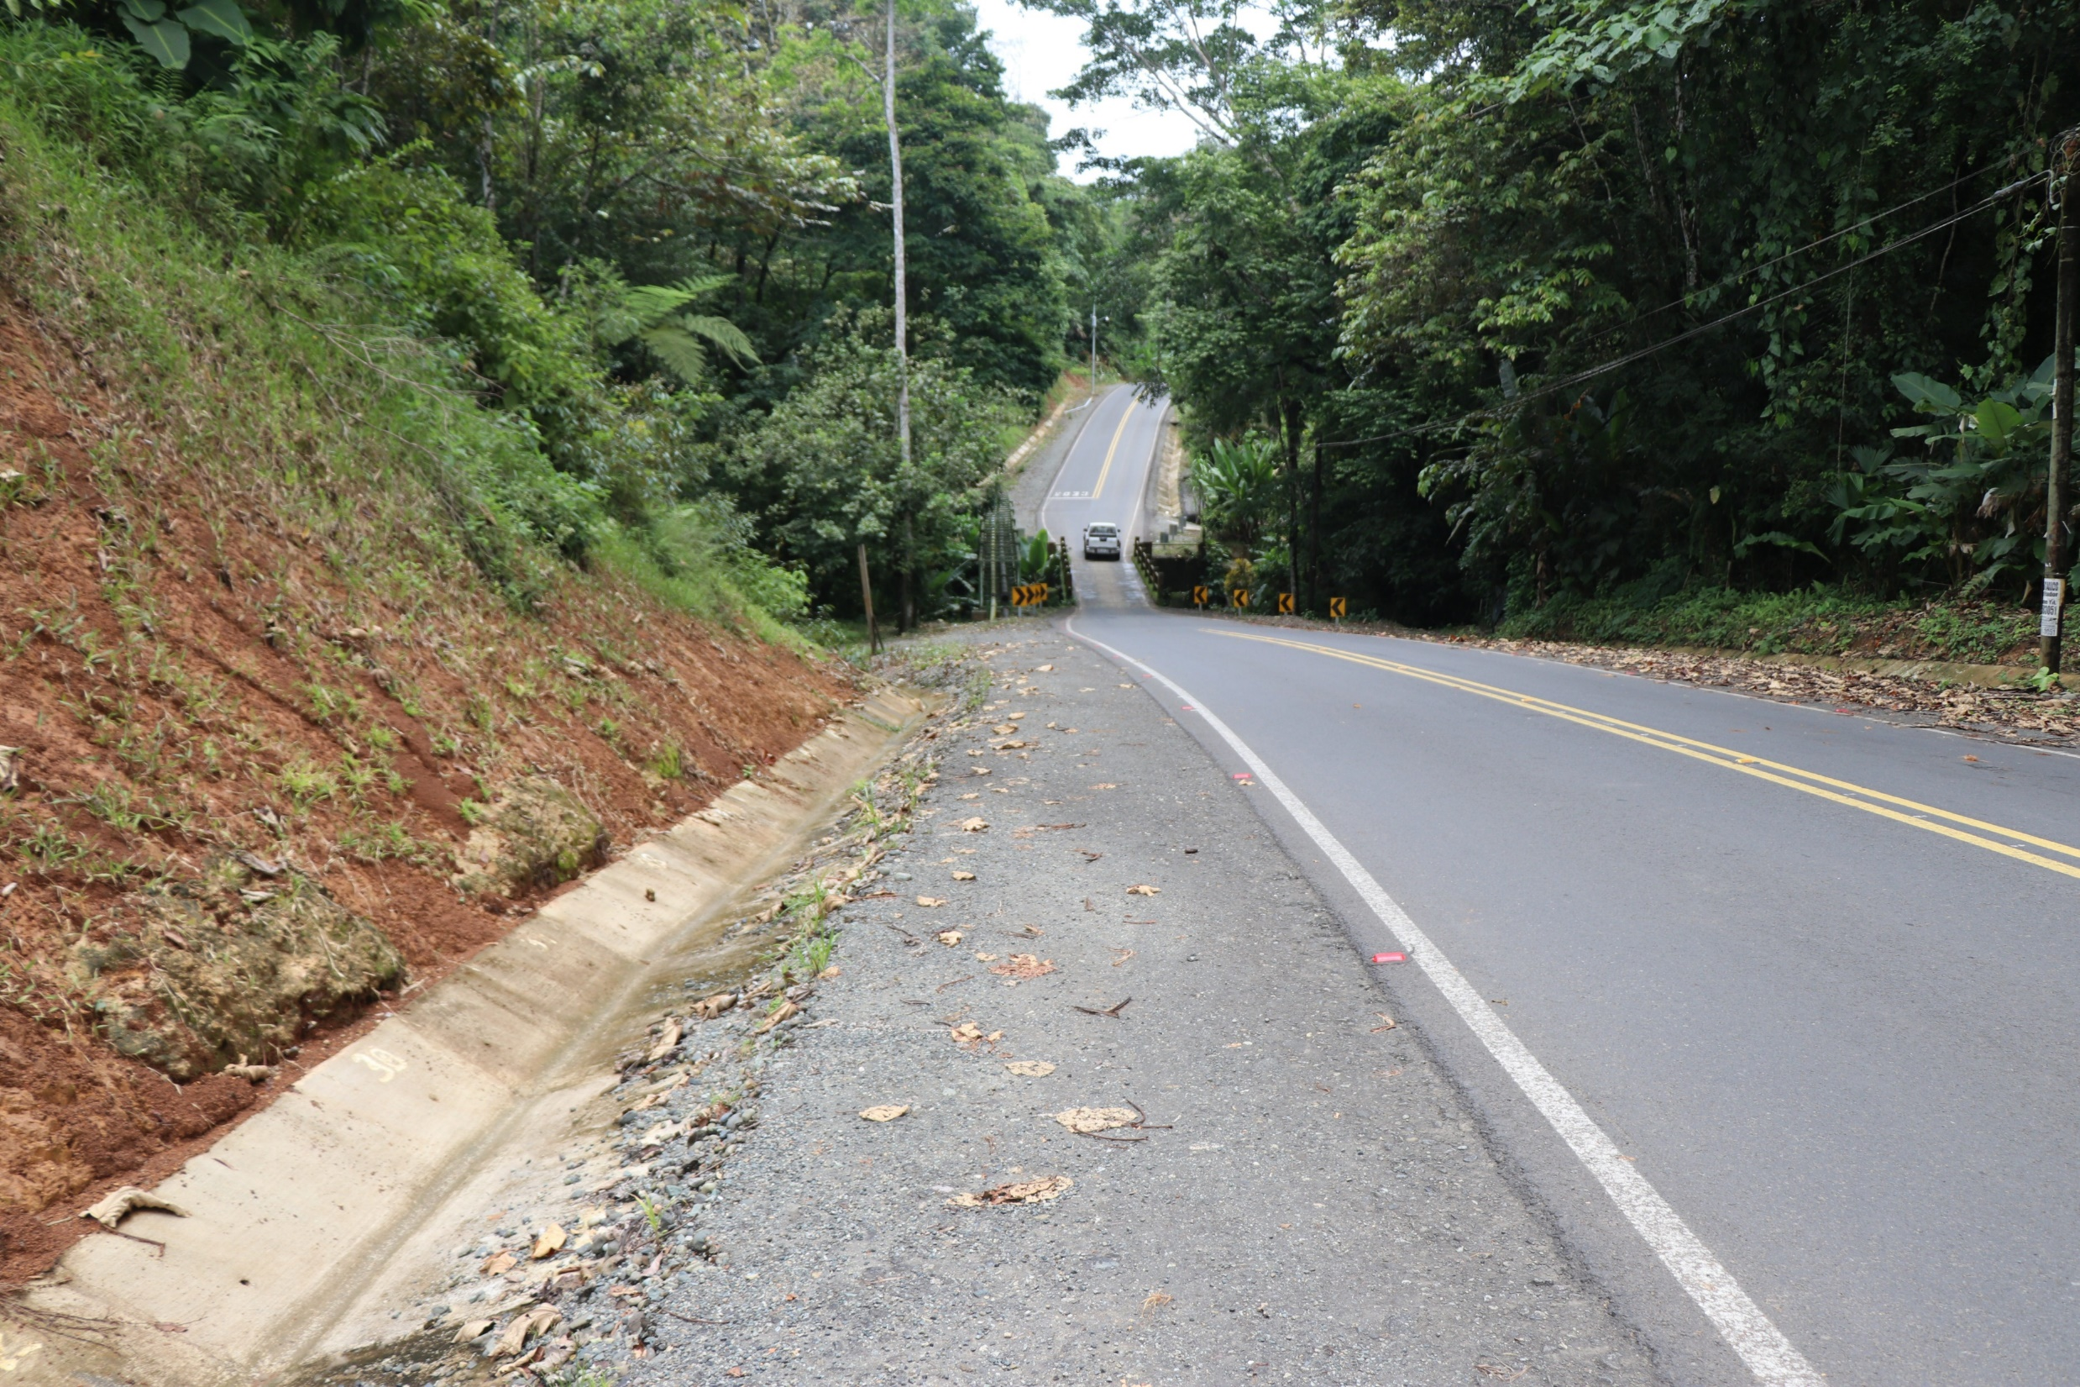
Who said roads are bad in Costa Rica?

Slide 23
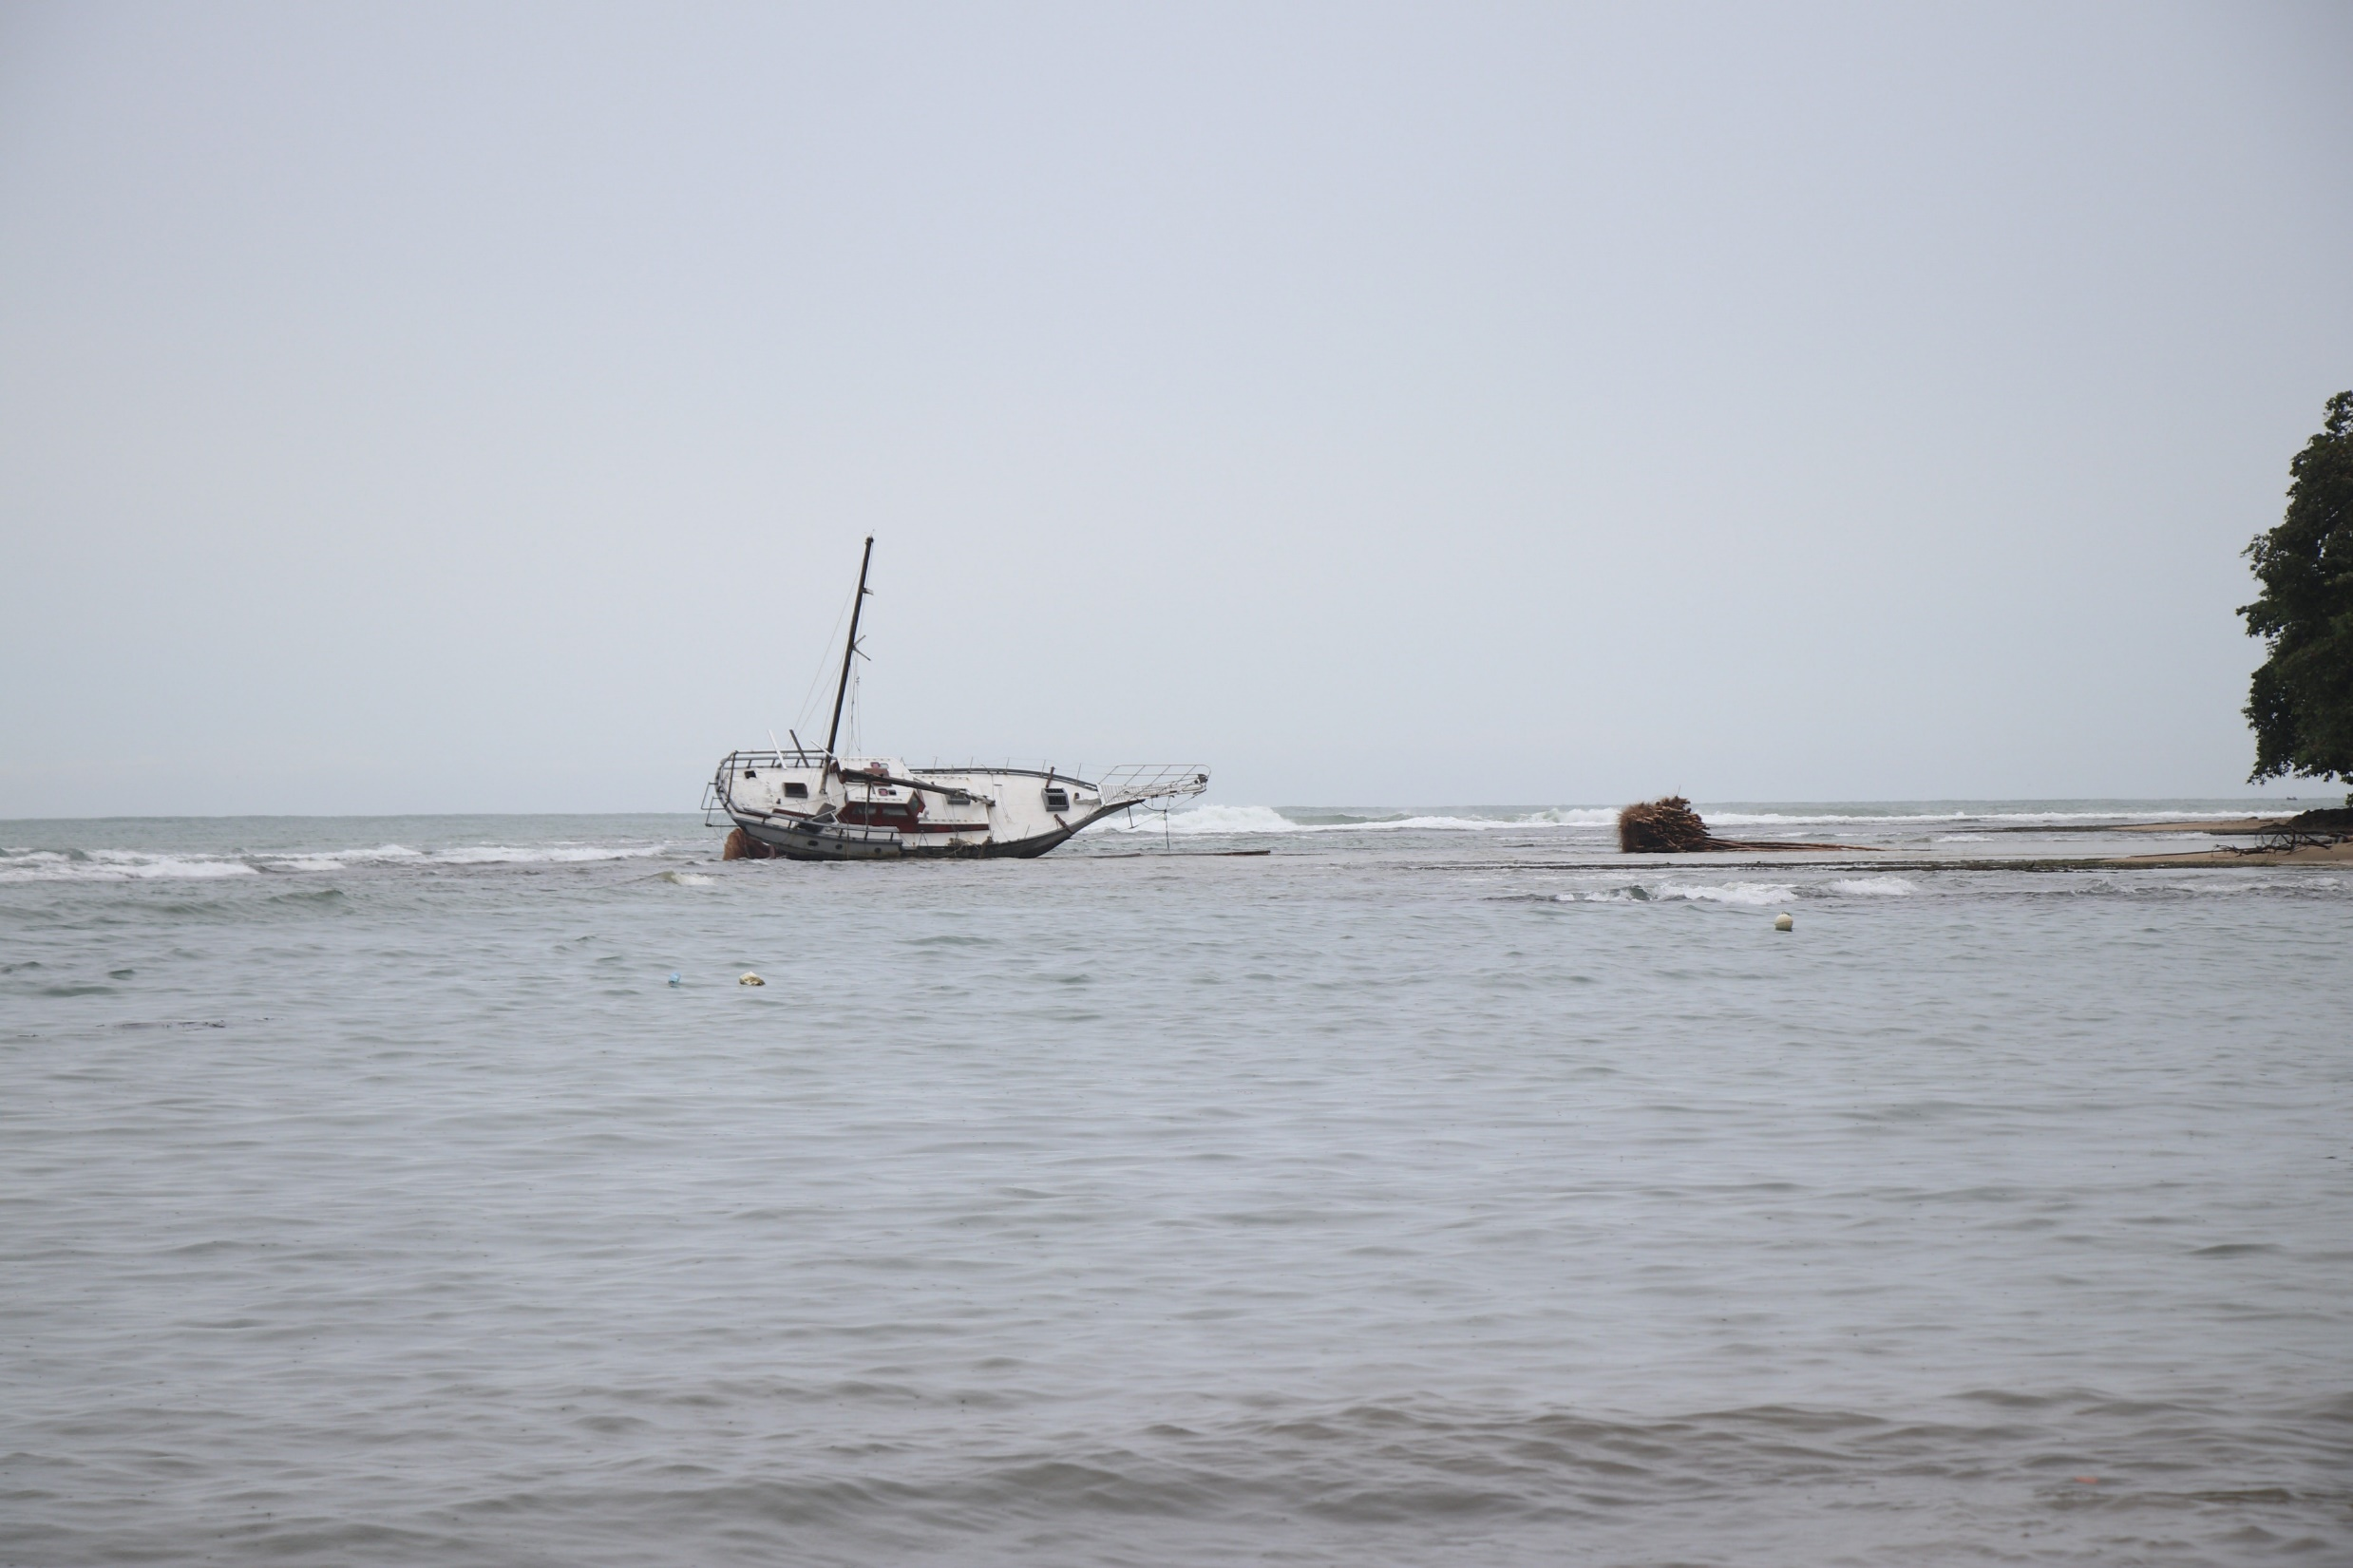
They do have a few wrecked ships.

Slide 24
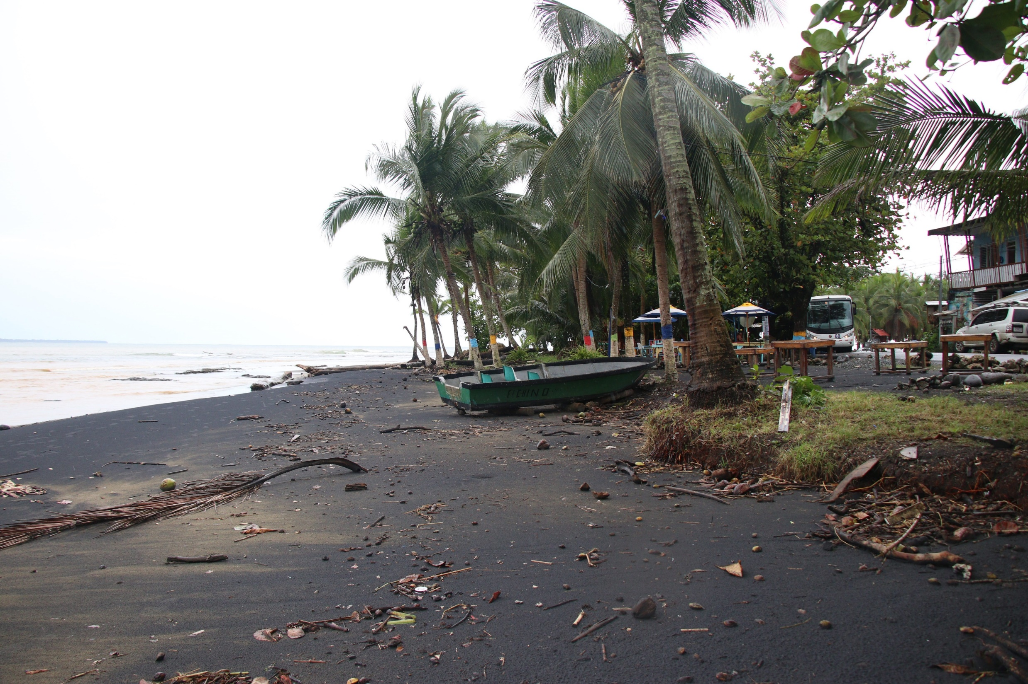

Slide 25
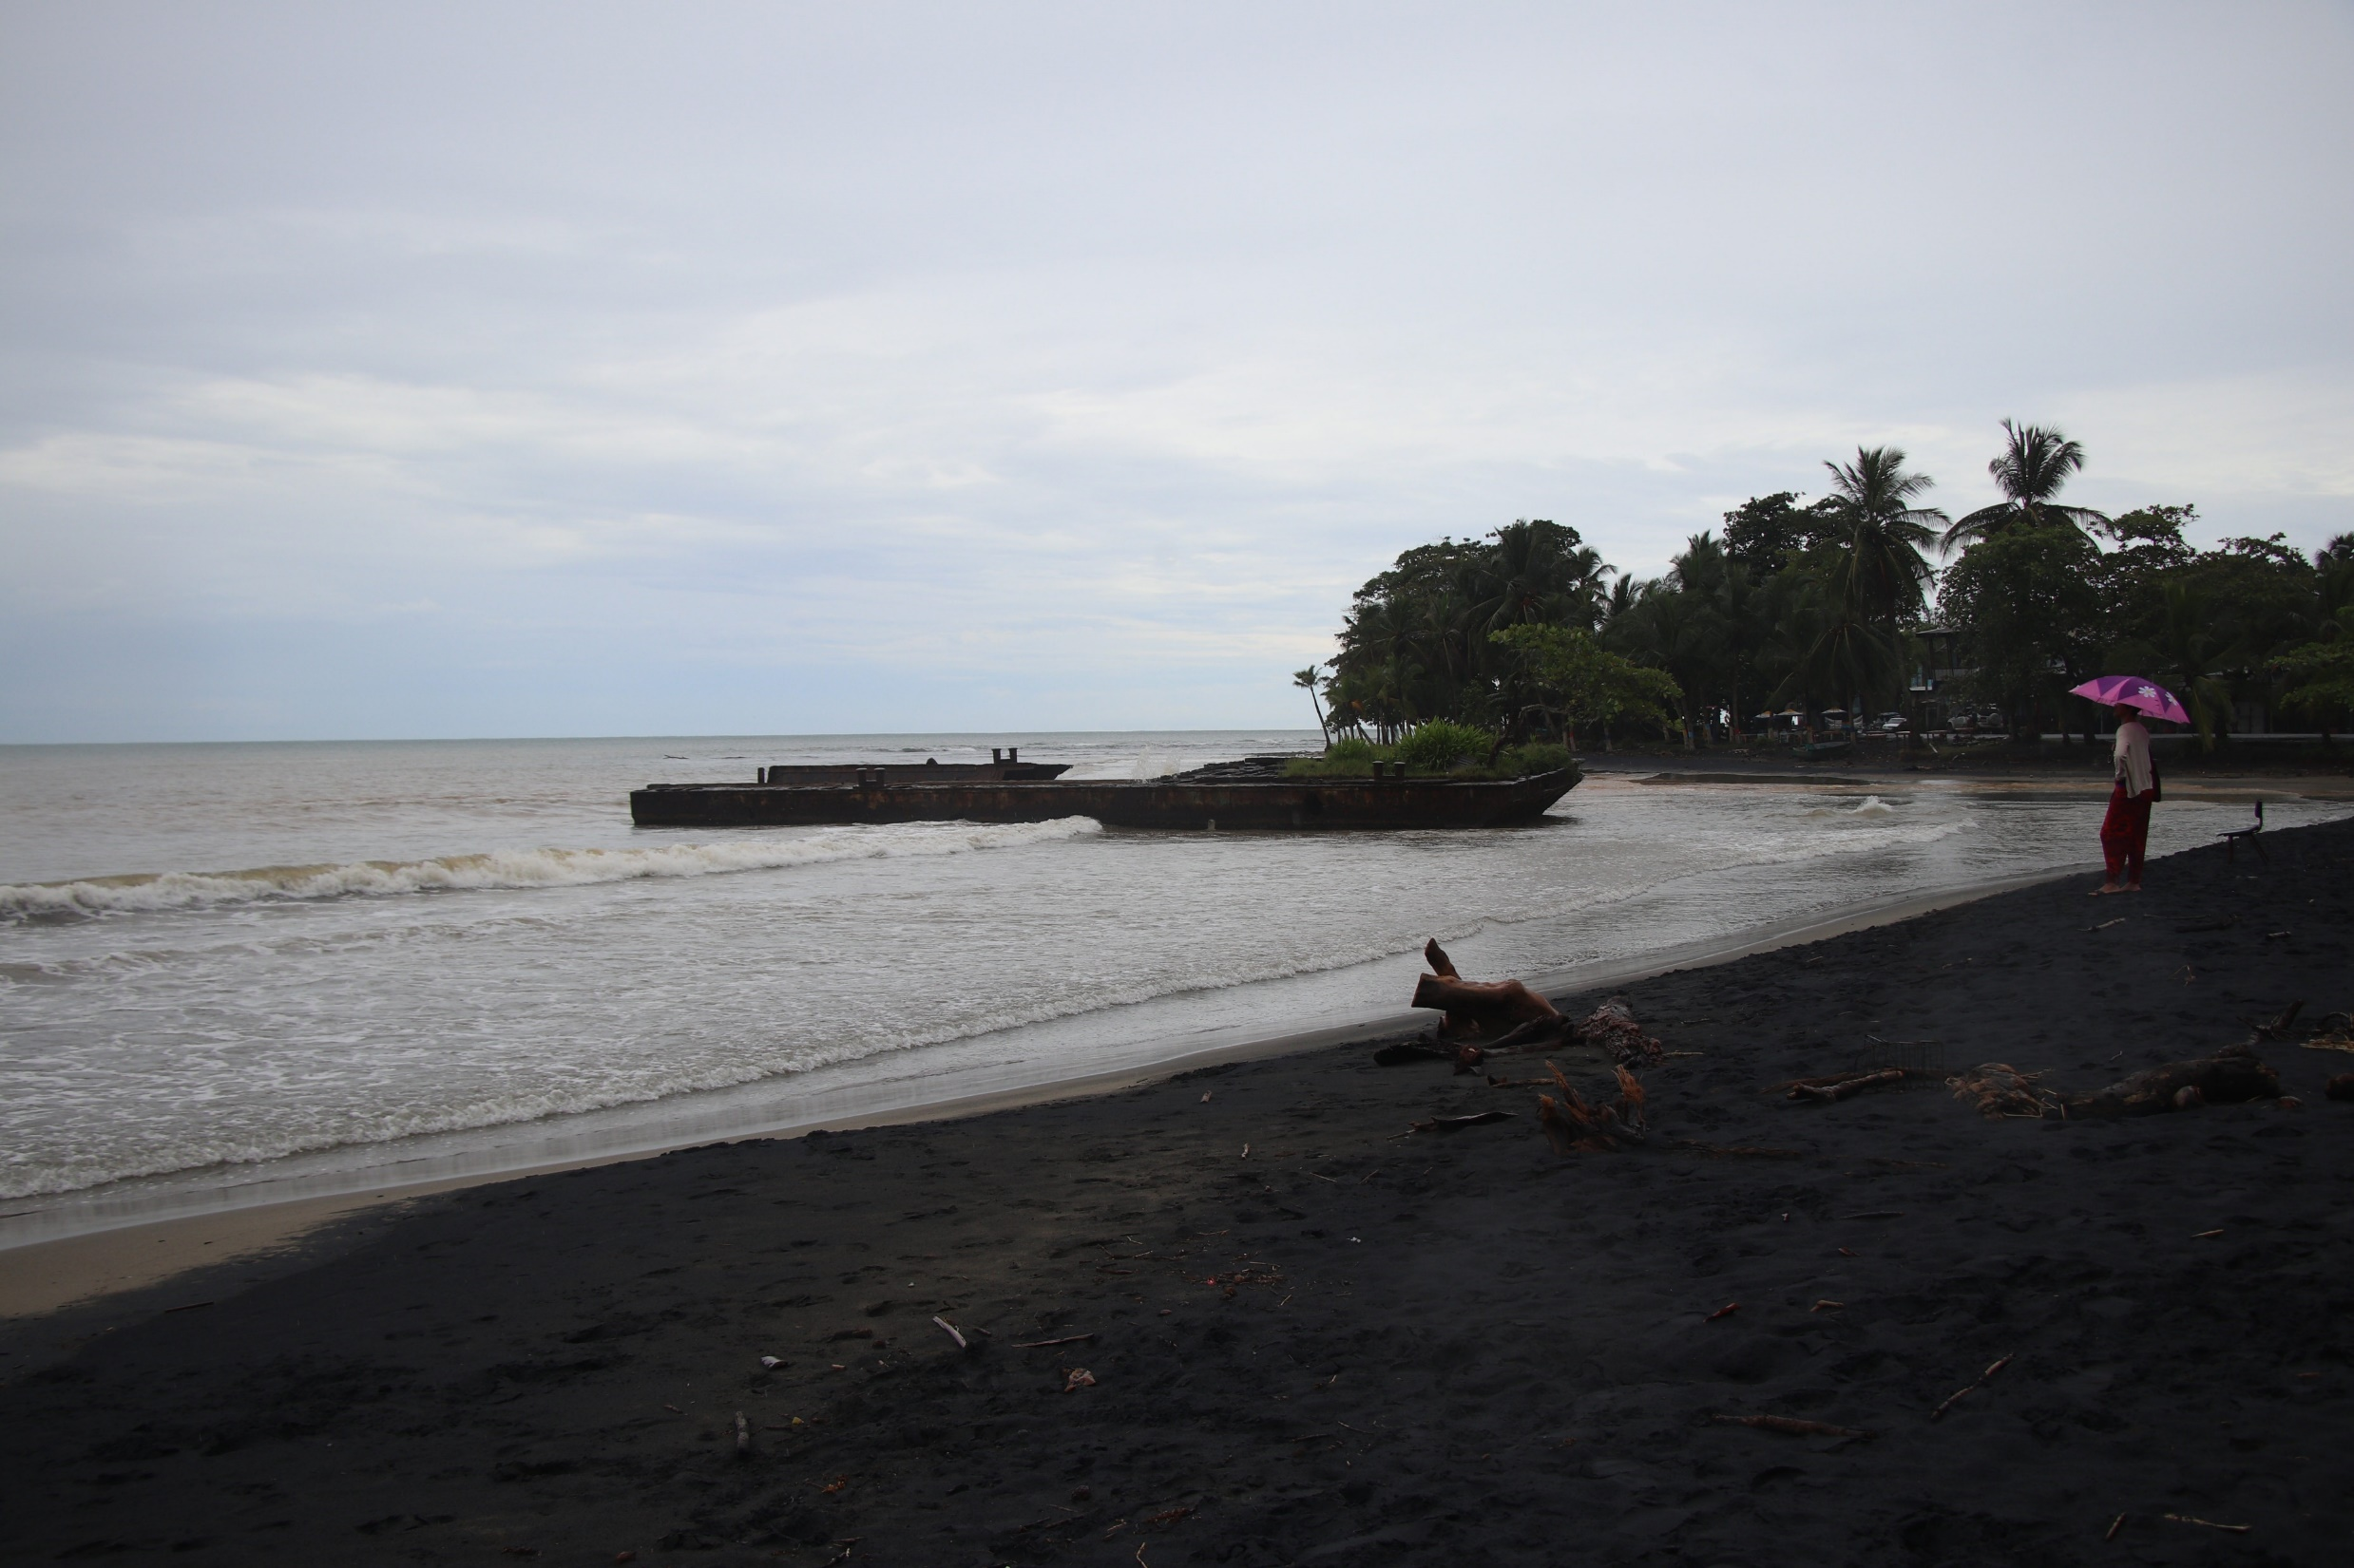

Slide 26
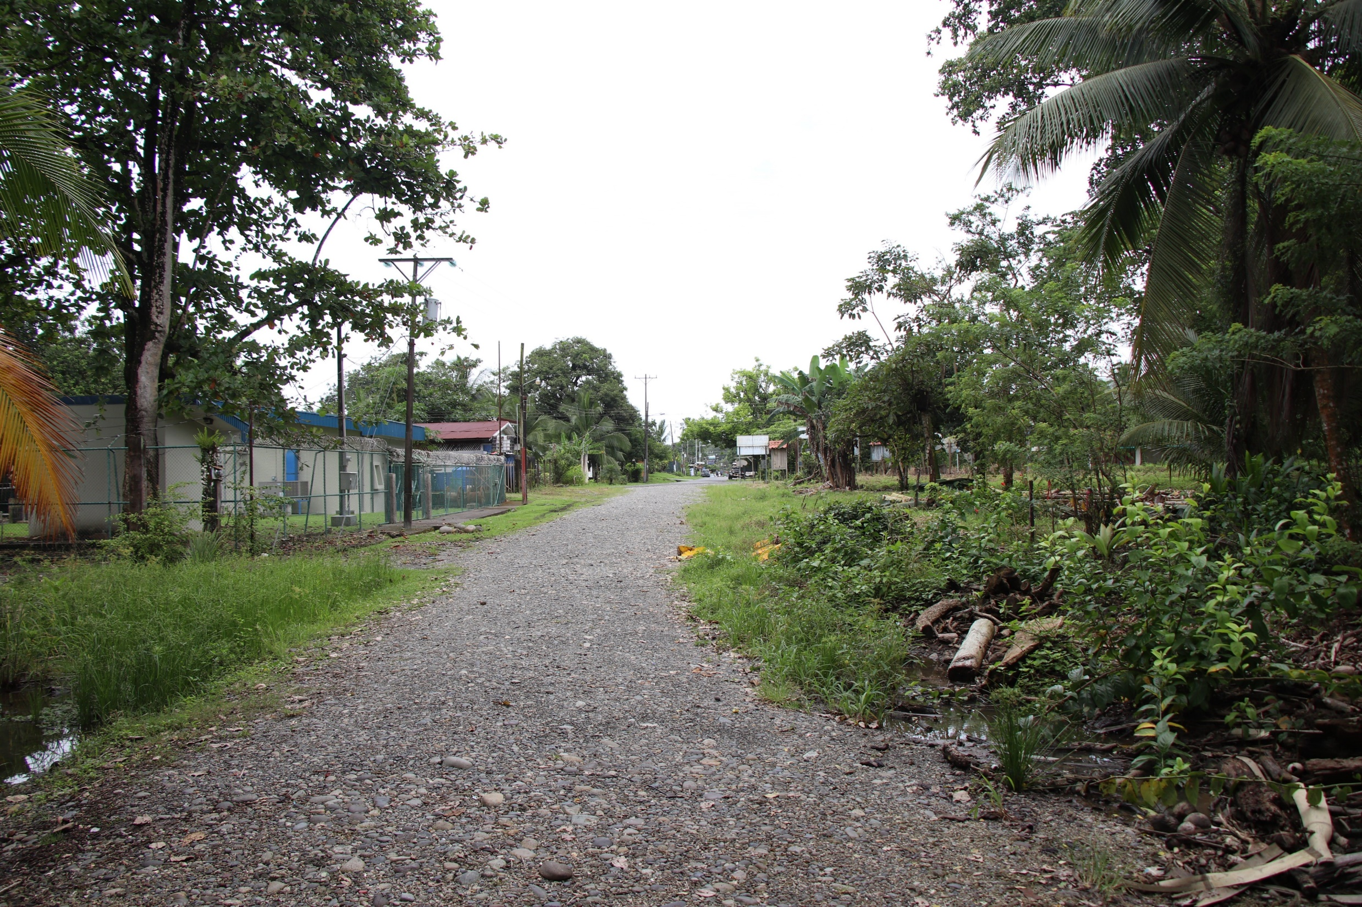
The blue top building is the local police station. From this point if you turn around you would be facing the beach.

Slide 27
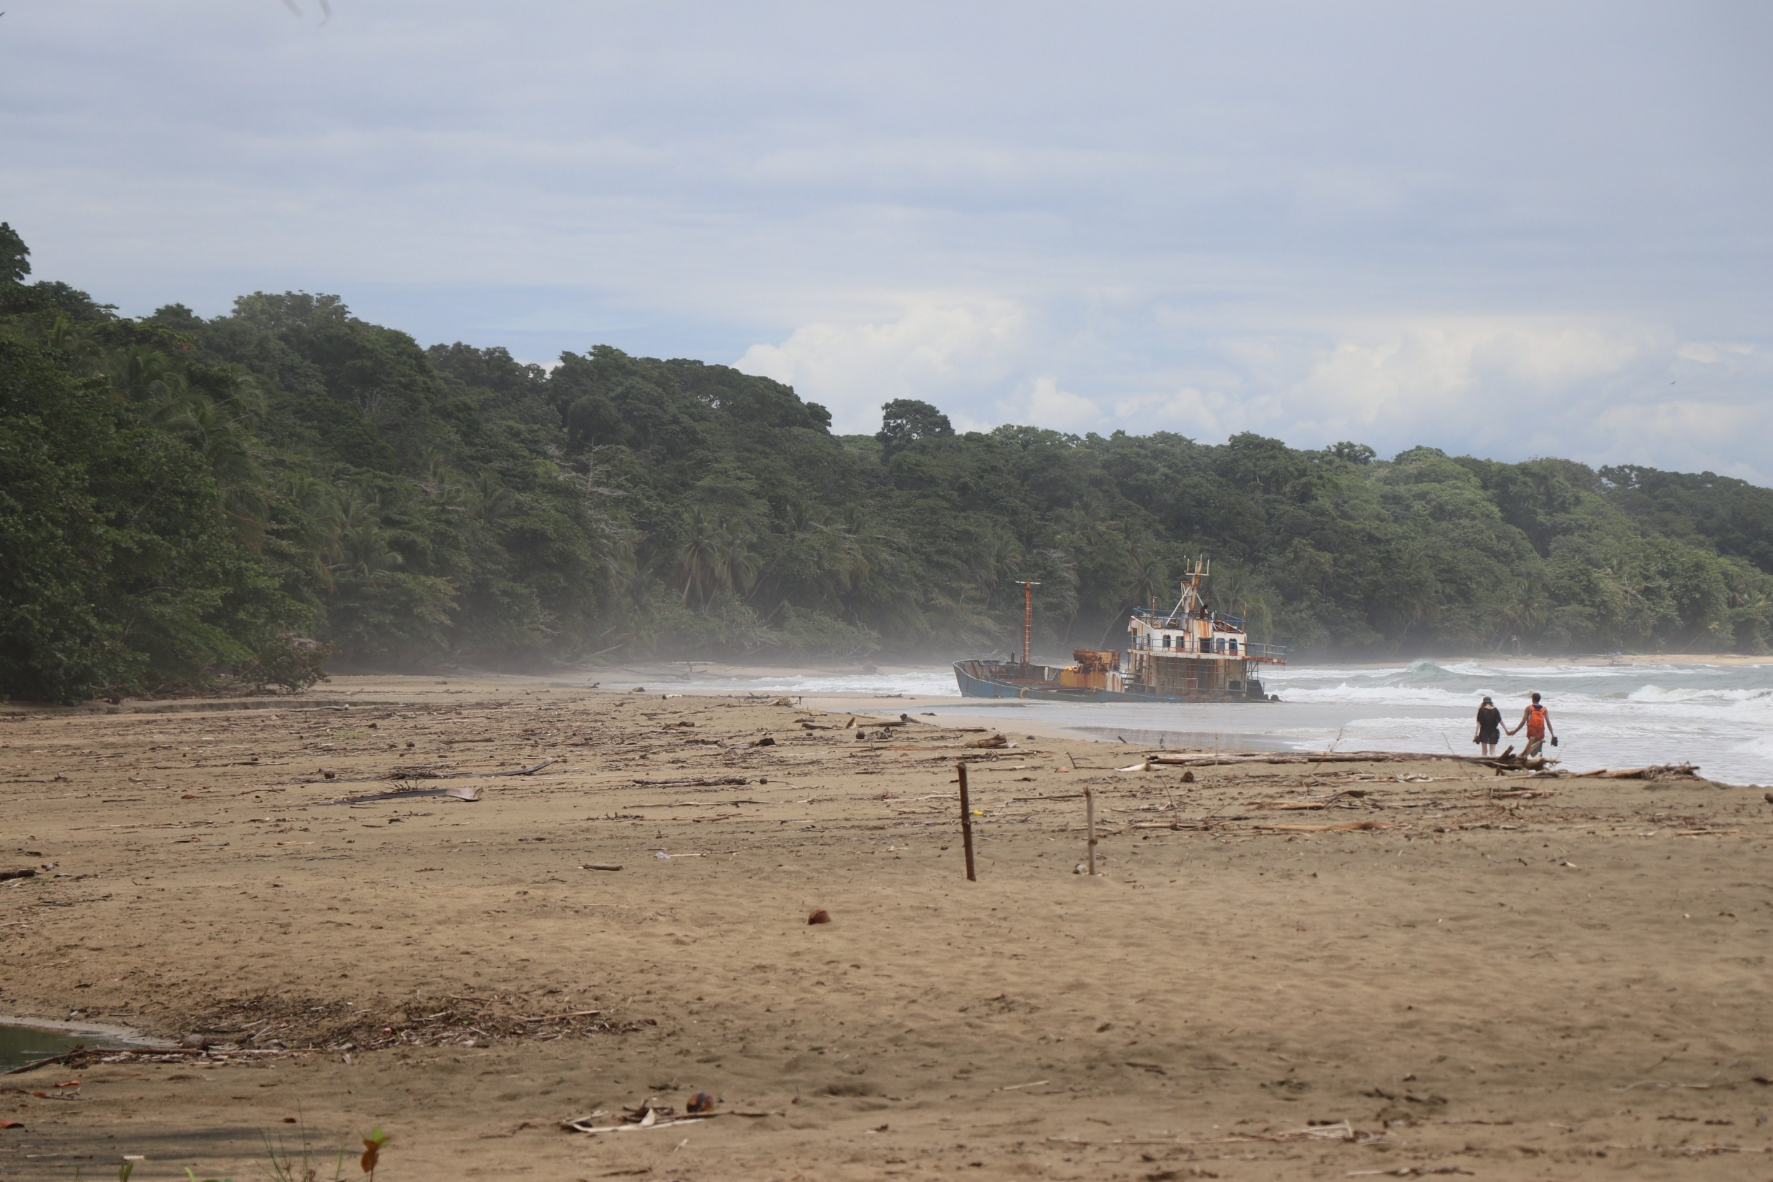
Another wrecked ship.

Slide 28
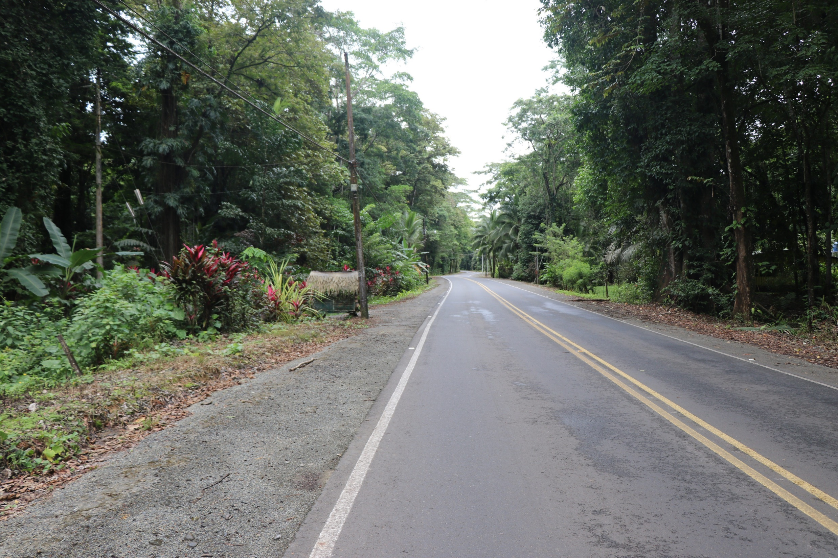
Another good road.

Slide 29
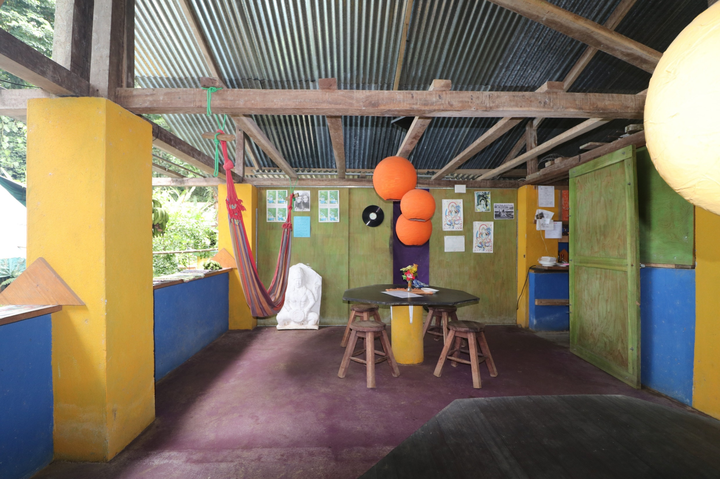
Colorful restaurant.

Slide 30
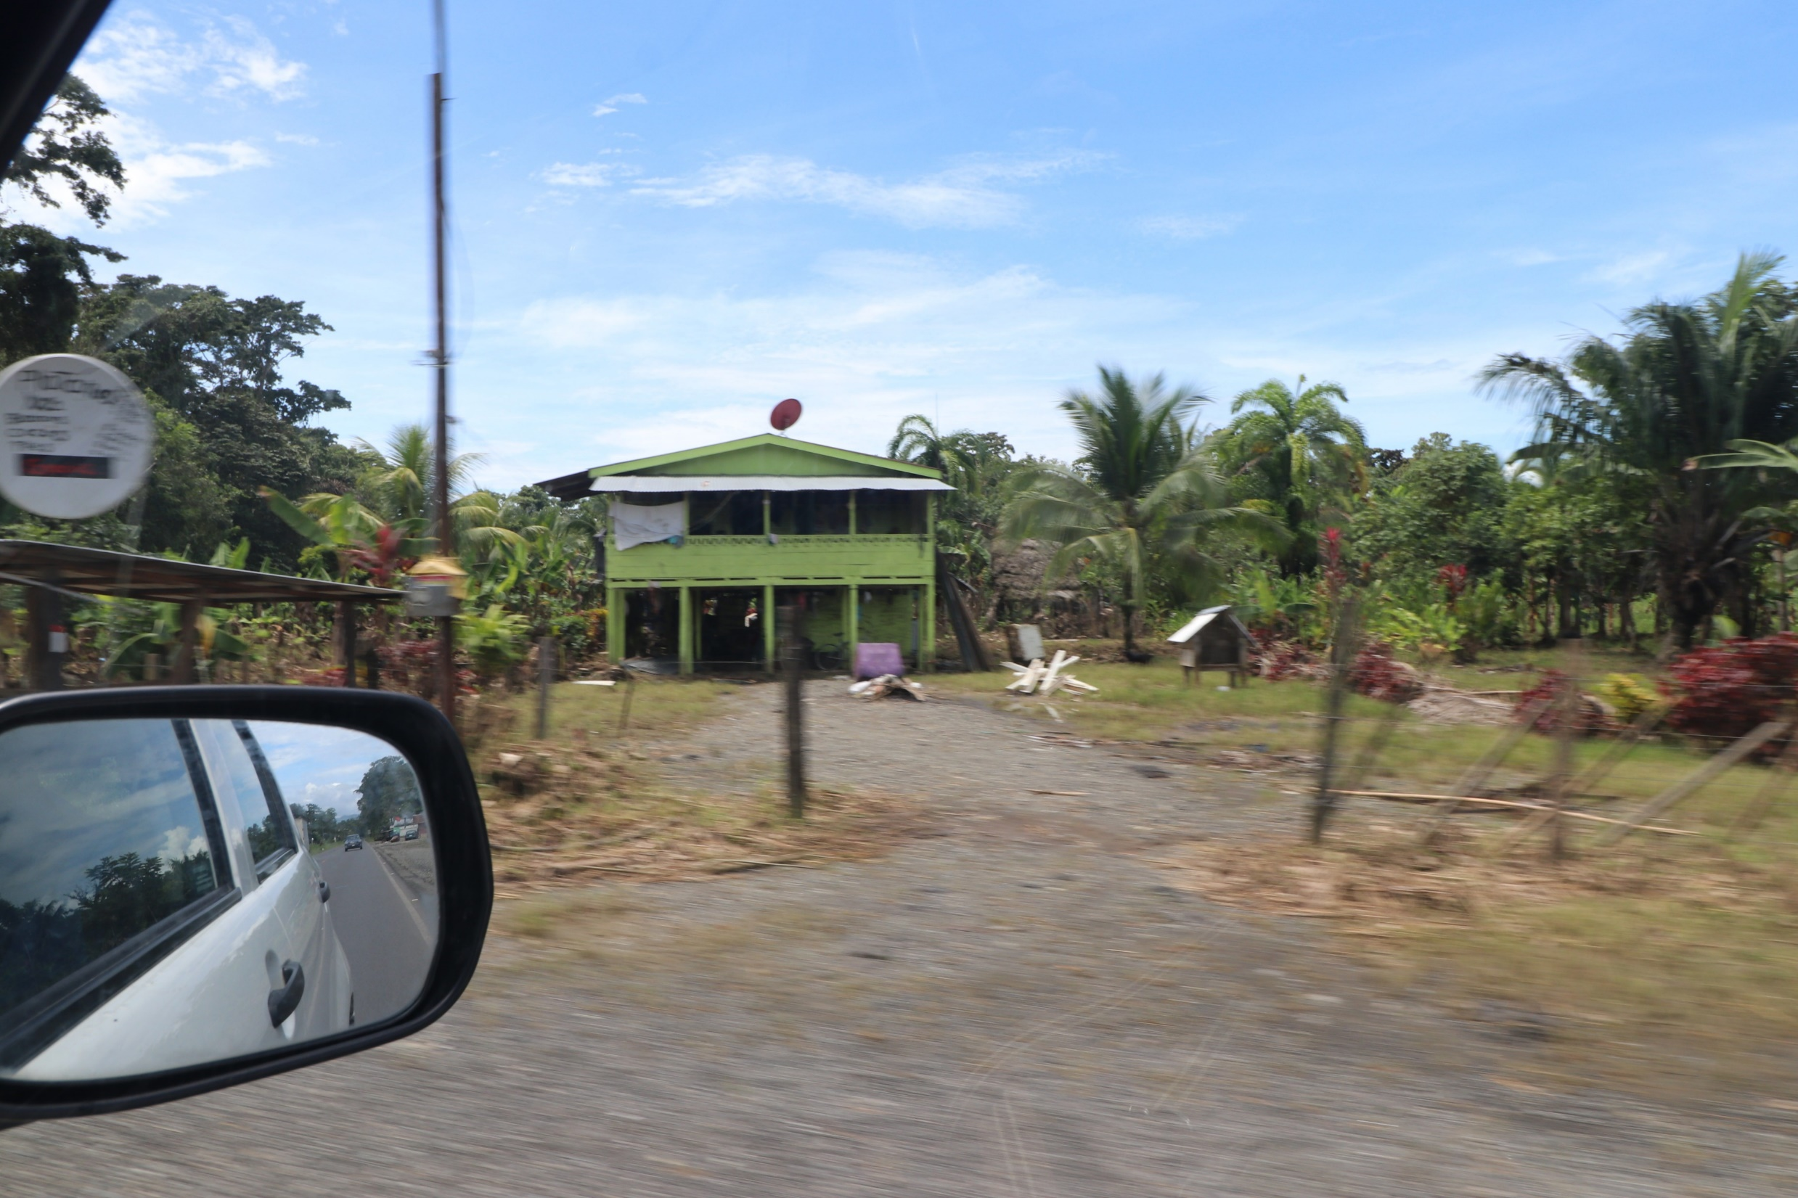
Local houses

Slide 31
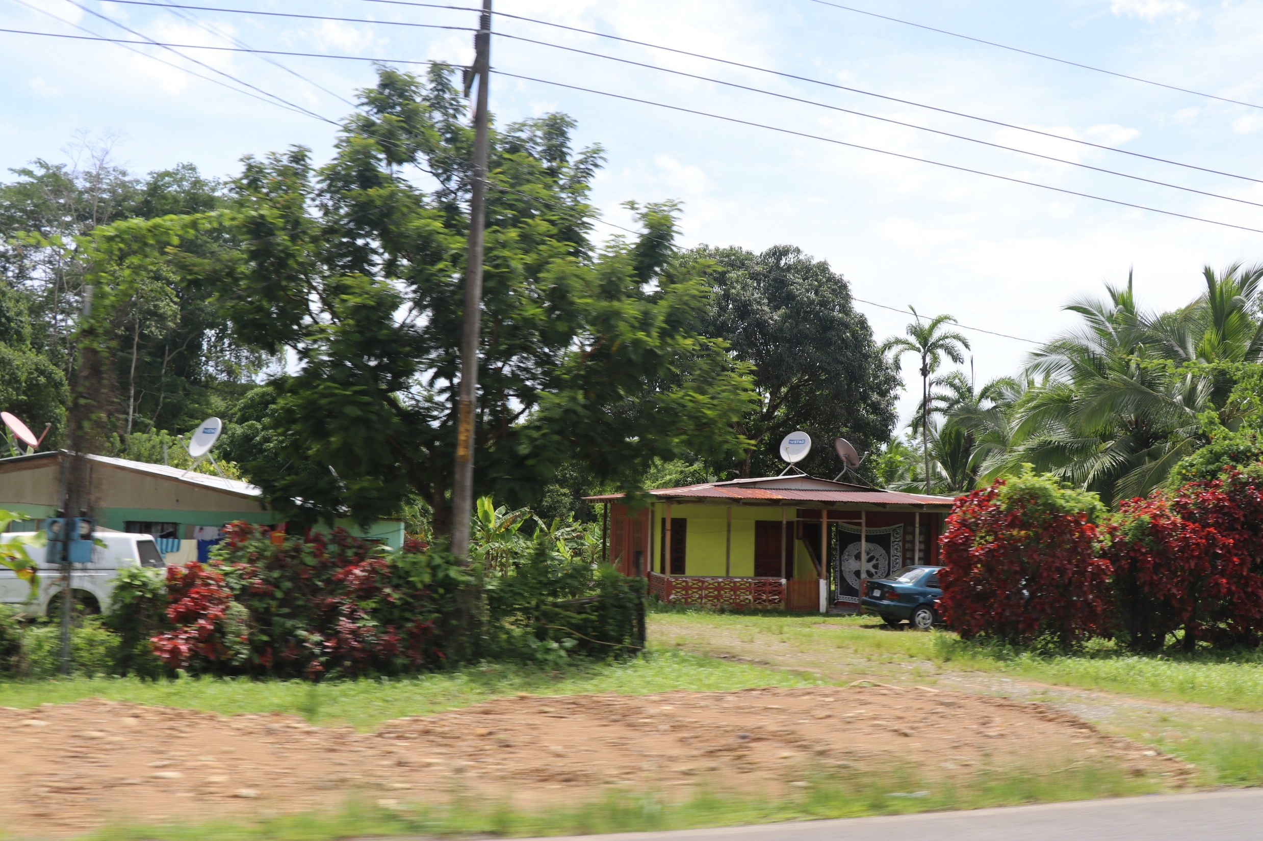
Local houses

Slide 32
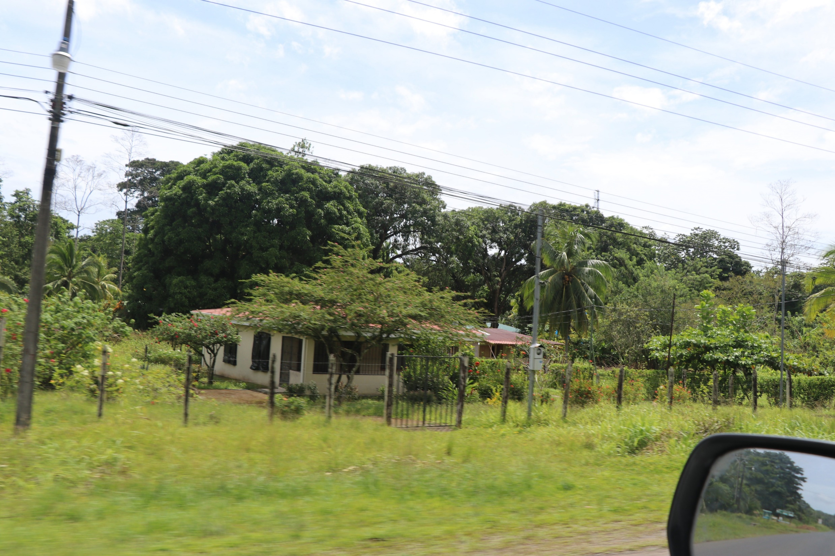
Local houses

Slide 33
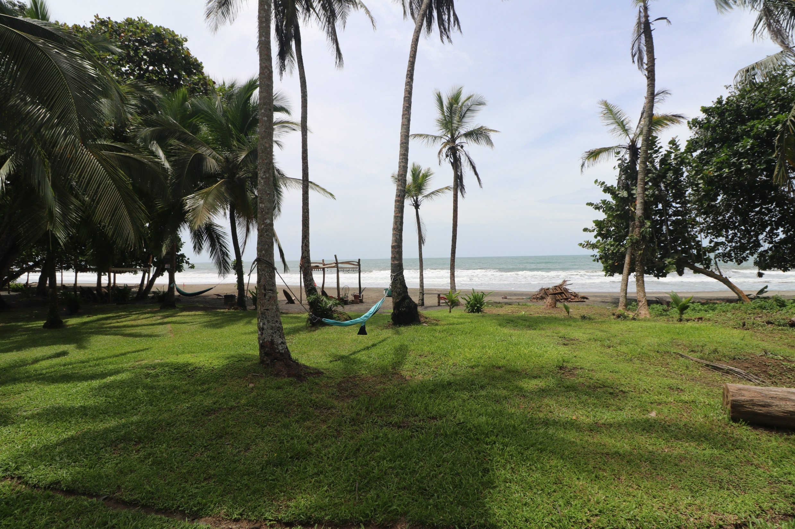
The beaches are still beautiful even in the winter. Picture taken in August which is winter in Costa Rica.

Slide 34
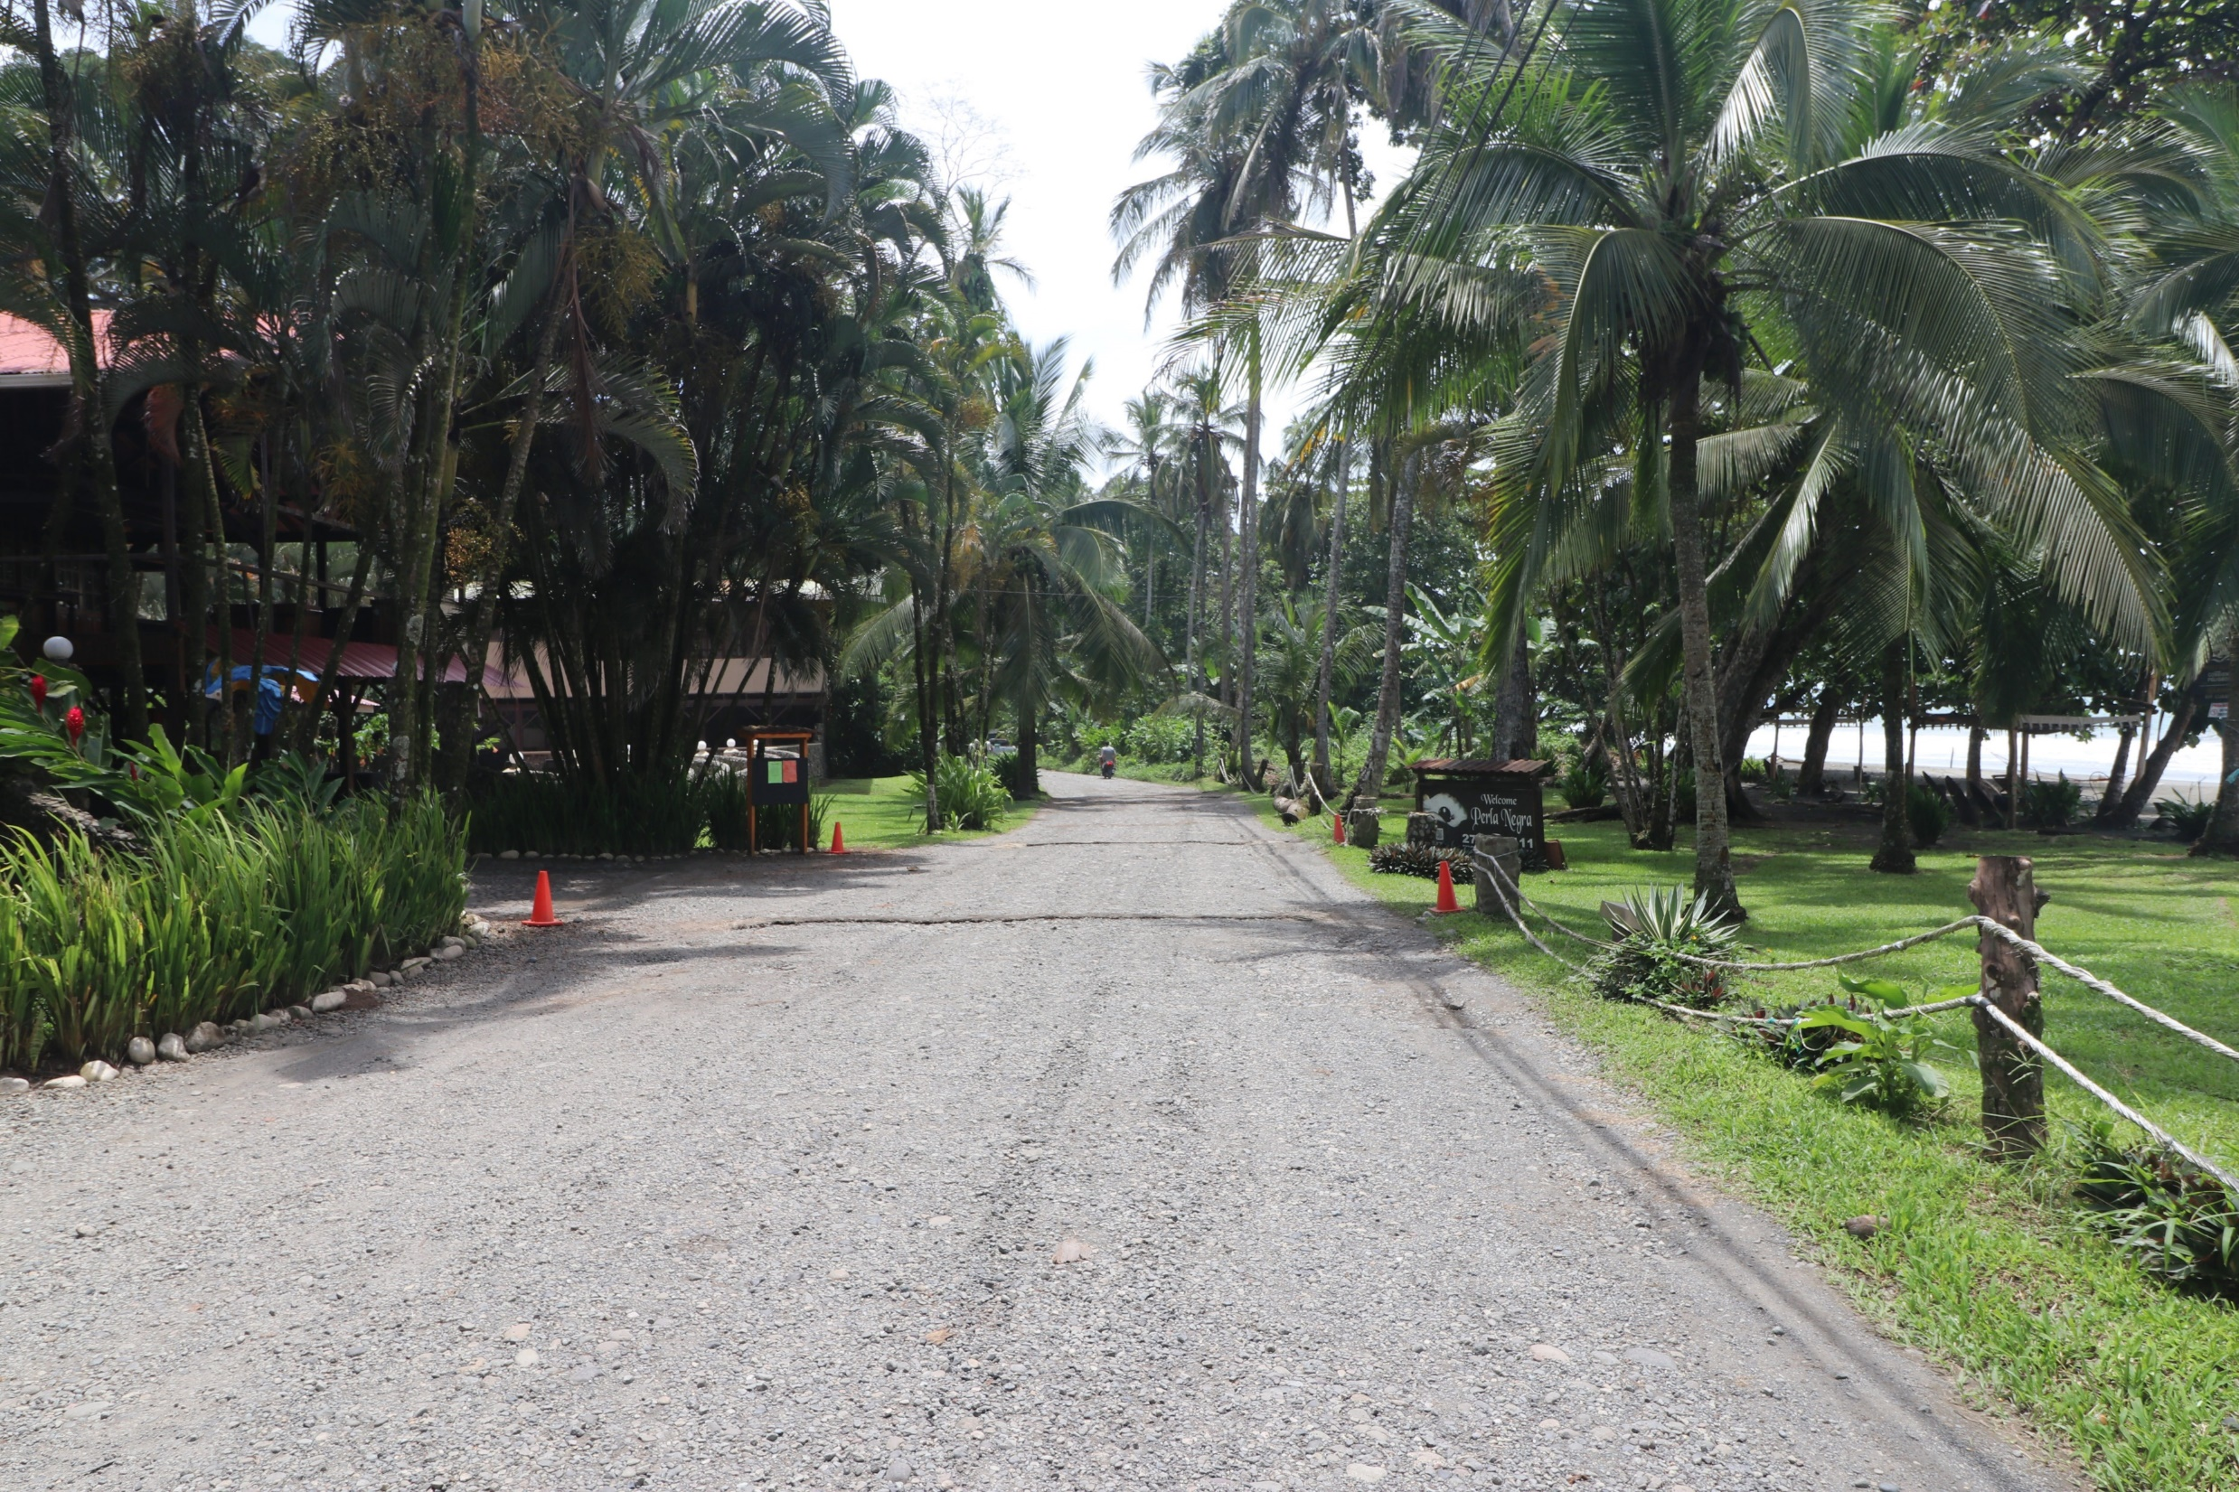
Local street, hotel on left beach on right. The same beach you saw in the side before.

Slide 35
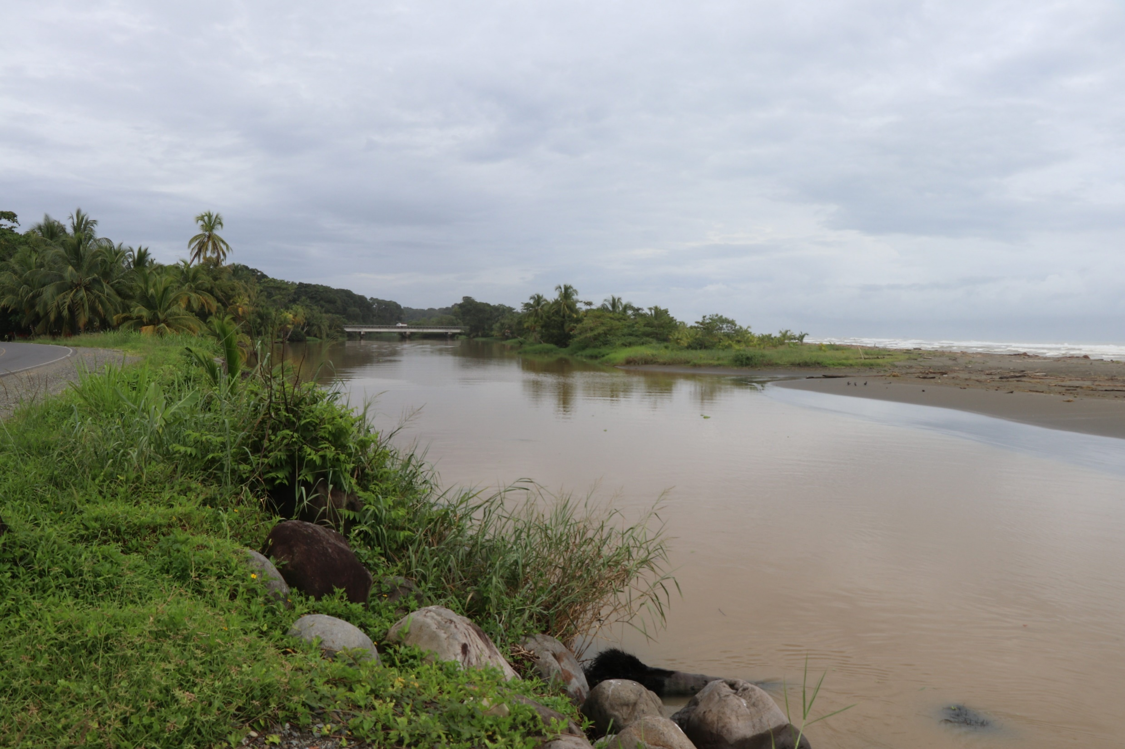
Local river, as you can see muddy because of the rain during the winter.

Slide 36
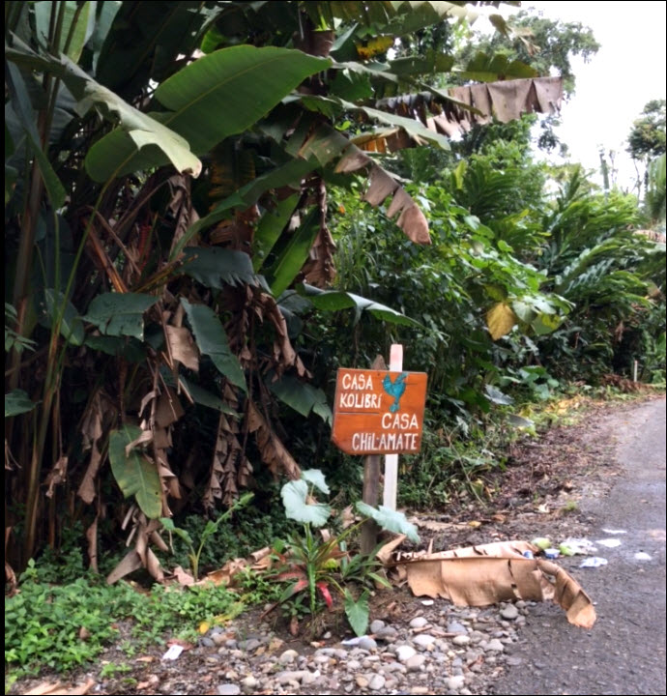
I took a picture of the sign by the road (main road hwy 256), to help me so I could remember what street to turn into to reach my house. All the drives have vegetation as you can see in this picture. It is hard to tell one from another.

Slide 37
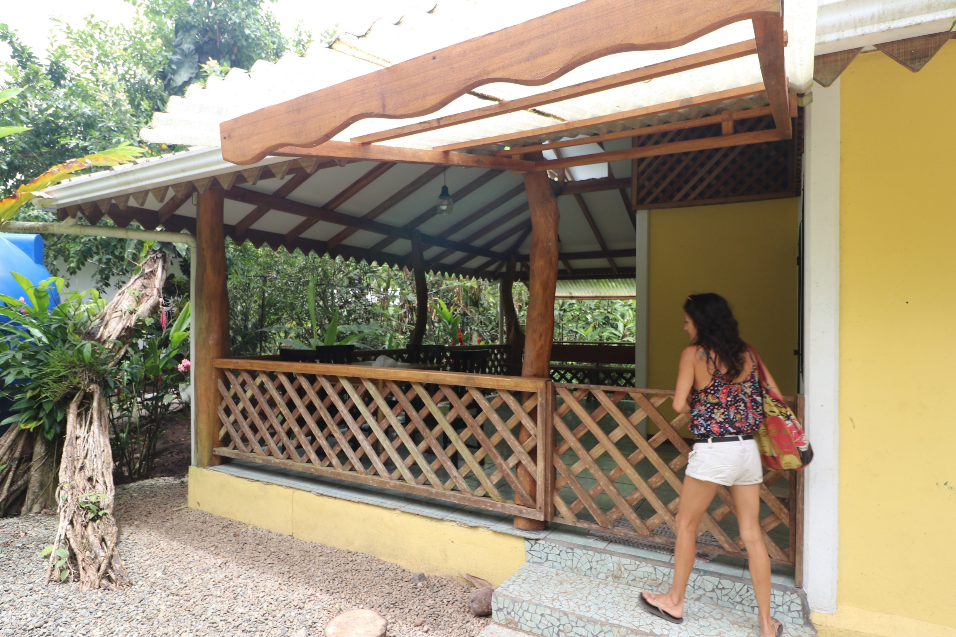
Property manager opening the gate to show me the house I ended up leasing. This is standard professional attire in Puerto Viejo.

Slide 38
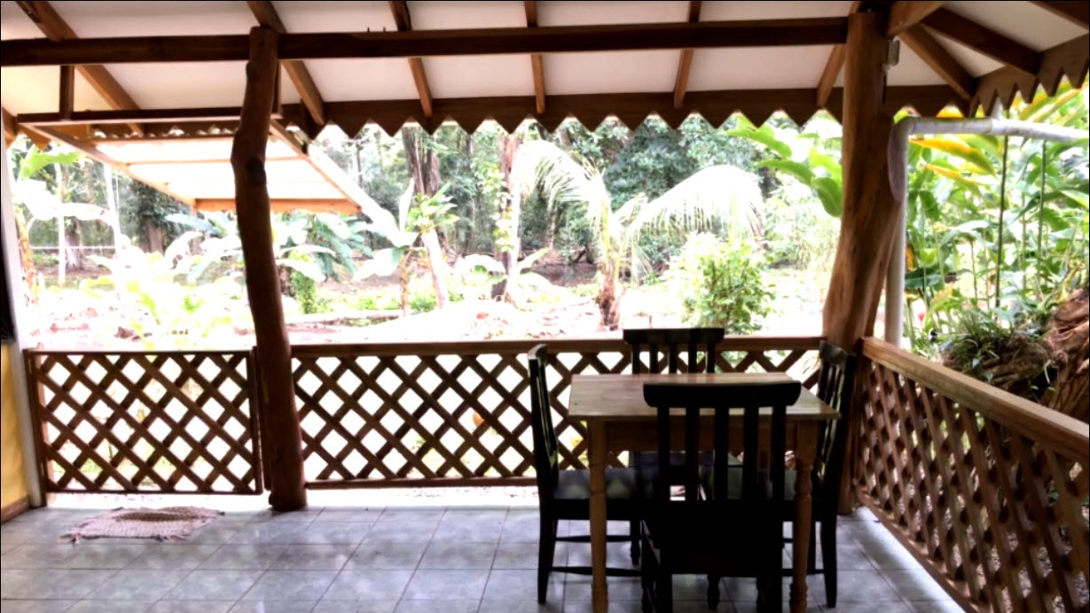
Nice deck area to have your meals in the fresh air.

Slide 39
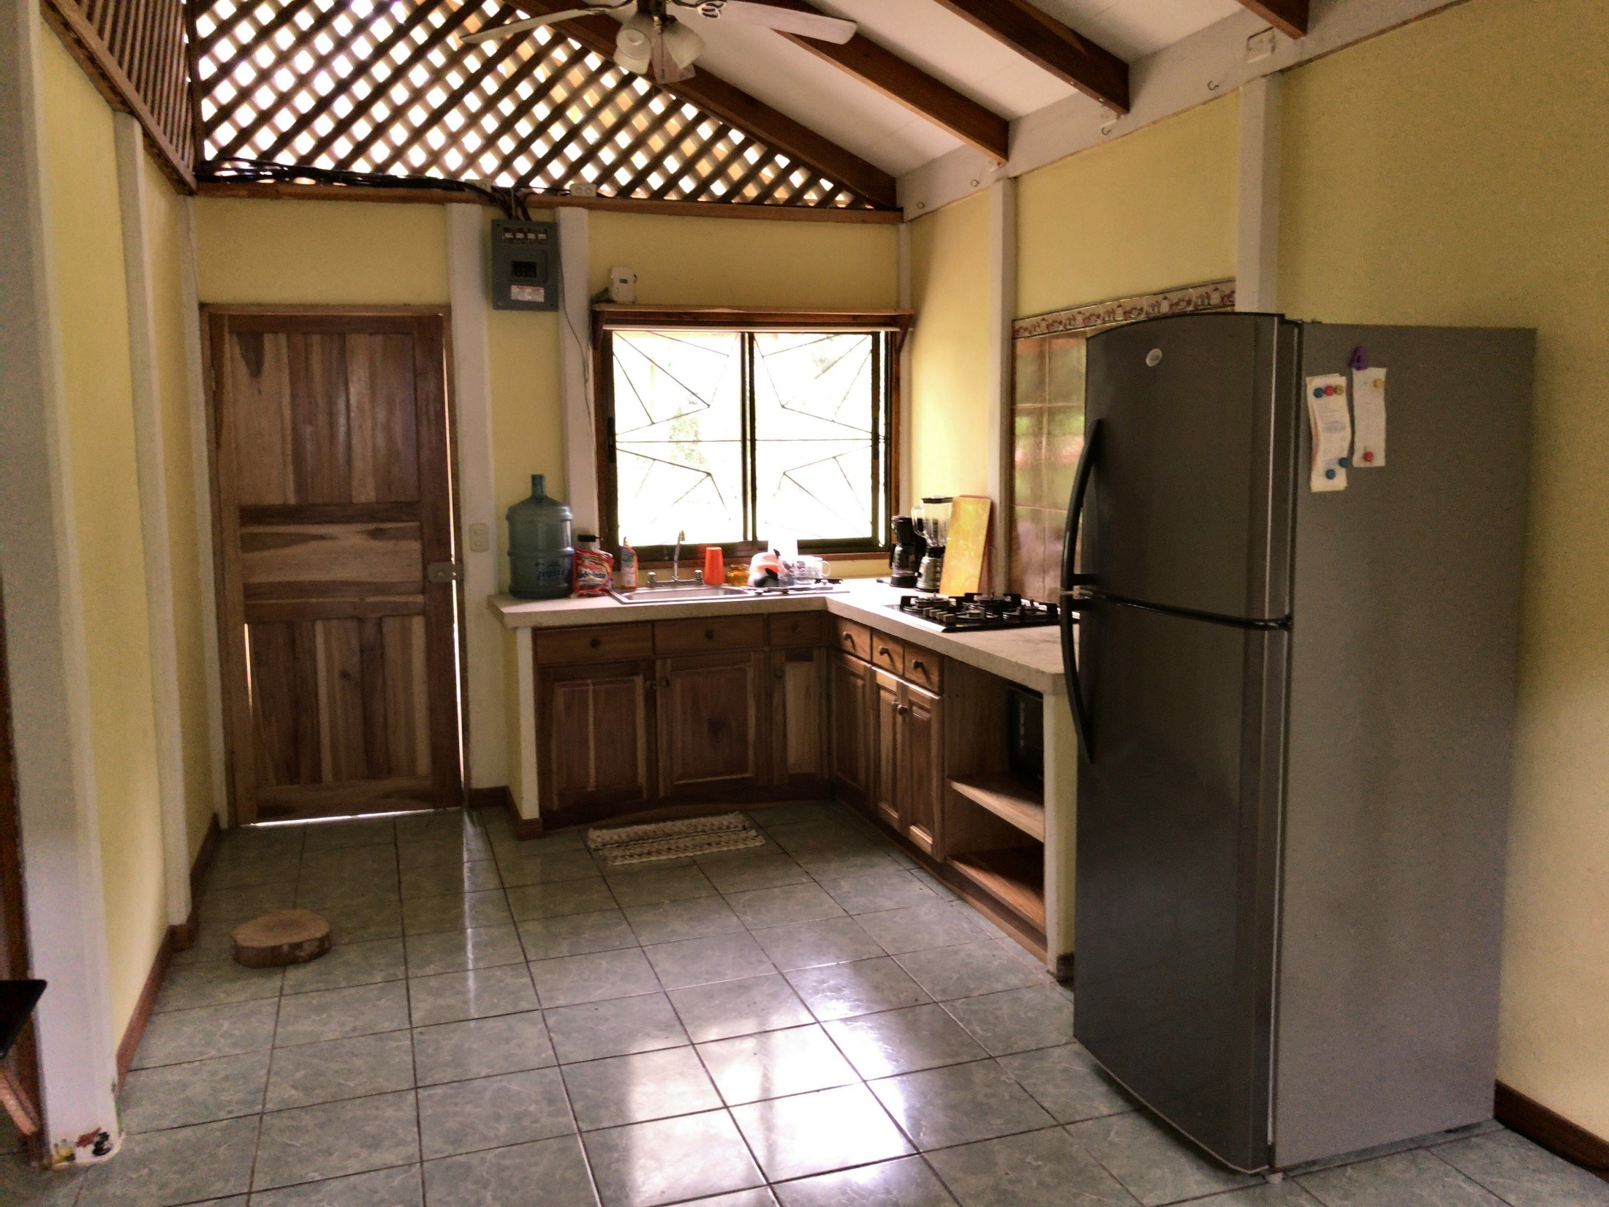
Kitchen area, all the comforts of home.

Slide 40
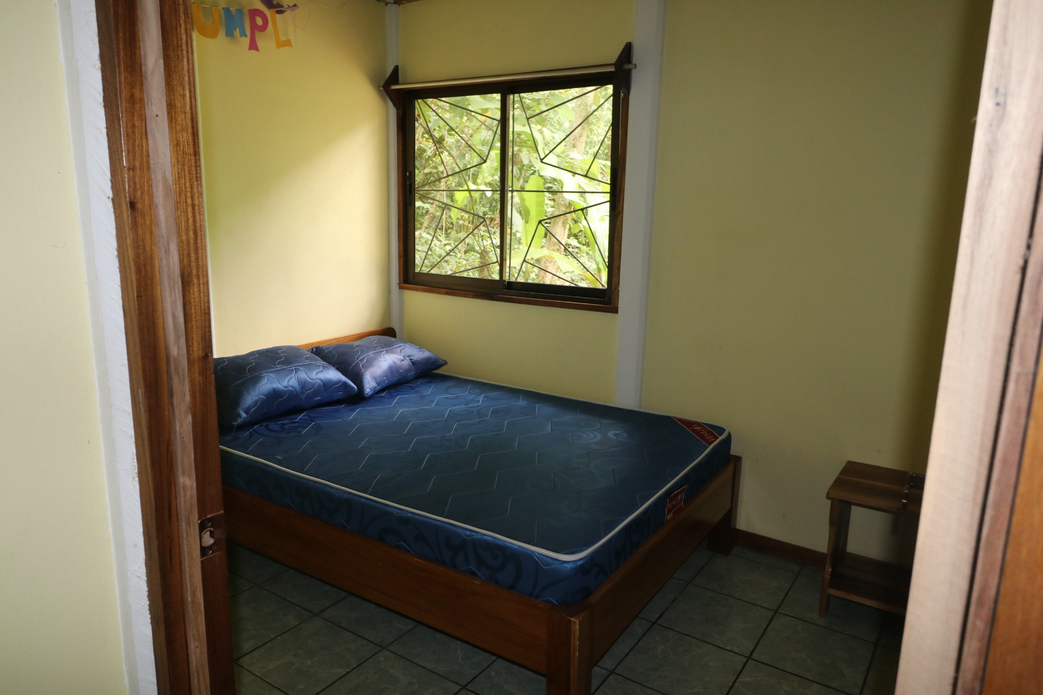
One of the two bedrooms in the house.

Slide 41
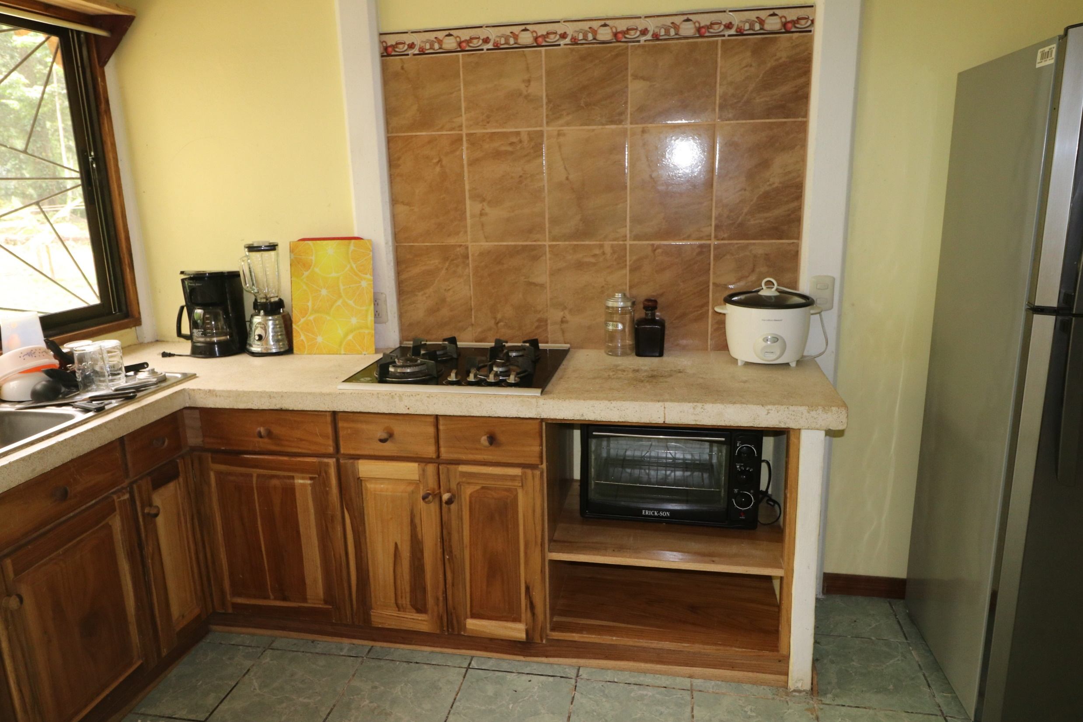
Kitchen area at a different angle.

Slide 42
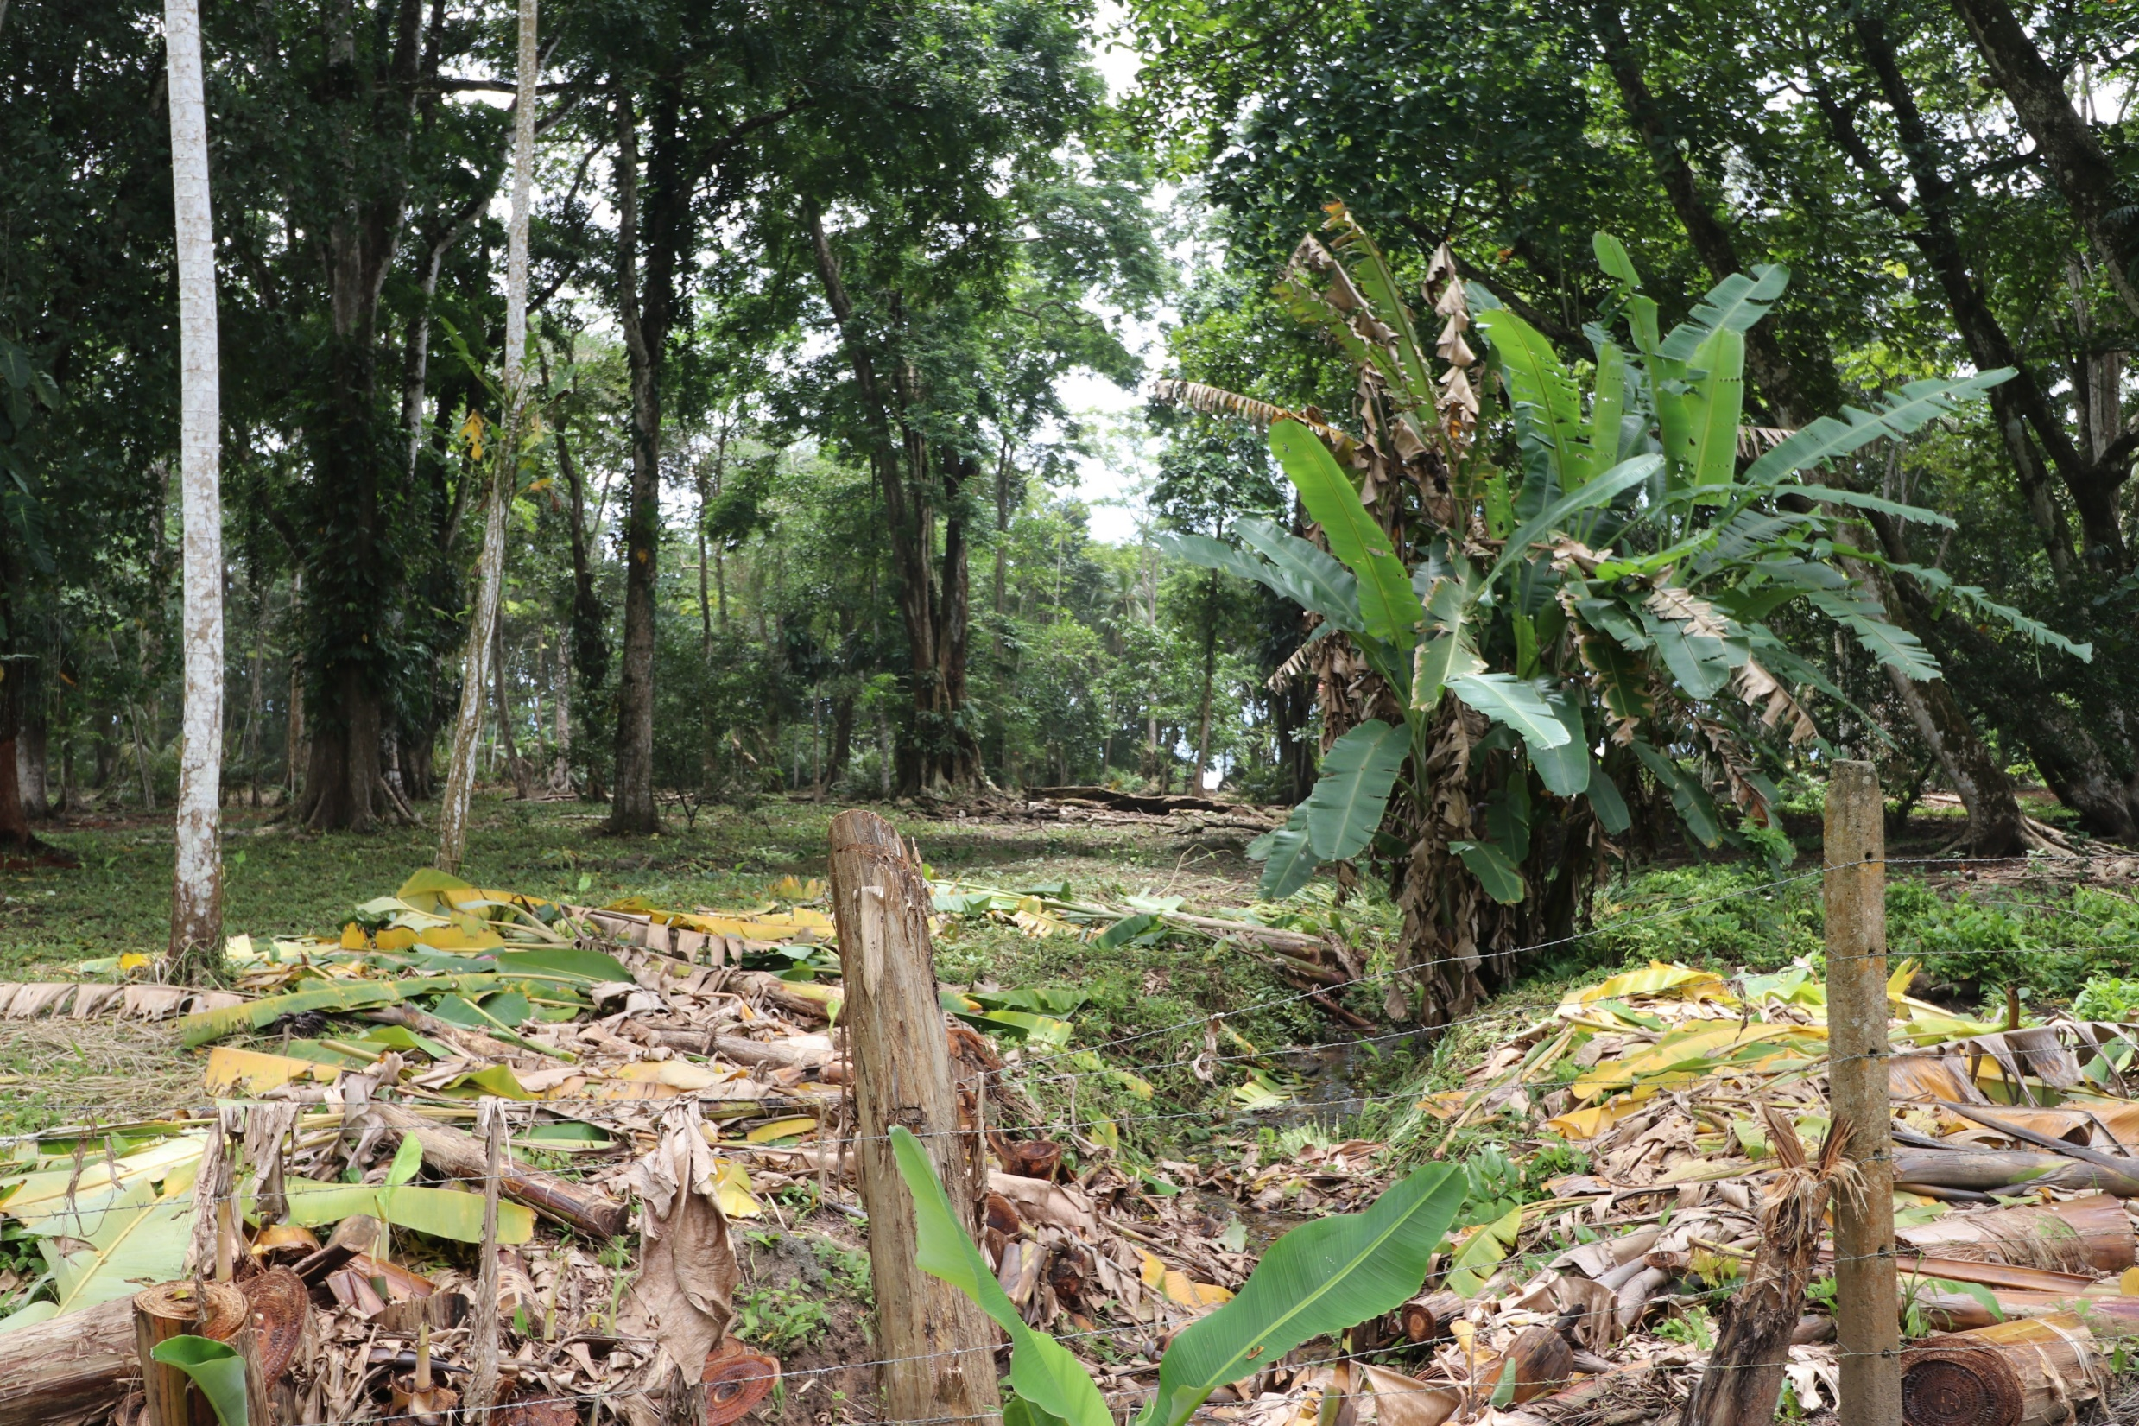
My side yard looking in the directions of the beach.
See arrow; the little white whole between the trees is the beach. About 250 meters.

Slide 43
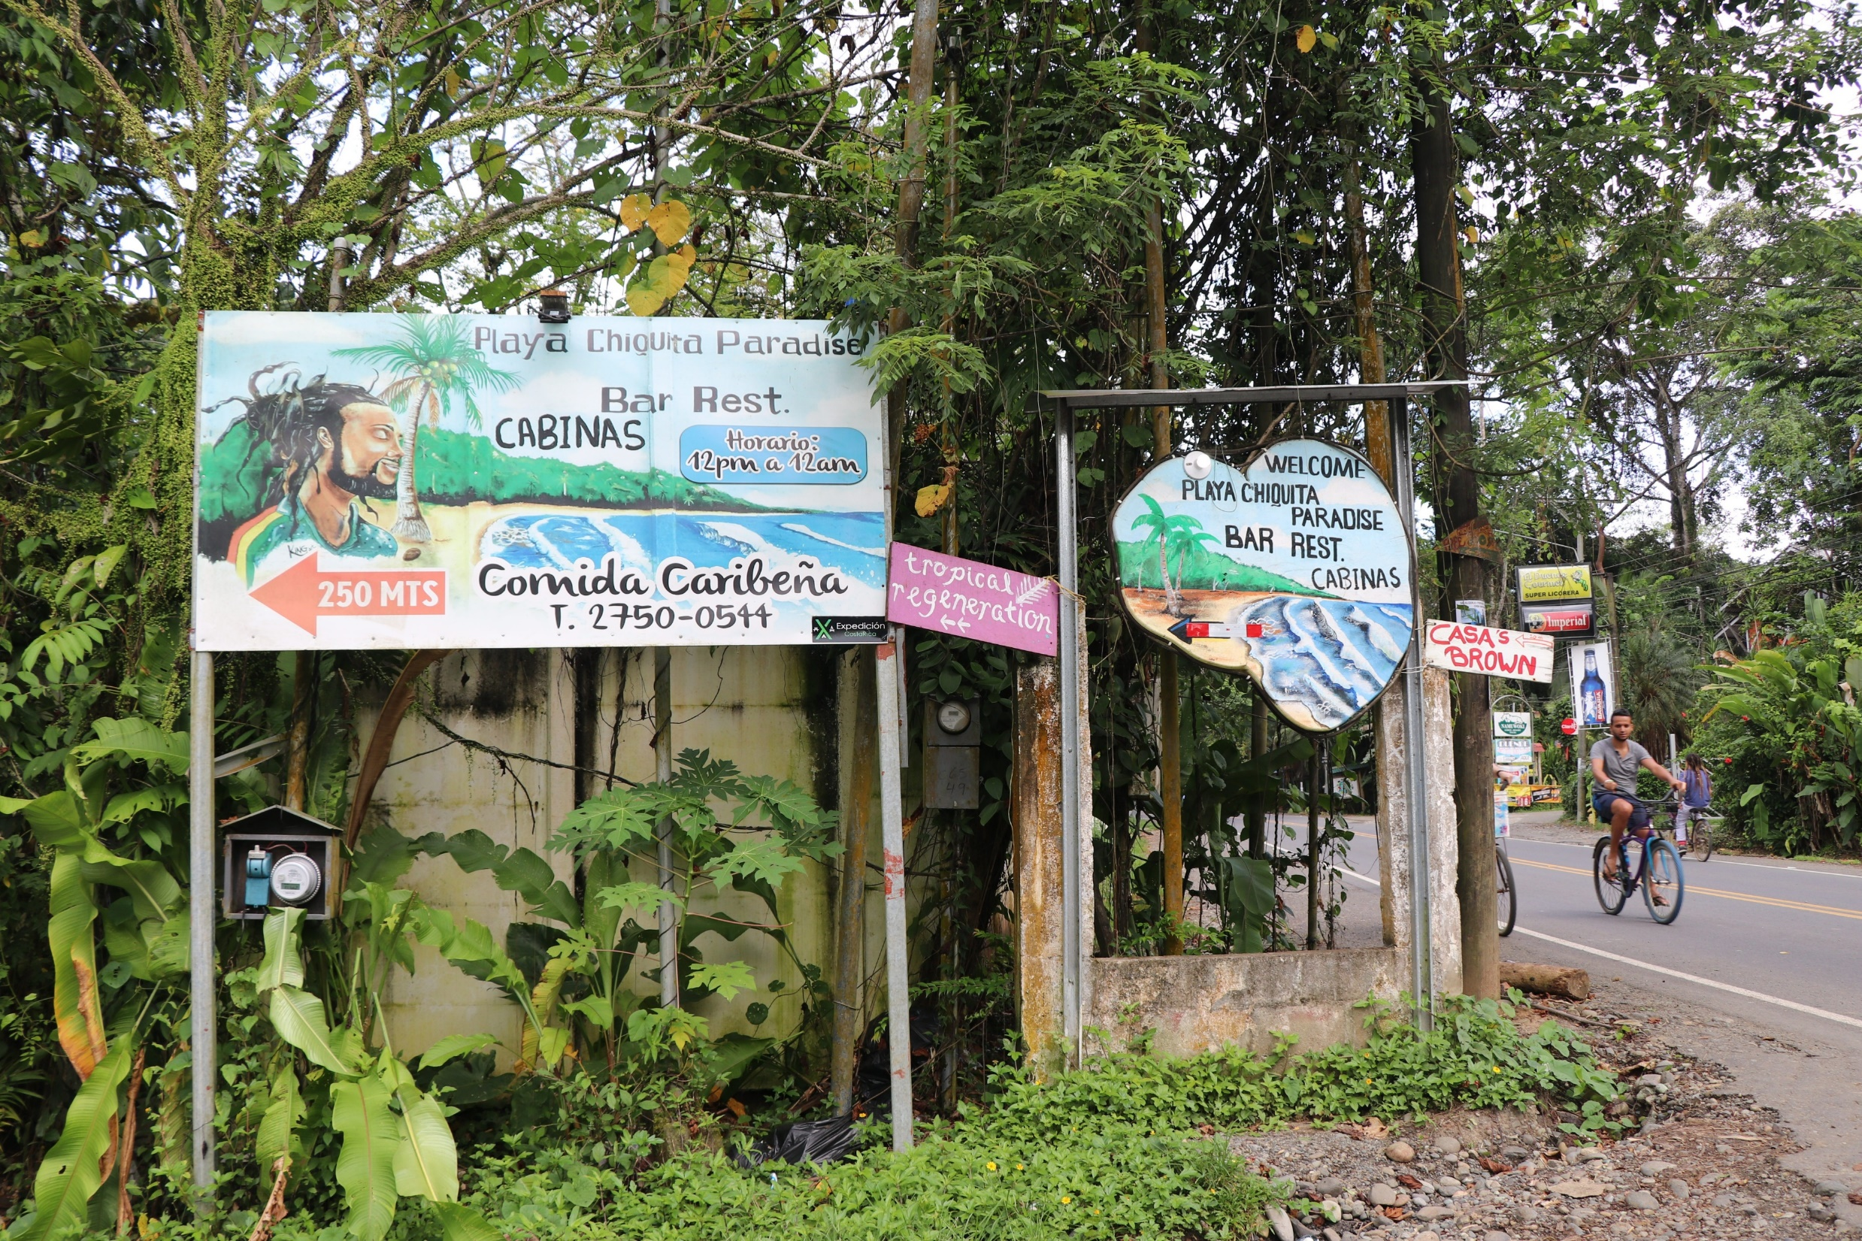
The turn off the main road to go down to the beach. The one I call my beach. Playa Chiquita
When you come out from my house to the main road, turn left go about 50 meters and this turn takes you down to this beach.

Slide 44
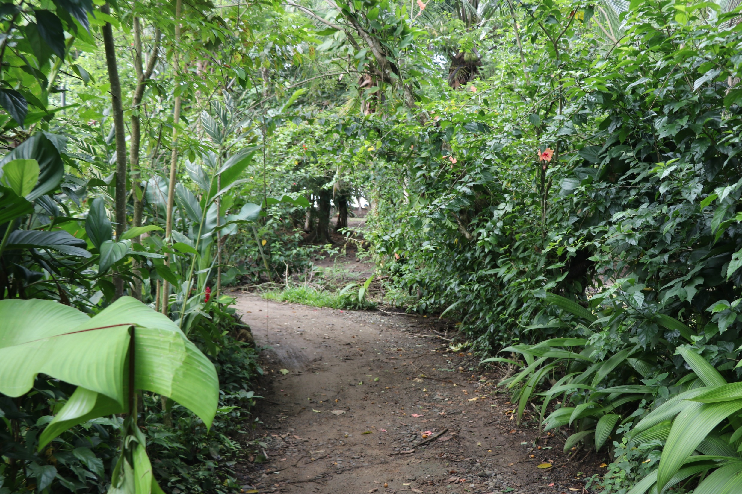
You can also walk to the beach.

Slide 45
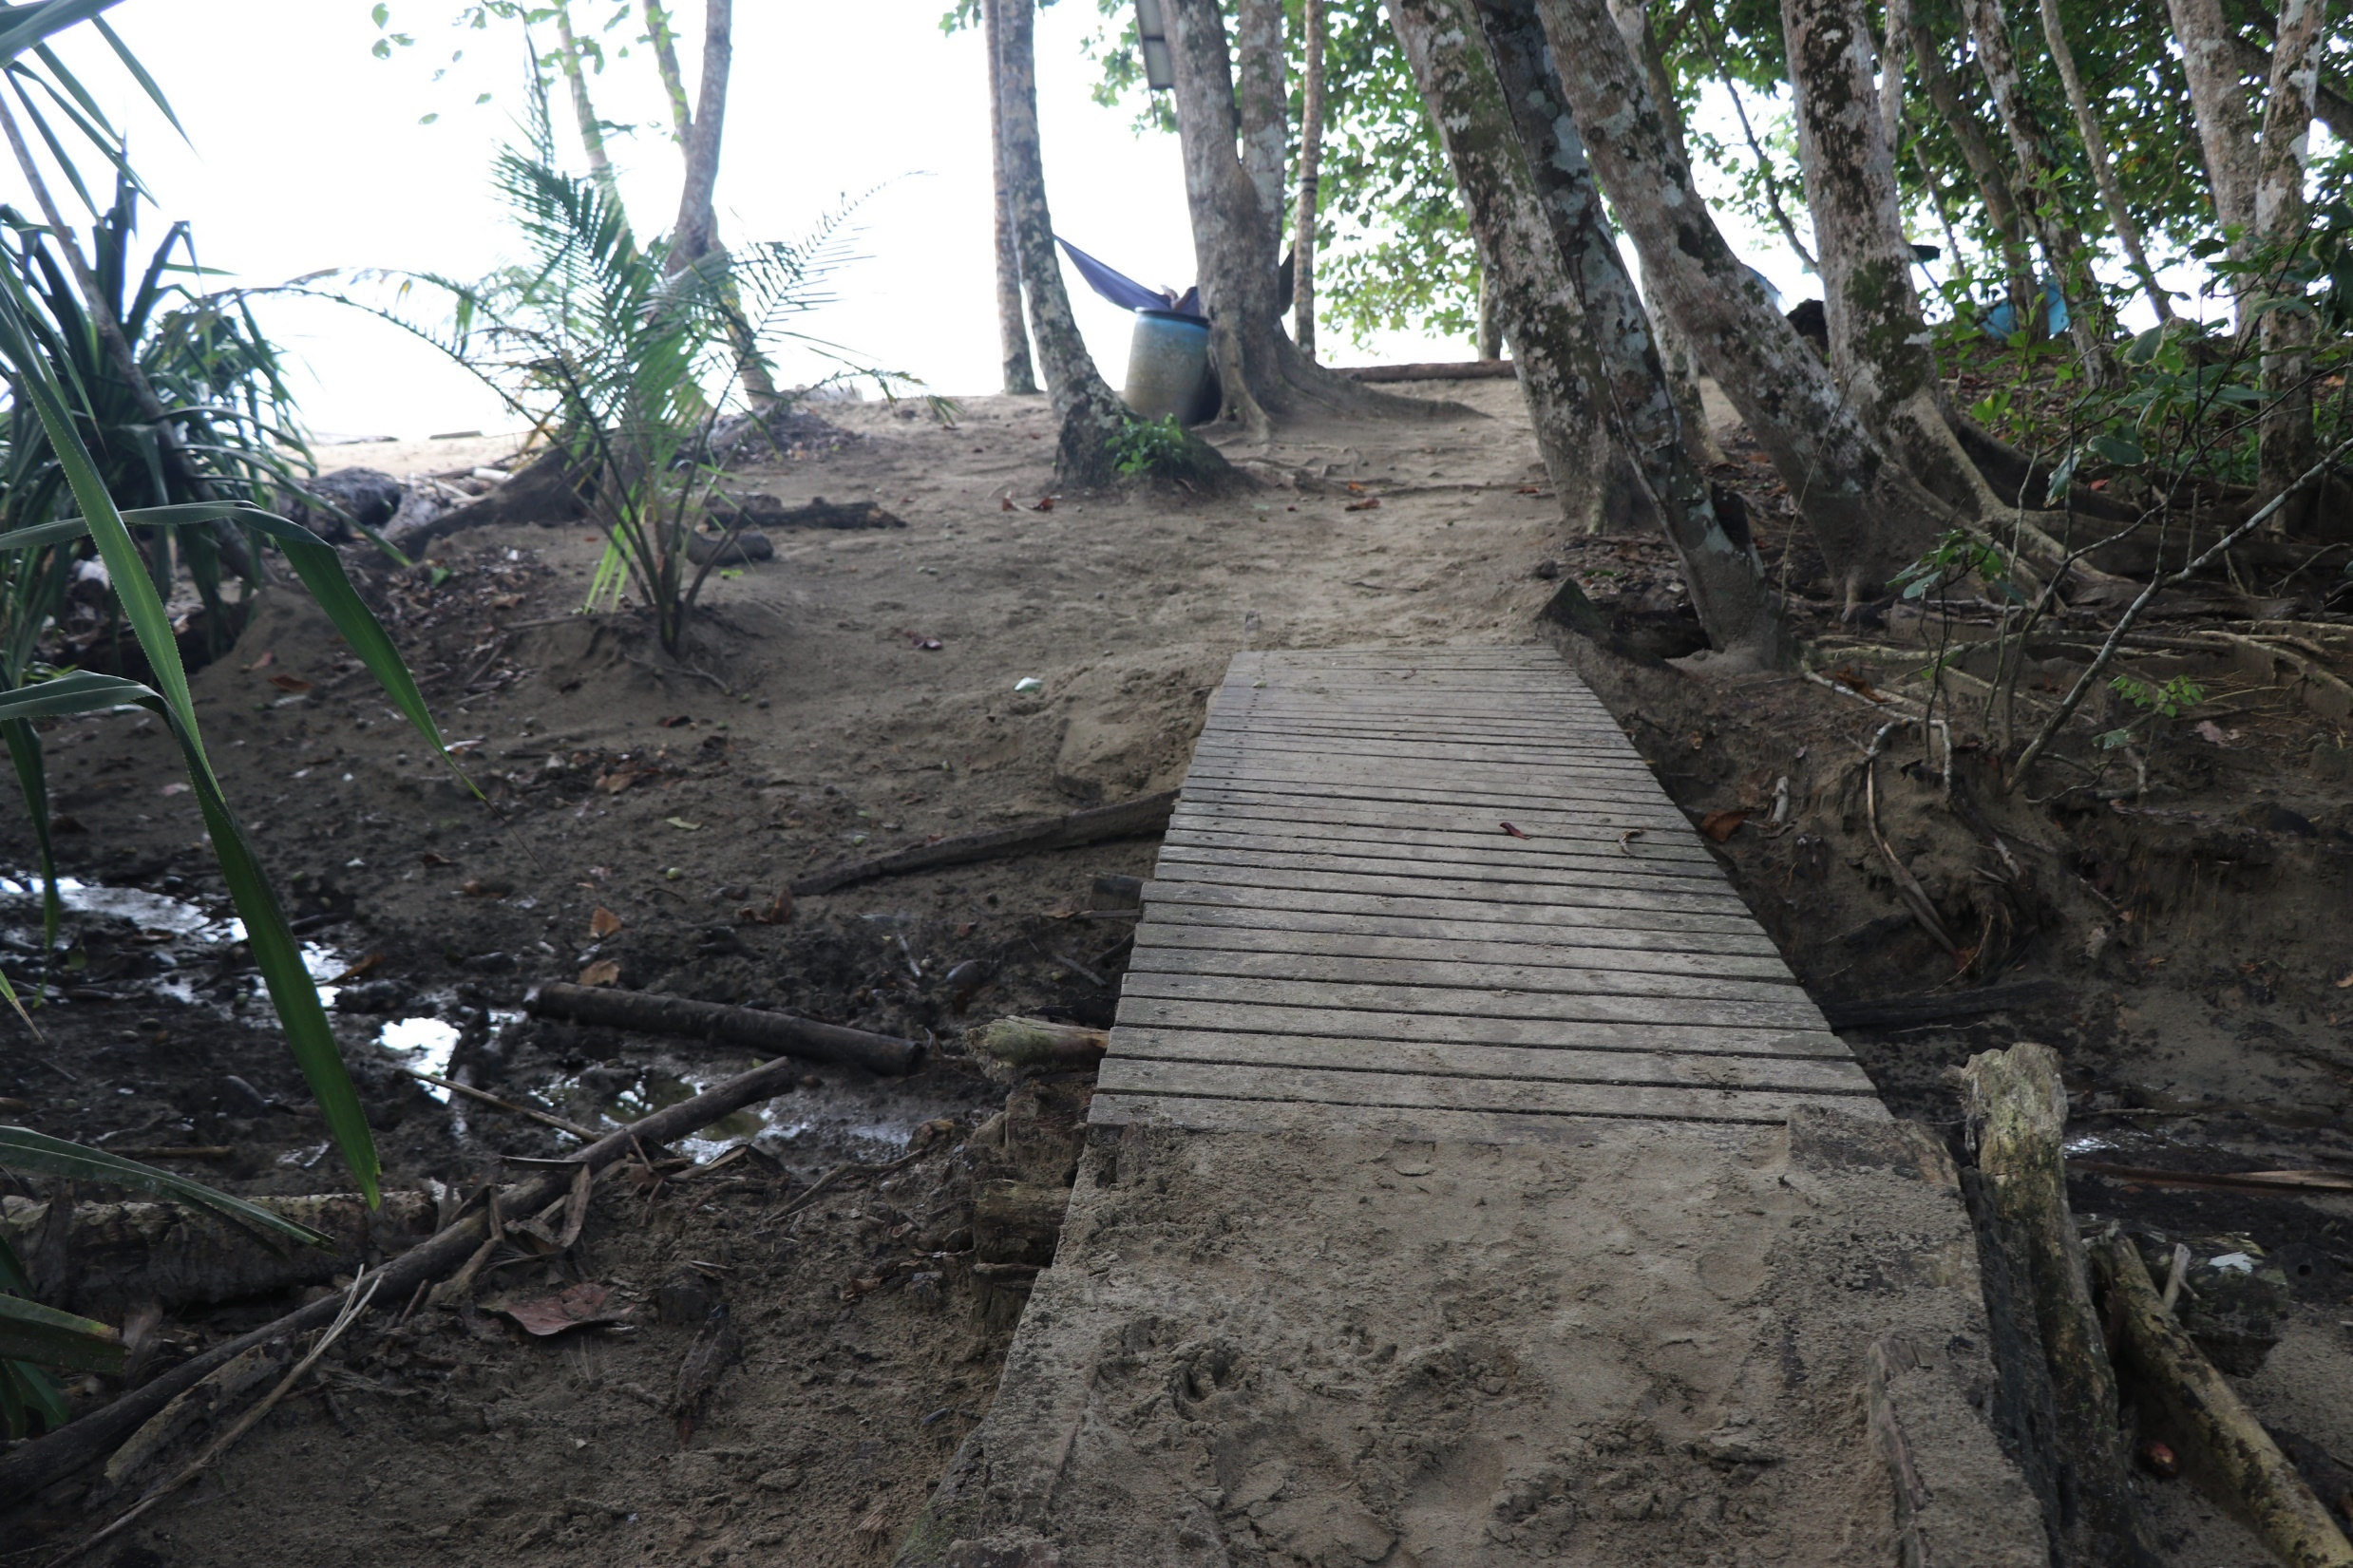
If you walk the foot path to the beach you will reach a little foot bridge right before you reach the beach.

Slide 46
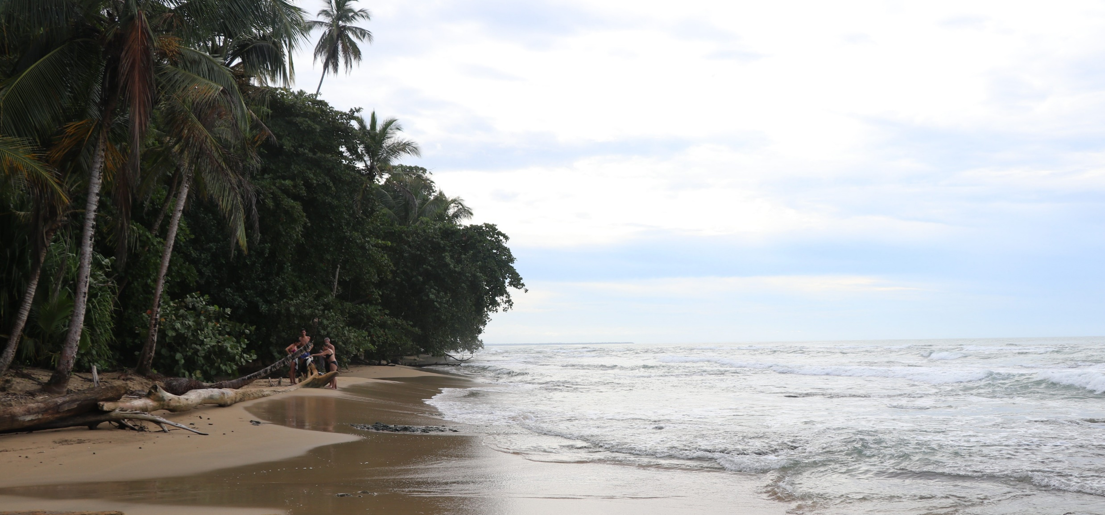
Looking North on the beach.

Slide 47
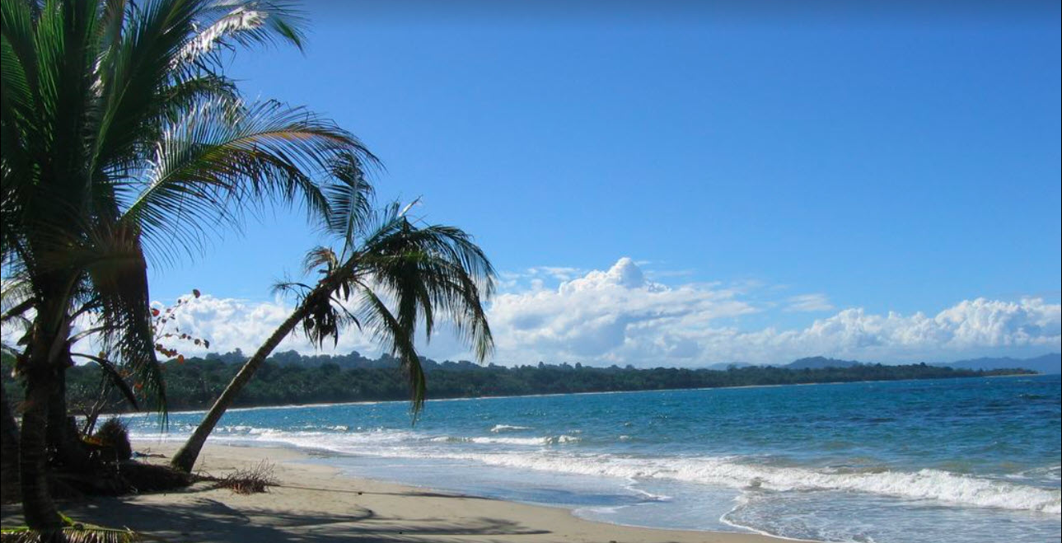
Beach on a sunny day.

Slide 48
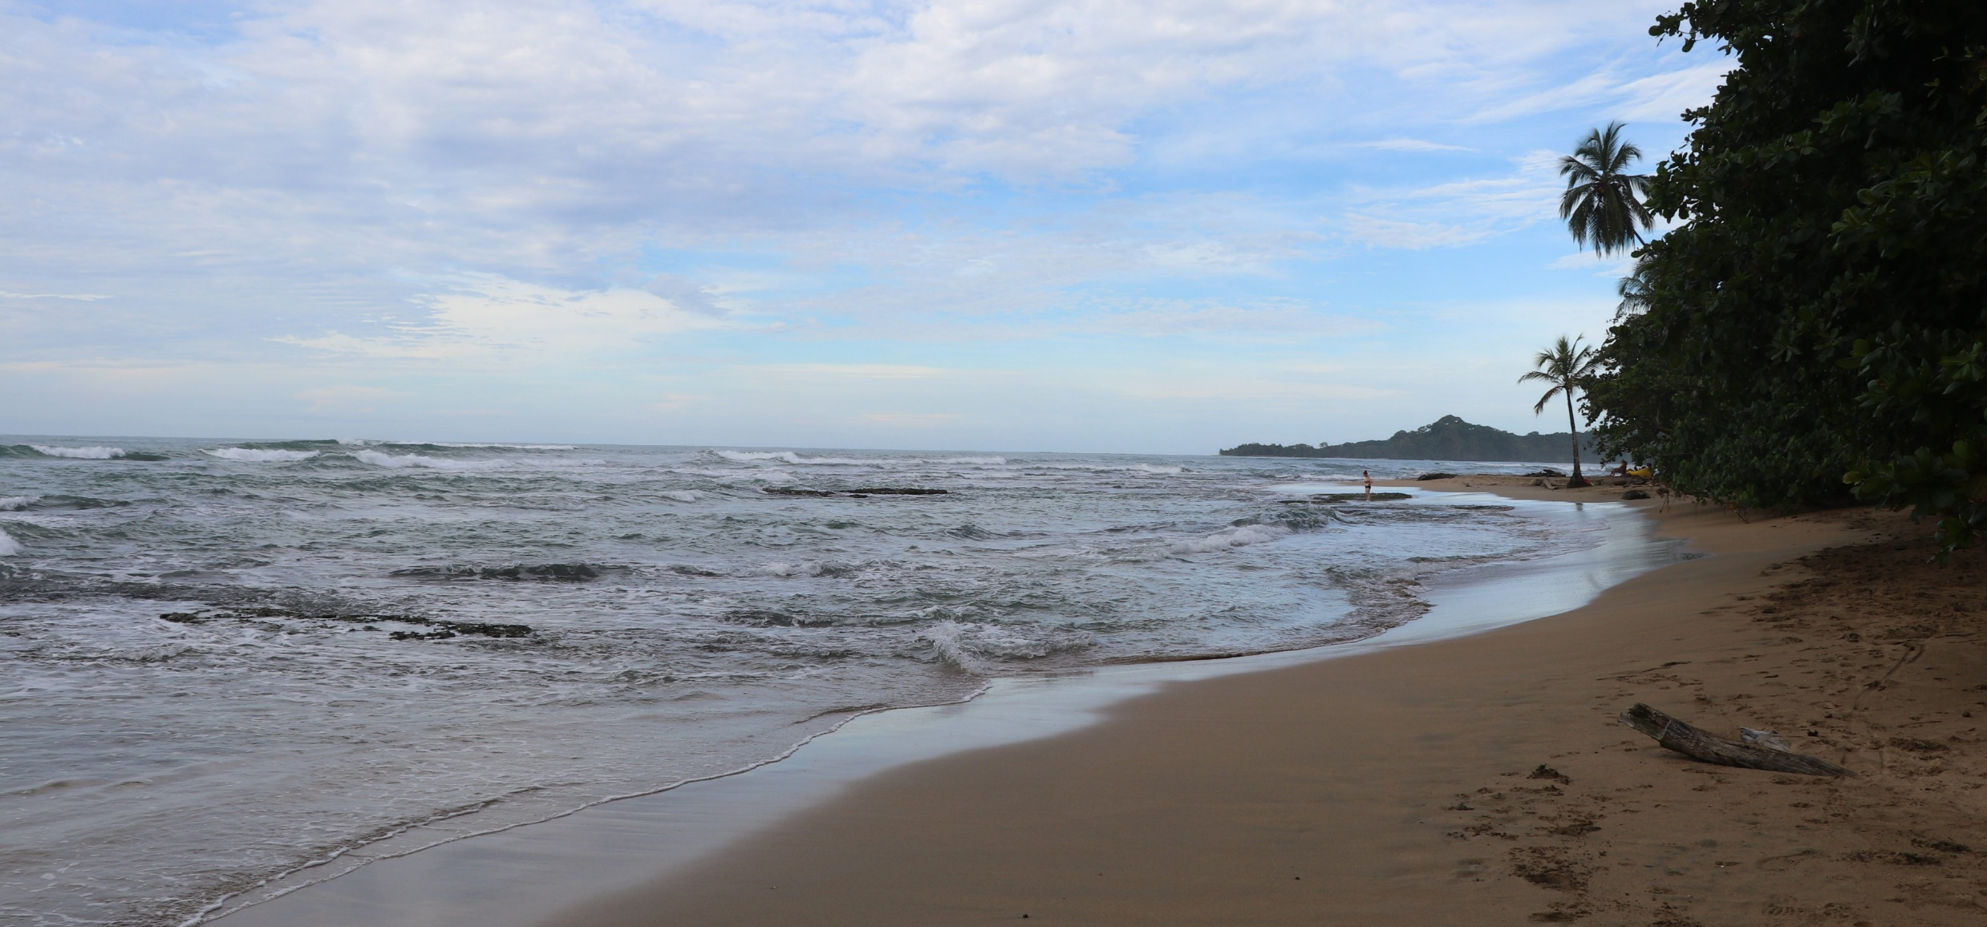
Looking South on the beach.

Slide 49
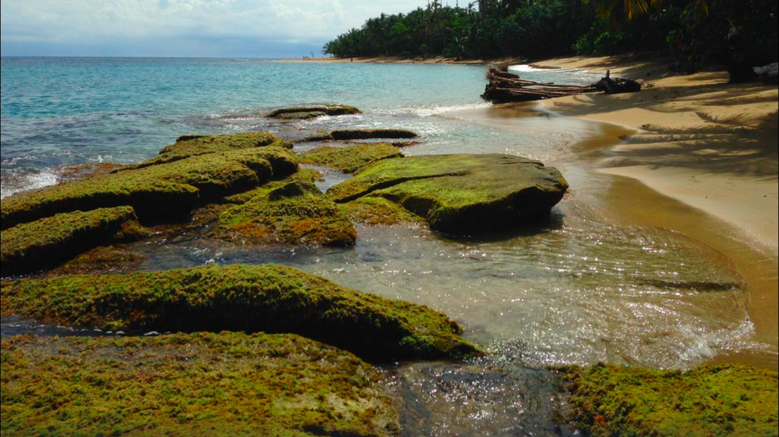

Slide 50
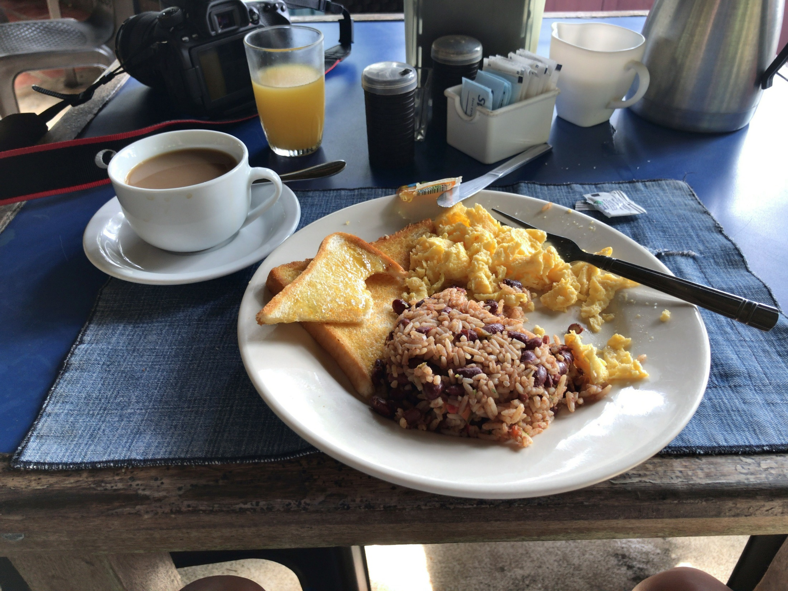
Typical breakfast in Costa Rica.

Slide 51
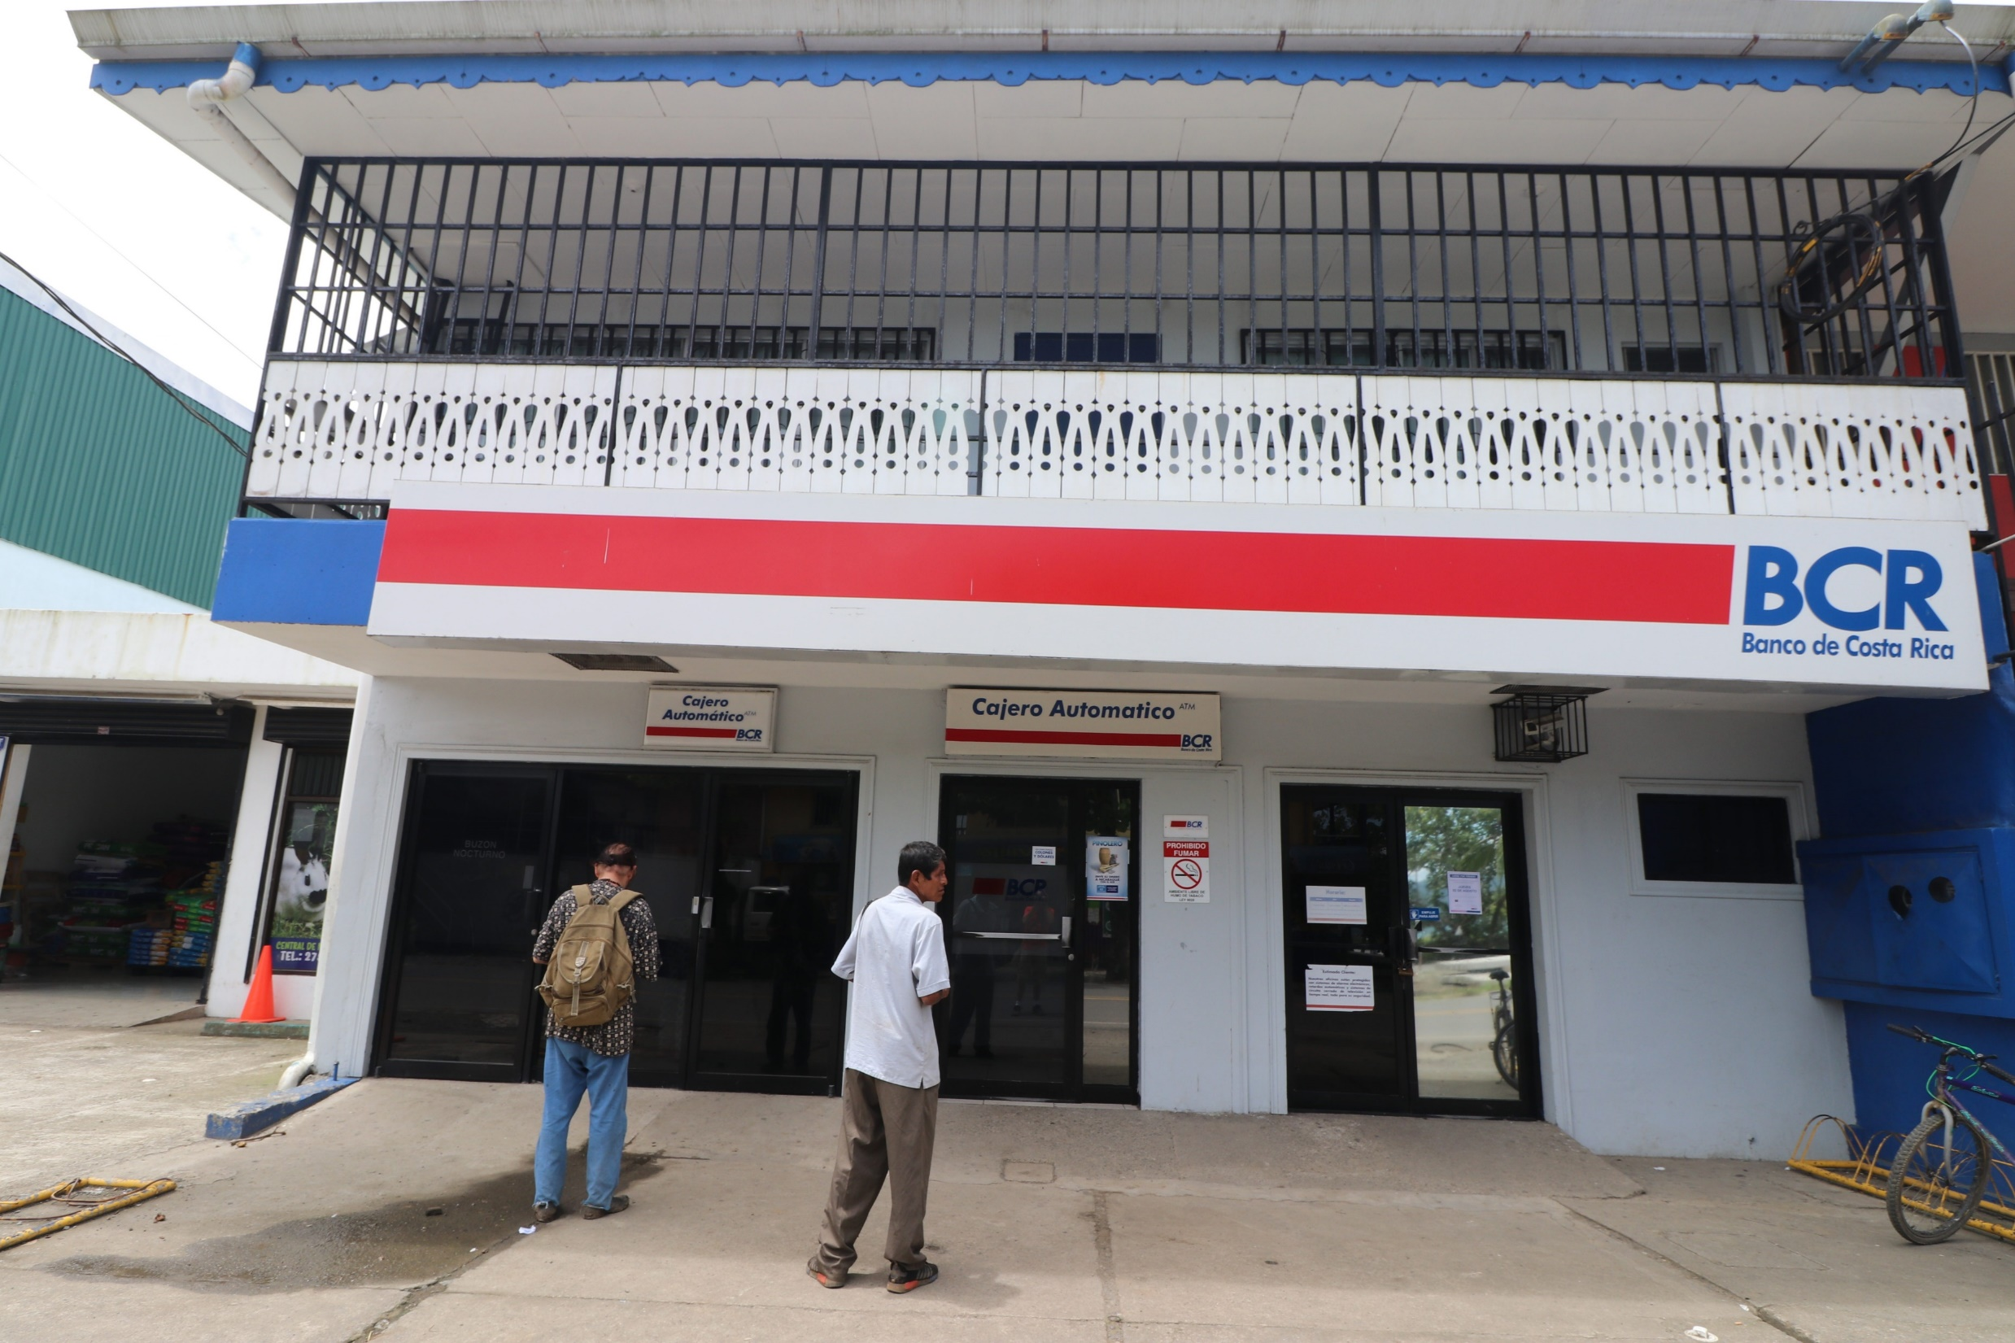
Waiting for the ATM at the local bank.

